Slide 1
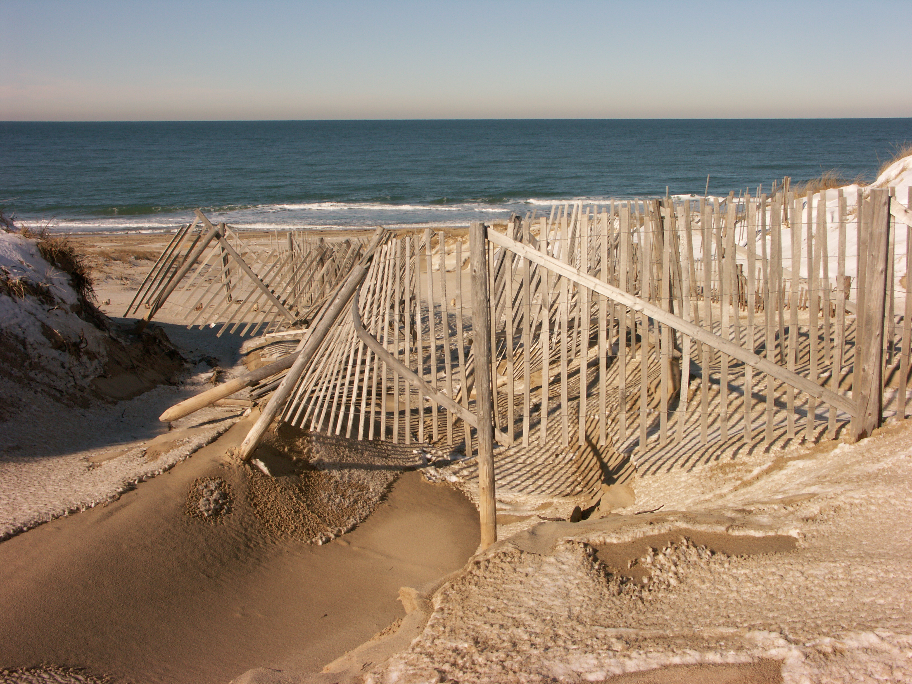

Welcome to Woods Hole
A brief history of exploration, discovery and other random ramblings about Cape Cod…
…and also a repository report for the USGS Woods Hole Coastal and Marine Science Center
Brian Buczkowski
2013 Curators of Marine and Lacustrine
Geological Samples Meeting
Woods Hole, MA
June 11th – 13th, 2013

Slide 2
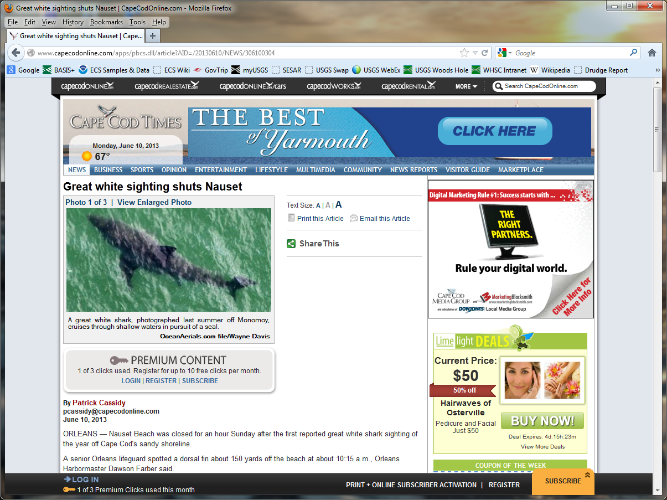
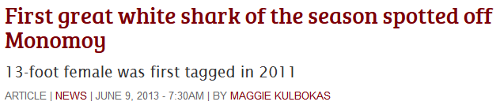
Don’t go in the water…
Cape Cod
Shark Tours
Lawyers swim for free!!!

Slide 3
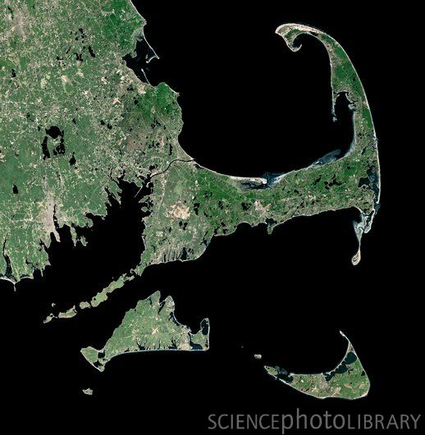
Good ol’ Cape Cod
you are here

Slide 4
“The fortunes of Cape Cod have always been linked to the sea…
…For centuries fishermen in search of a livelihood, explorers in search of new worlds, and pilgrims of one sort or another in search of a new life - down to the beach-bound tourists of today - all have turned to the waters around this narrow peninsula arcing into the Atlantic to fulfill their needs and ambitions.”
“ Cape Cod History” from Fodors.com
http://www.nytimes.com/fodors/fdrs_feat_44_2.html

Slide 5
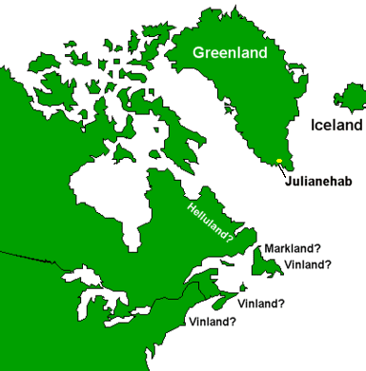
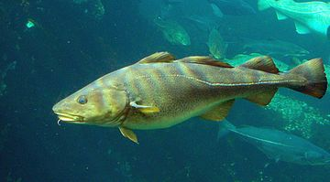
Voyages of Discovery
Vikings??? (late 10th century)
  Possible site of Leif Ericson’s Vinland??
Bartholomew Gosnold (1602)
  Gave Cape Cod its name
“Much fatter and in better
health than when we went
out of England”

Slide 6
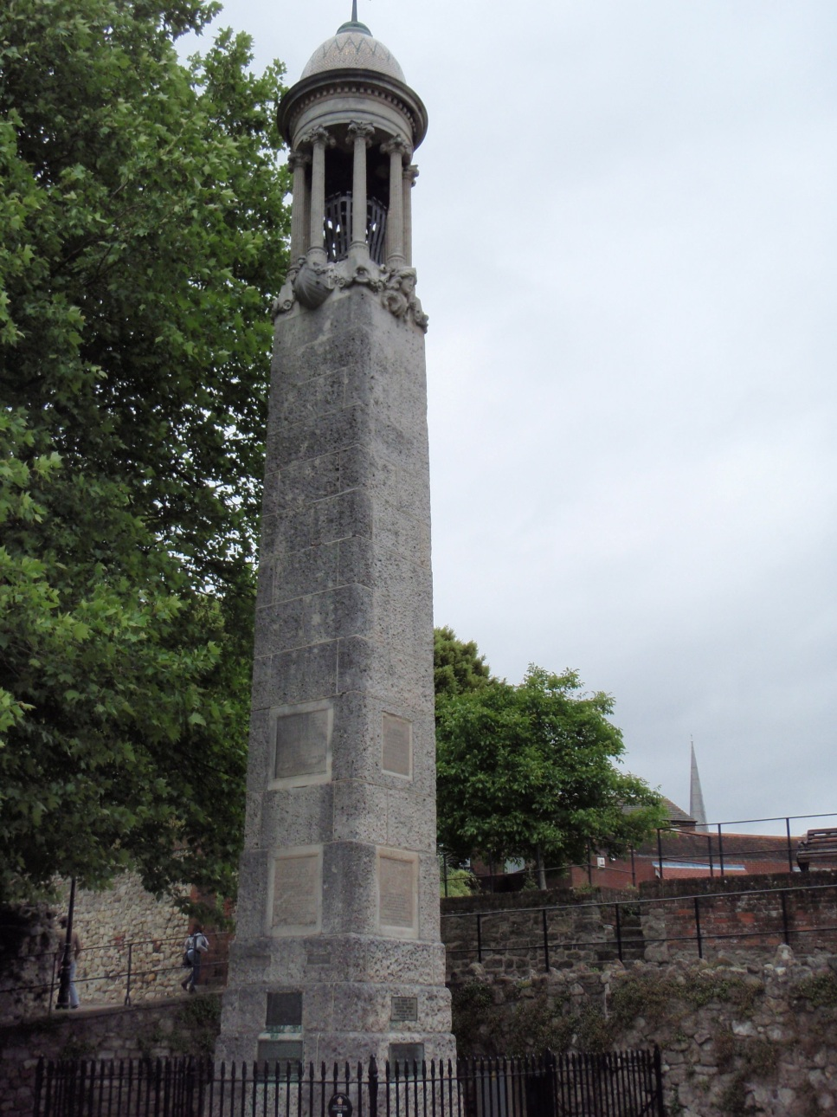
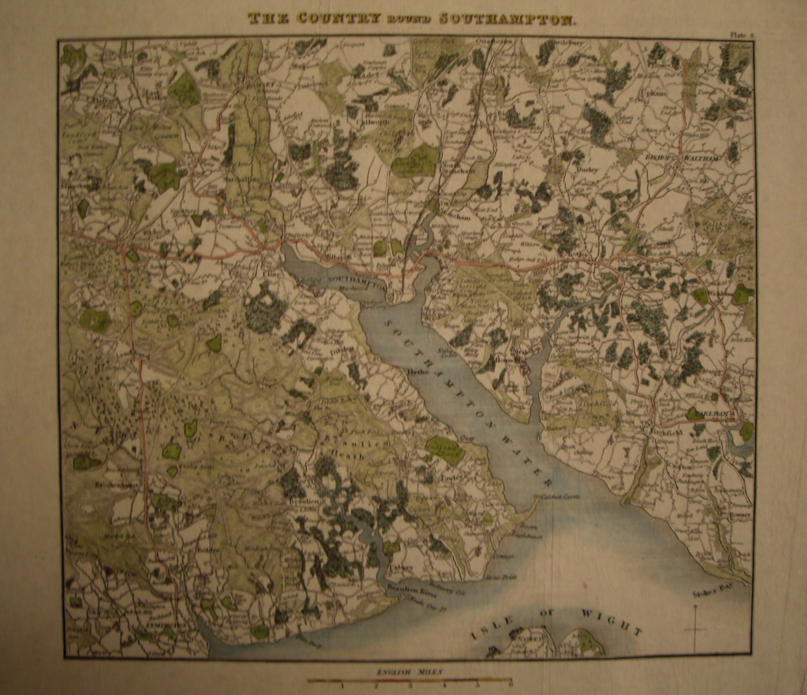
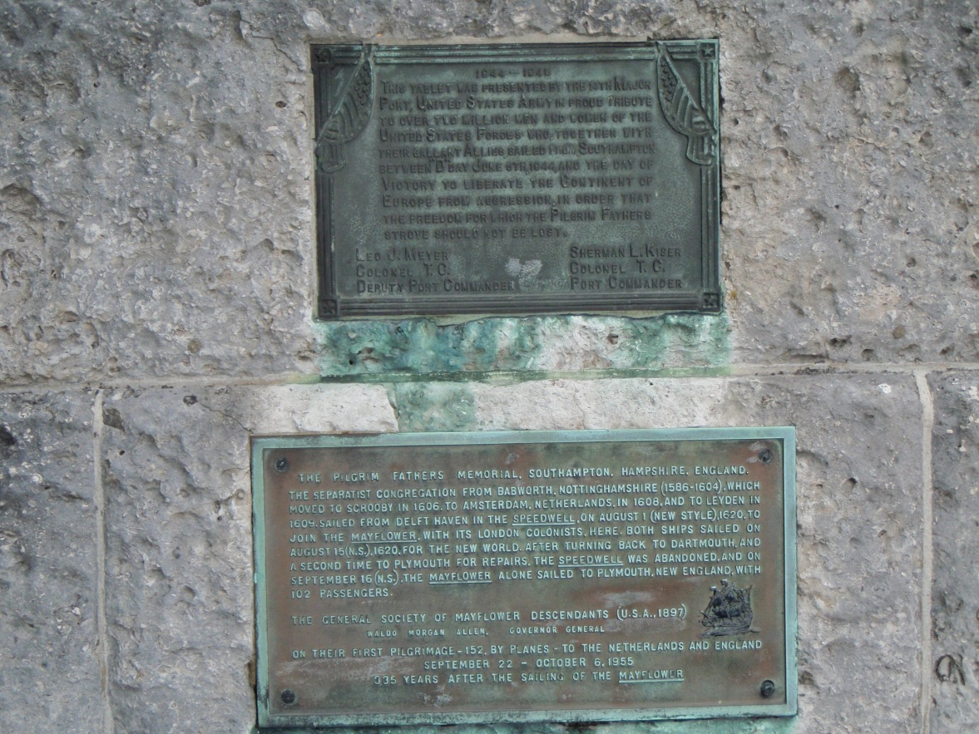
European Settlement
1620

Slide 7
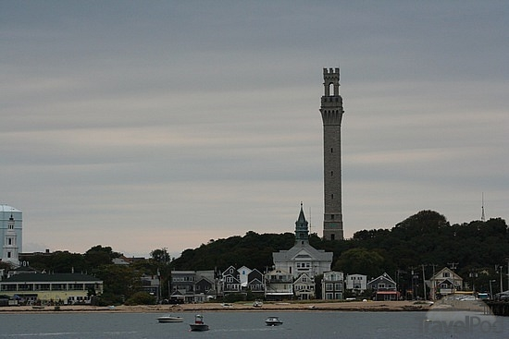
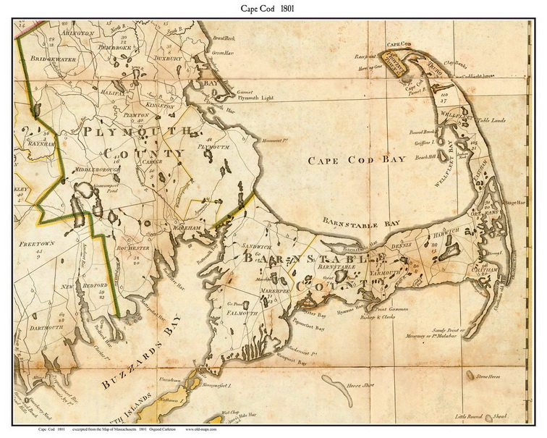
European Settlement
1620

Slide 8
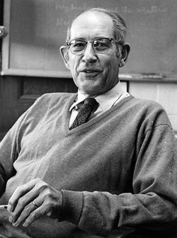
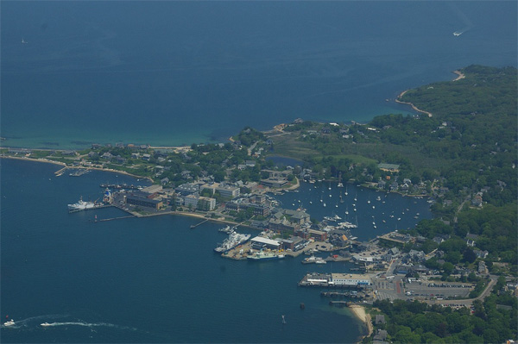
Woods Hole, Massachusetts
Image courtesy WHOI
Image courtesy Marine Biological Laboratory
  Six Scientific Institutions
    MBL
    WHOI
    USGS
    WHRC
    SEA
    NOAA
Notes:
8

Slide 9
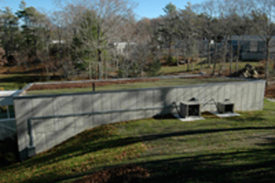
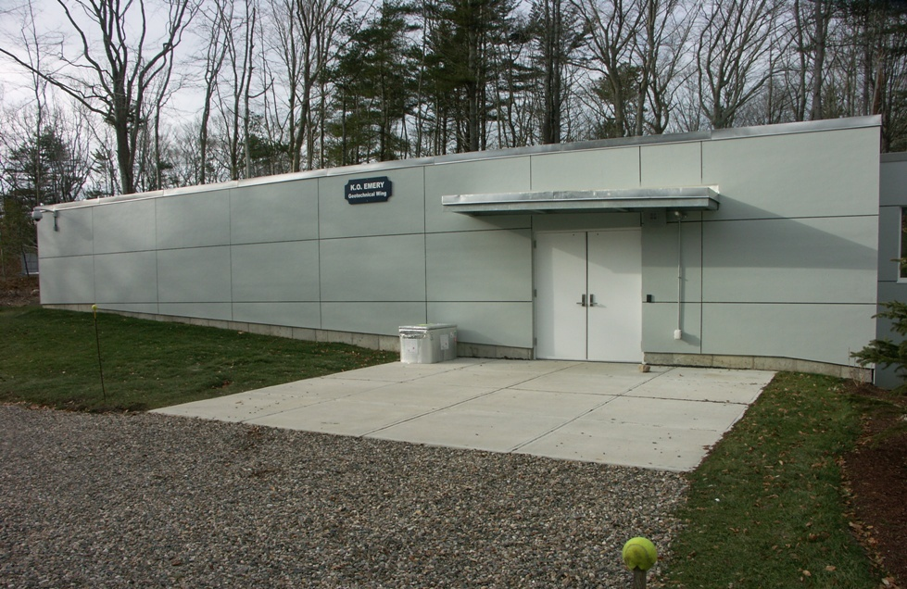
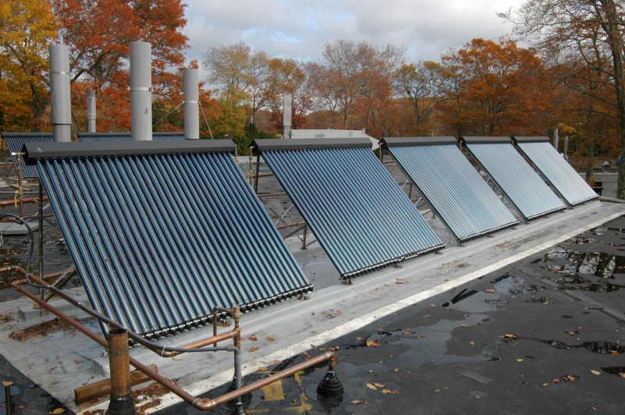
Facilities
Images courtesy Dann Blackwood, USGS
  K.O. Emery Geotechnical Wing
    777.5 ft² Refrigerated space (+4ºC)
    420 ft² Frozen space (-20ºC)
    Core lab & Prep area
Notes:
9

Slide 10
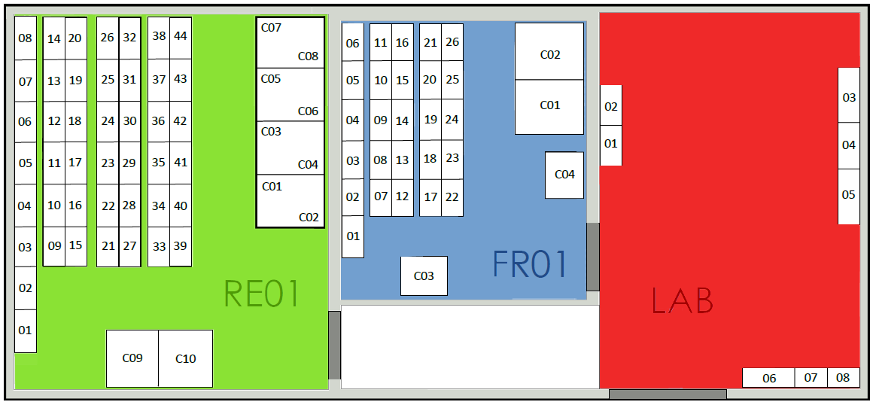
Facilities

Slide 11
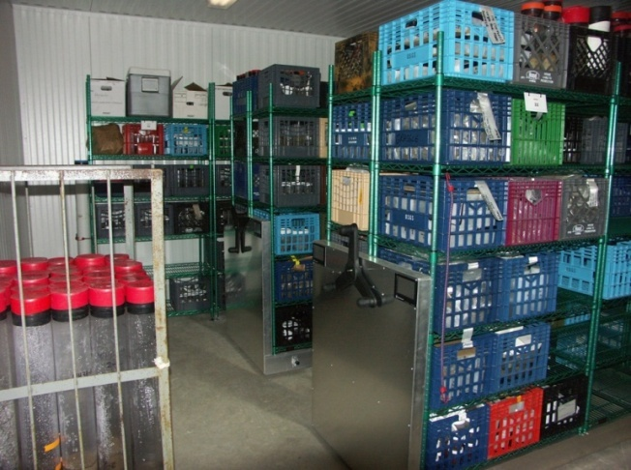
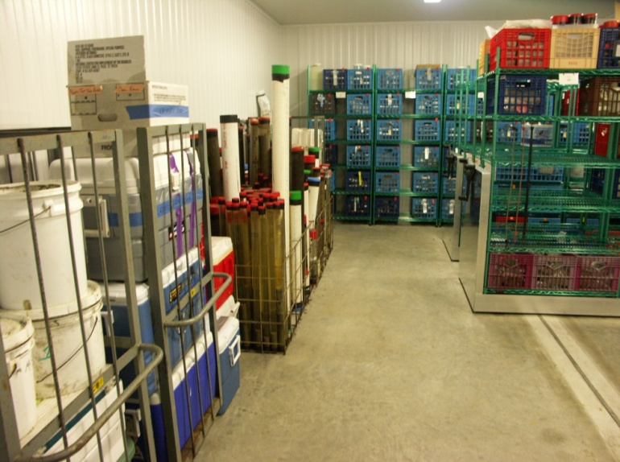
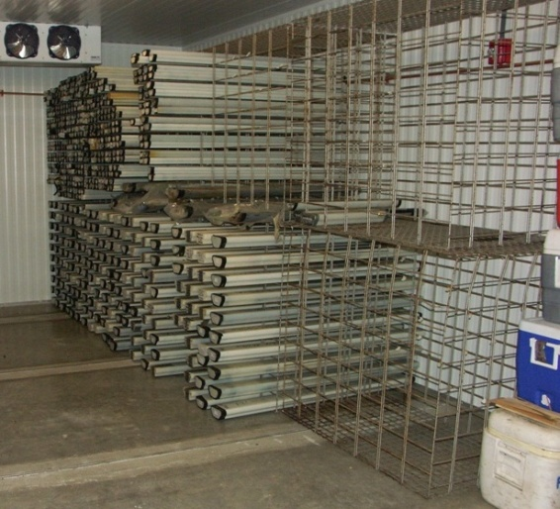
Facilities
Walk-in Refrigerator and Freezer
  High-density rolling storage
    Designed by SpaceSaver
    Stainless steel
    Cold and humidity-tolerant
  Racks for D tubes and
  whole cores

Slide 12
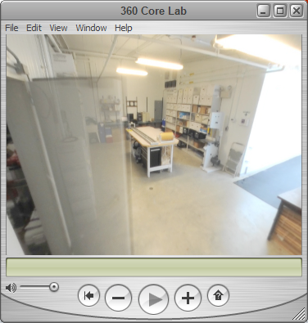
Facilities
Core Lab/ Dry Storage (K.O. Wing)
  Dried samples stored in white archival boxes
  Computer station for temperature and facility monitoring
Image courtesy Dann Blackwood, USGS

Slide 13
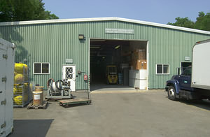
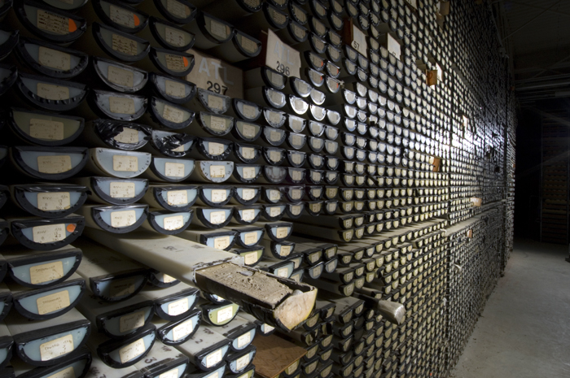
Facilities
Dry Storage (MOF warehouse & WHOI)
  Long-term storage at our warehouse
  and in the WHOI core storage facility
Image courtesy Dann Blackwood, USGS
Image courtesy Woods Hole Oceanographic Institution

Slide 14
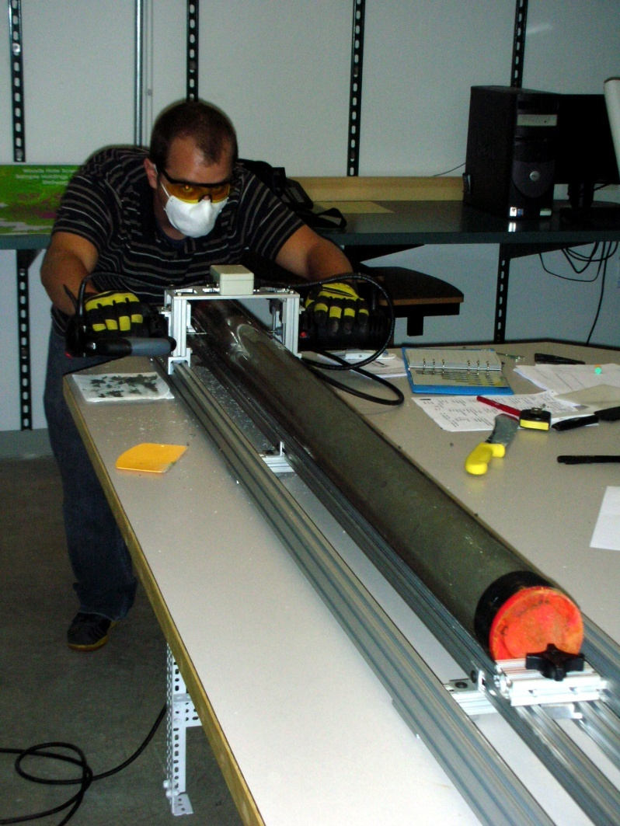
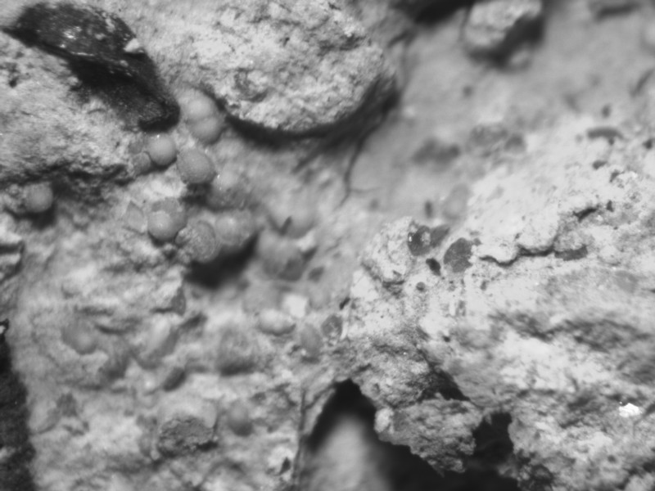
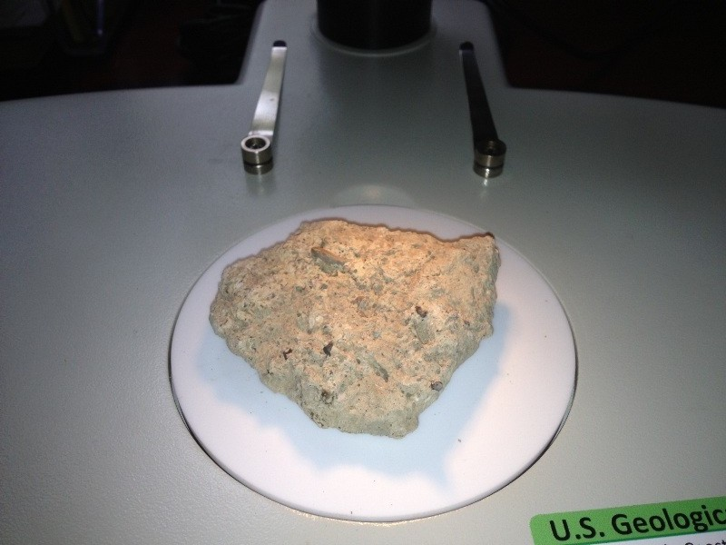
Facilities
Laboratory Capabilities
  Core splitter
  Digital binocular microscopy
  Grain size analysis lab
  Gas hydrates (GHASTLI) lab
  Layout area
At WHOI
  XRF, MSCL
  NOSAMS lab
  Rock lab

Slide 15
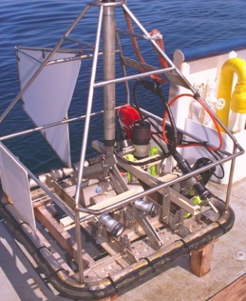
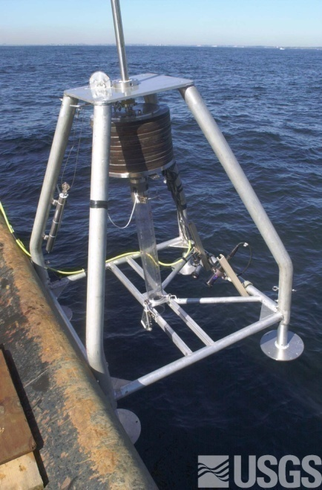
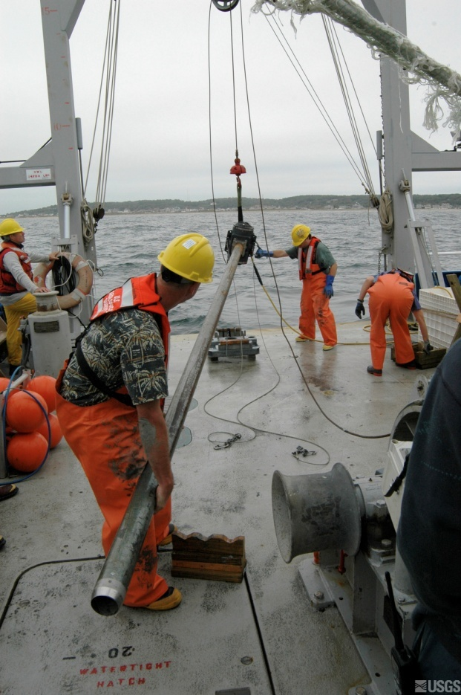
WHSC Collections
~1100 core sections in D-tubes
~300 unsplit (to be cut/piston extruded)
  Mass Bay, Mid-Atlantic Bight, Gulf of
  Maine, Gulf of Mexico, Chesapeake Bay,
  AMCOR
>9000 grabs
  Mass Bay, Great Lakes, Stellwagen Bank
3030 slides
  Foram collections from Atlantic coast
Gas hydrate samples
  Gulf of Mexico, North Slope of Alaska
Images courtesy Dann Blackwood, USGS

Slide 16


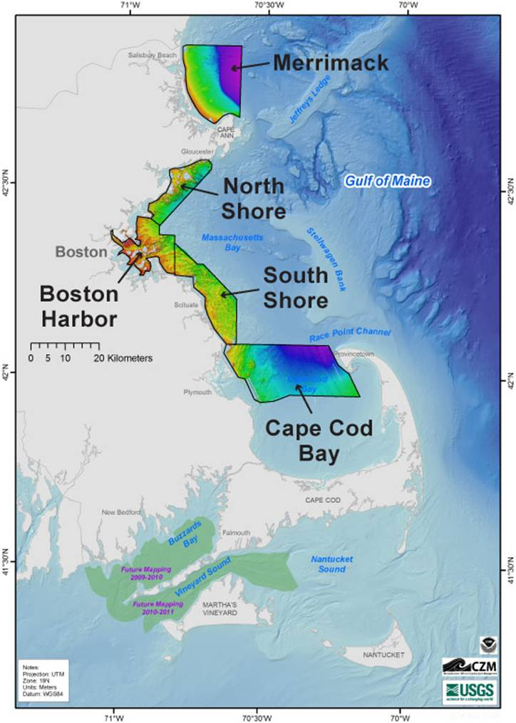
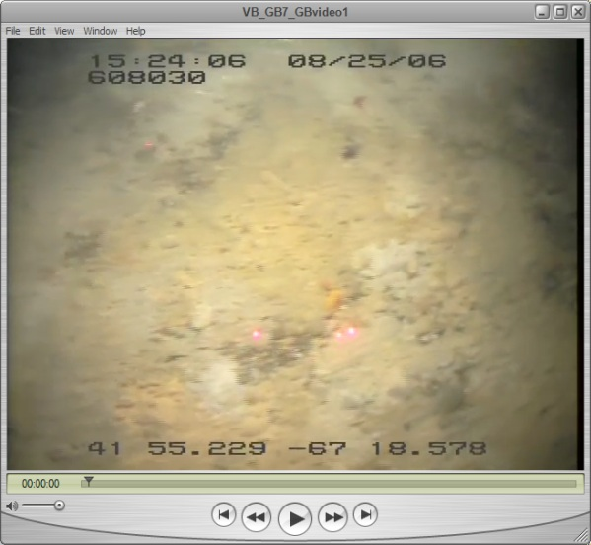
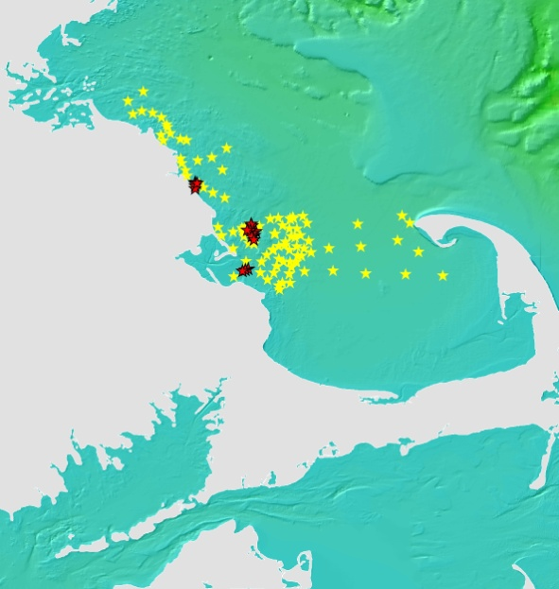
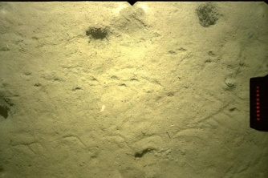
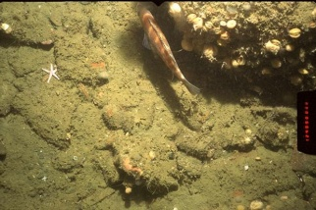
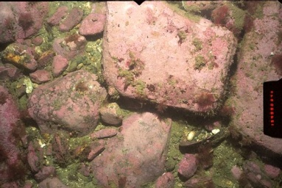
Projects
Massachusetts Coastal Zone Management
Seafloor Mapping Cooperative
  Provide geologic information for
  ocean-resource management
  Grab samples and vibracores in
  in conjunction with geophysics,
  video transects and photographs

Slide 17

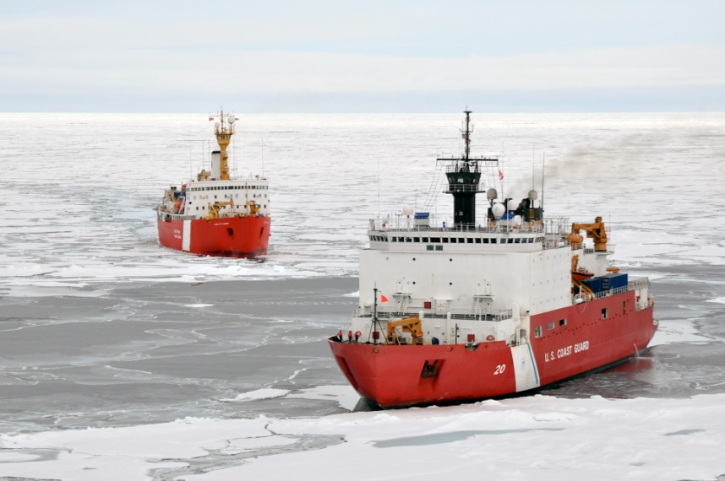



Projects
U.S. Extended Continental Shelf project
    U.N. Convention on the Law of the Sea
Interagency organization
  USGS as sample repository
  NGDC as data repository
Sample Collections
  2008 - HLY0805 7 Dredges
  2009 - HLY0905 5 Dredges
  2010 - HLY1002 11 Cores from 6 sites
  2012 - HLY1202 5 Dredges
Image courtesy U.S. Coast Guard
http://continentalshelf.gov/

Slide 18
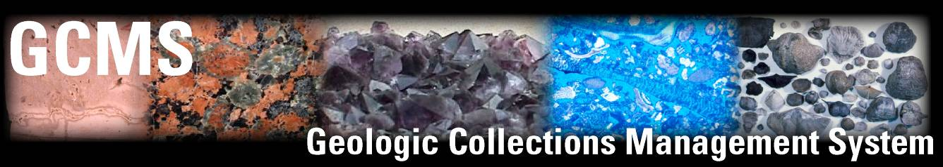

The USGS Geologic Collections
Management System
Collections Management system for USGS geologic collections
  Developed by the USGS National Geologic and Geophysical Data Preservation Program (NGGDPP)
  Elements
    Standardized forms for accession and evaluation
    Framework for addition of USGS data and metadata into ScienceBase
    Proposal to implement IGSNs as standard UUID for all geological collections materials

Slide 19


Data Management
Foghorn
“Don’t, I say don’t bother me dog.
Can’t you see I’m thinkin’?”

Slide 20
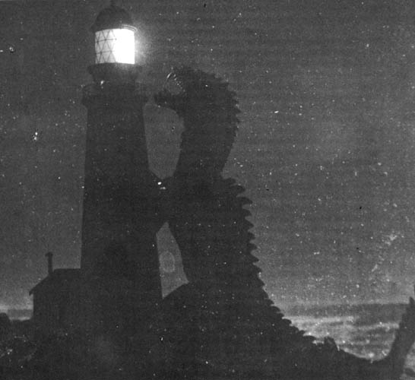
Data Management
Pre-Cruise Report
Post-Cruise Report
Project Planning
Data Collection and Processing
Expected Products and Publications

Slide 21
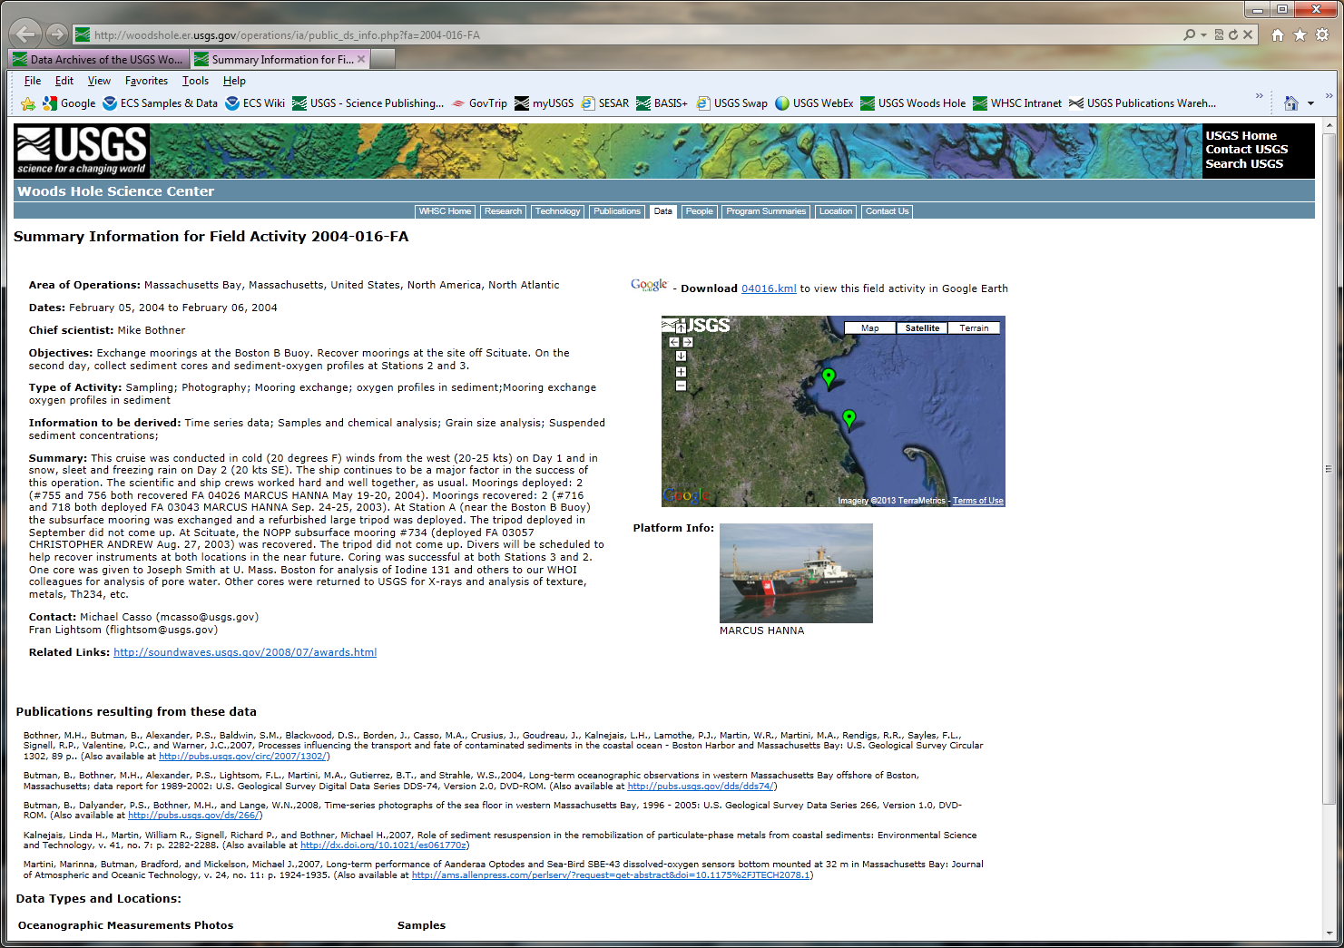

Slide 22
Accessing the Collections
Ocean Floor Samples Portal
  http://woodshole.er.usgs.gov/operations/ia/samples.html
  Allows internal and external users to access the database
    Text-based searches
    Google Earth KML file
    IMS Portal
  Links to archive manual and other resources
  (link to NGDC Index)
  Excel template available for download

Slide 23
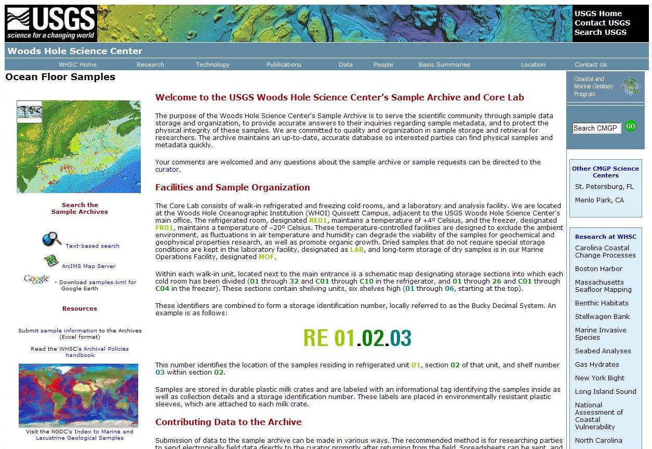
Accessing the Collections

Slide 24
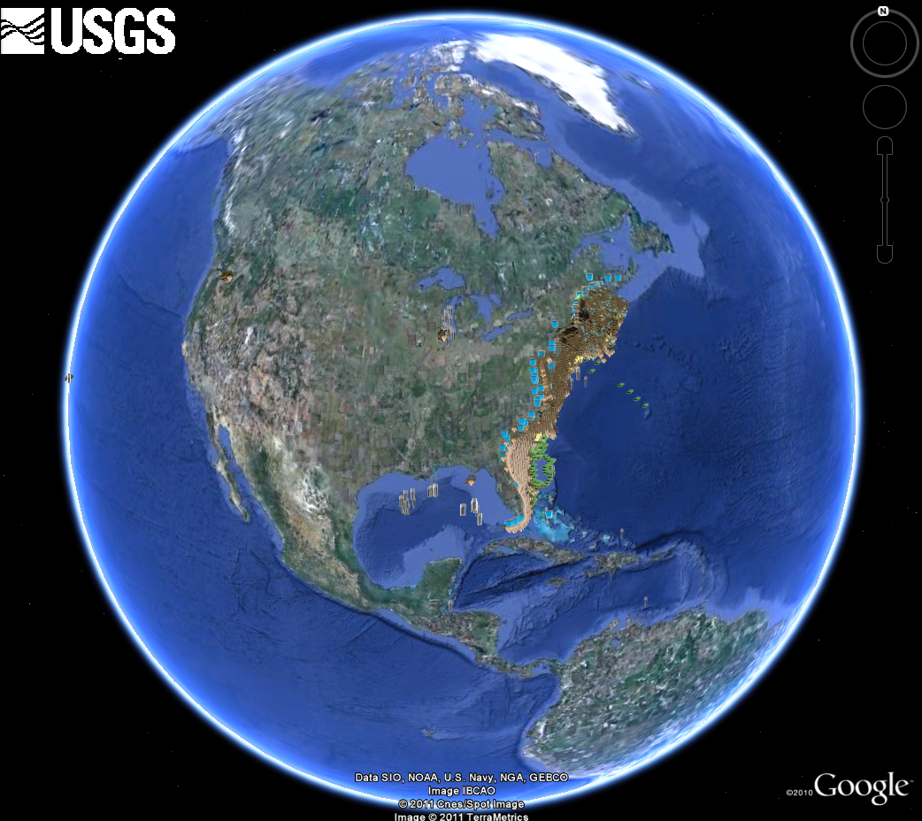
Sample Distribution

