Slide 1
Getting to Know You
Solar & Terrestrial Physics Division
aka Space Weather
Bill Denig, Chief
NOAA/NESDIS/NGDC/STP
303 497-6323
William.Denig@noaa.gov
Click Here

Slide 2
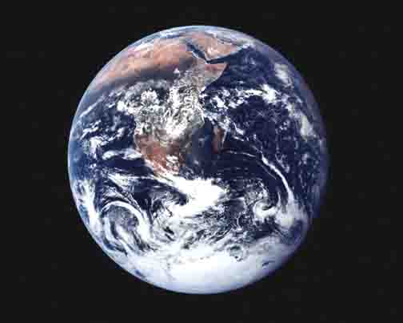
Solar-Terrestrial Physics
Its All a Matter of Perspective
When you look at earth from space . . .
. . what do you see?

Slide 3
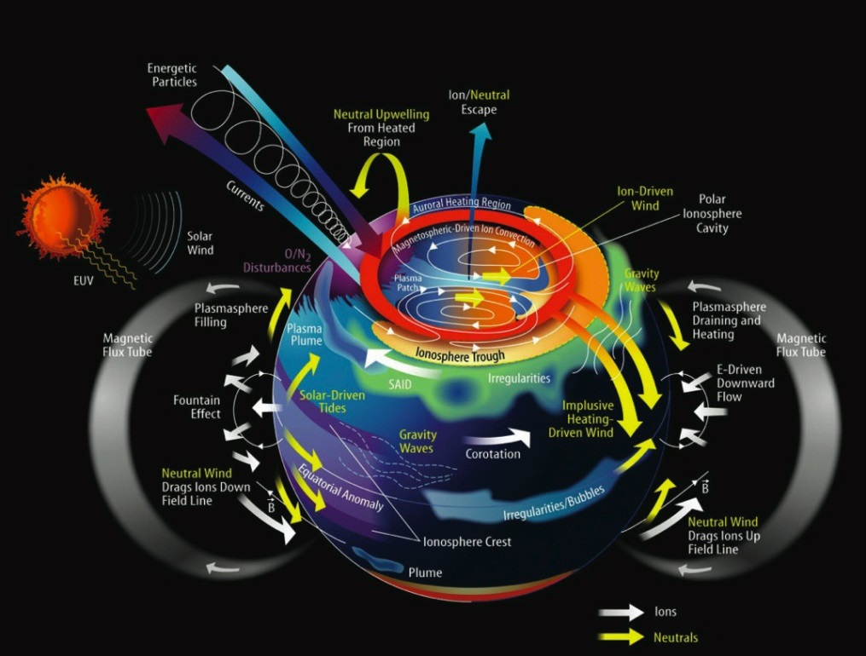
Solar-Terrestrial Physics
Its All a Matter of Perspective
When you look at earth from space . . .
. . what do you see?
. . what do I see?

Slide 4
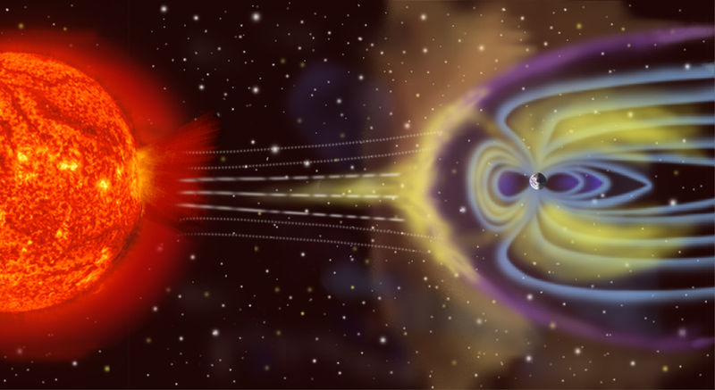
Solar-Terrestrial Physics
Illustration – “Image Not To Scale”
Credit – K. Endo (NGDC)
Notes:
Points to make:
The earth is constantly bombarded by charged particles flowing outward from the sun (solar wind).
The pressure of the solar wind compresses the earth magnetic fields on the dayside and stretches them out on the nightside creating the magnetosphere.
The solar wind varies greatly in dynamic pressure (density & speed) – solar, coronal mass ejections release enormous amounts of high energy particles at high speeds which can greatly affect “space weather” at the earth.
The accompanying movie provides a more accurate depiction of the relative scale sizes for the sun and earth.
The earth is constantly bombarded by the streaming charged particles of the solar wind. The earth’s magnetic field effectively blocks these particles and causes them to deflect, for the most part, around the earth. The pressure of the solar wind on the sunward side of the earth compresses the dayside magnetic field and elongates the field on the nightside. Embedded within the high-beta plasma of the solar wind is the highly dynamic interplanetary magnetic field (IMF). Depending on the orientation of the IMF with respect to the earth’s geomagnetic field there can be either strong coupling between the IMF and the terrestrial field or weaker coupling.
This cartoon illustrates the configuration of the earth’s outer magnetic field under the influence of the solar wind. Prior to the mid 1960’s there was vigorous debate concerning whether the earth’s magnetic topology was open or closed; that is, if the geomagnetic field did or did not, respectively, merge with the IMF. The currently accepted notion is that the earth’s magnetic topology is open and that the IMF and geomagnetic fields merge on the dayside and reconnect within the tail region. The physics which govern these processes are complex and modeling their interaction is only possible using non-linear plasma theory. On the dayside there is anecdotal evidence for magnetic field merging from satellites near the space-earth interface typically referred to as the magnetopause. The evidence for magnetic merging within the lower atmosphere can be seen in the motion of discrete auroral structures that form within the auroral zone near noon and then move poleward. Similarly on the nightside the stretched magnetic field lines reconnect and tend to snap back to a more dipolar configuration which causes transient currents to flow within the auroral zones resulting in ground-based magnetic perturbations.

Slide 5
Solar-Terrestrial Physics
So What is the Correct Scale?
University of Michigan (Aaron Ridley)
Notes:
A CME emits ~1 billion tons of gas = 10**16 g
The mass of the earth is ~6x10**27 g

Slide 6
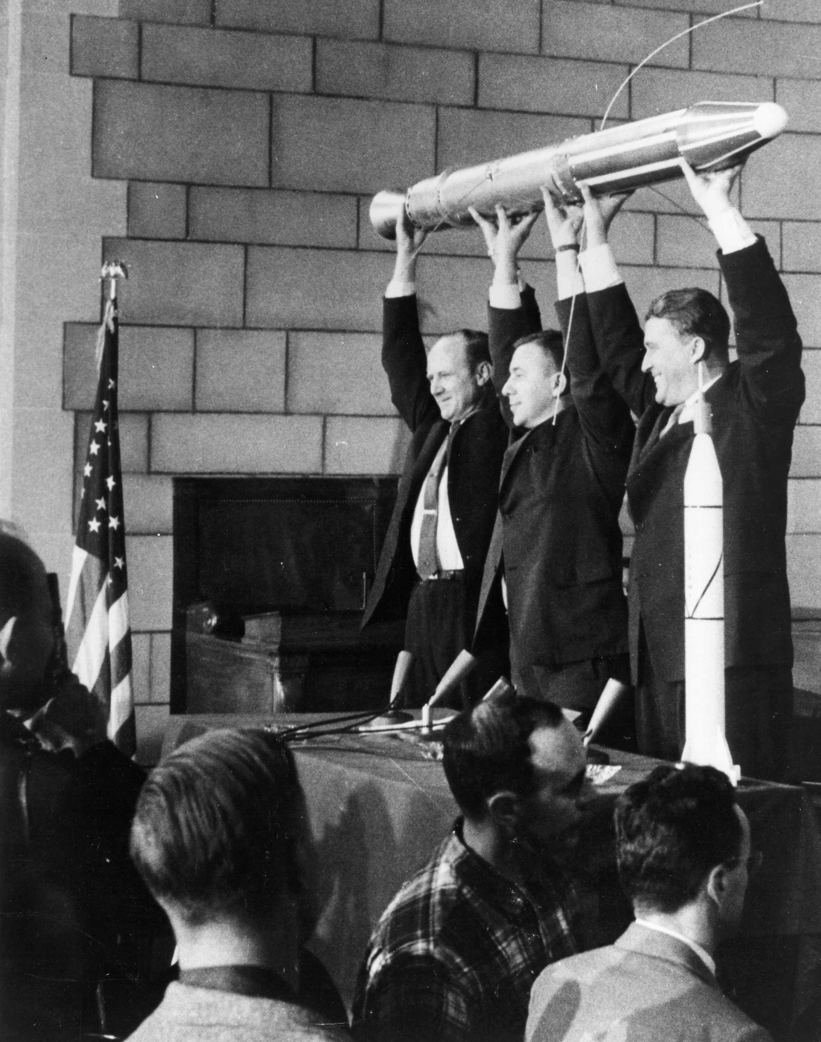
Solar-Terrestrial Physics
And What is the Big Deal?
My God, space is radioactive
Solar Radiation Storms
Geomagnetic Storms
Radio Blackouts
20 days of the sun

Slide 7
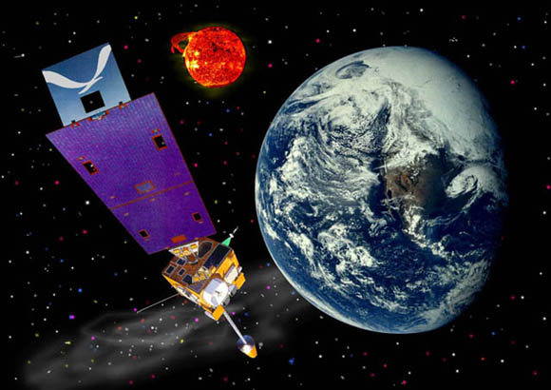
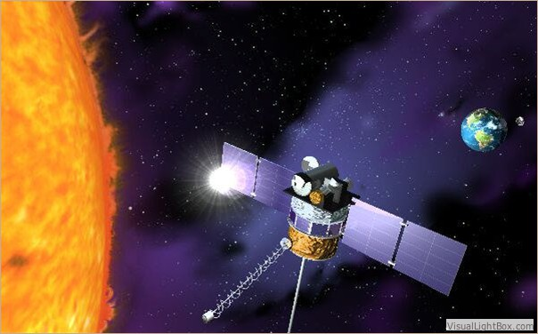
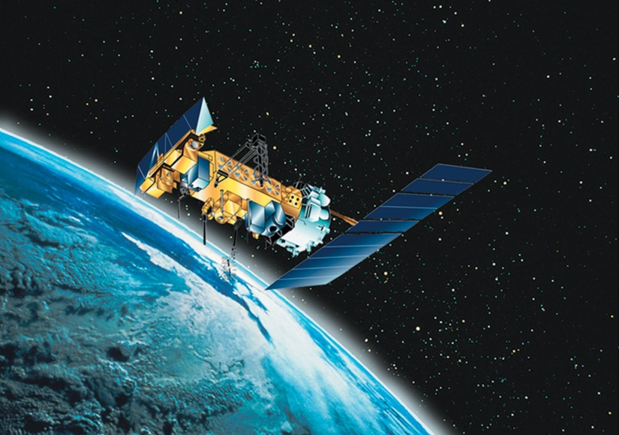
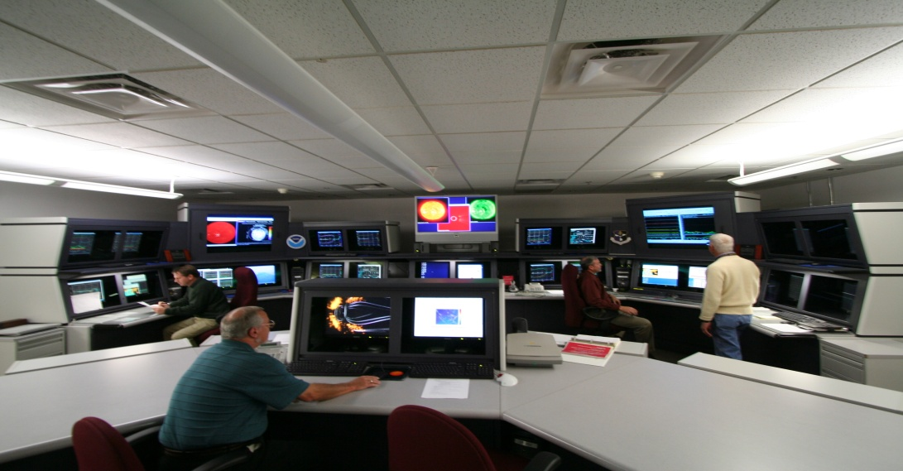
Solar-Terrestrial Physics
What is NOAA Doing About It?
DSCOVR (NESDIS)
Launch Jan 2015
@ L1 (240 Re)
GOES (NESDIS)
POES/MetOp (NESDIS)
Space Weather Prediction
Center (NWS)

Slide 8
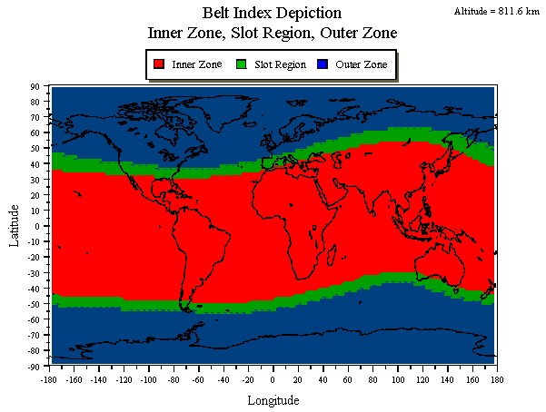
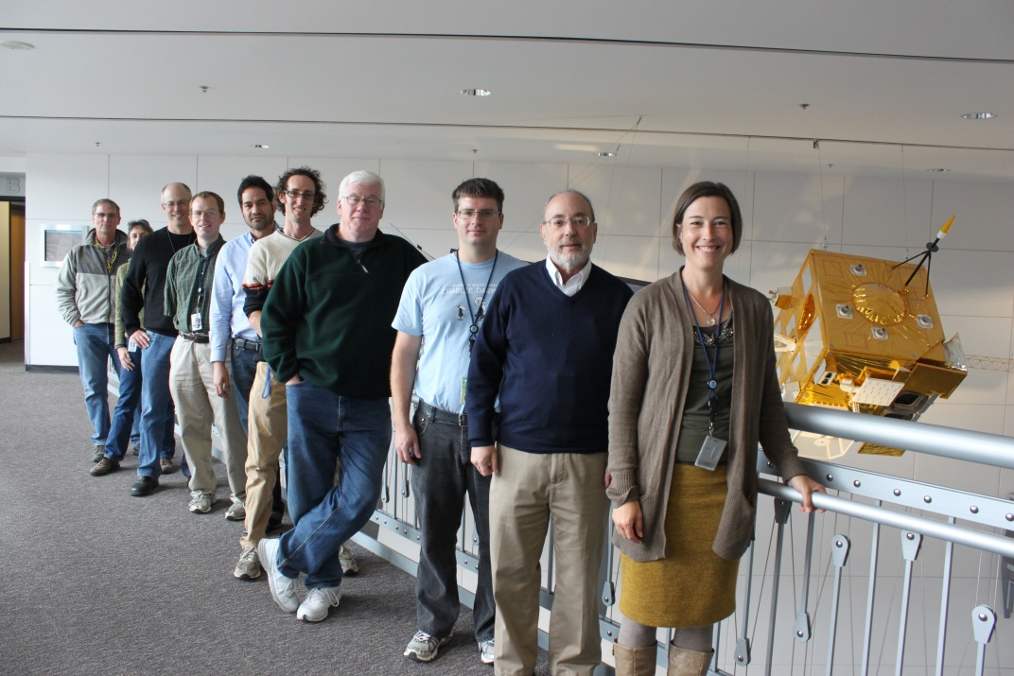
Solar-Terrestrial Physics
What Do You Do?
The Space Weather Team is responsible for:
Archive, Assess and Assessment of NOAA (and USAF) space environmental data
Performing space environmental reports for spacecraft charging anomaly assessments
Supporting the O&M (including calibration) of the GOES and POES space weather sensors
Calibration and Validation (Cal-Val) of GOES-R L1b/L2+ space weather data and products
Development of L2+ science codes and prototype ground processing system for the GOES-R
Supporting the mission planning and future dissemination of DSCOVR interplanetary data
SWT includes advisory team members from the NOAA Space Weather Prediction Center

Slide 9
Solar-Terrestrial Physics
How Much Satellite Data??
Over 30 years of continuous operational space environmental data are available online. For the most part the measurement parameters have remained the same except for some improvements in sensor design and performance – sometimes, much to the angst of the operational agencies:
NOAA GOES – particles, fields, solar observation
Date range: 1974 – present
# of satellites: 15 (not counting 1 failure)
NOAA POES – energetic charged particles
Date range: 1978 – present
# of satellites: 12 (not counting 1 failure)
USAF DMSP – particles & fields, UV imagery
Date range: 1976 – present
# of satellites: 17 (not counting 1 failure)
Availability: on-line (F6 and beyond only)
It keeps going and going and going

Slide 10
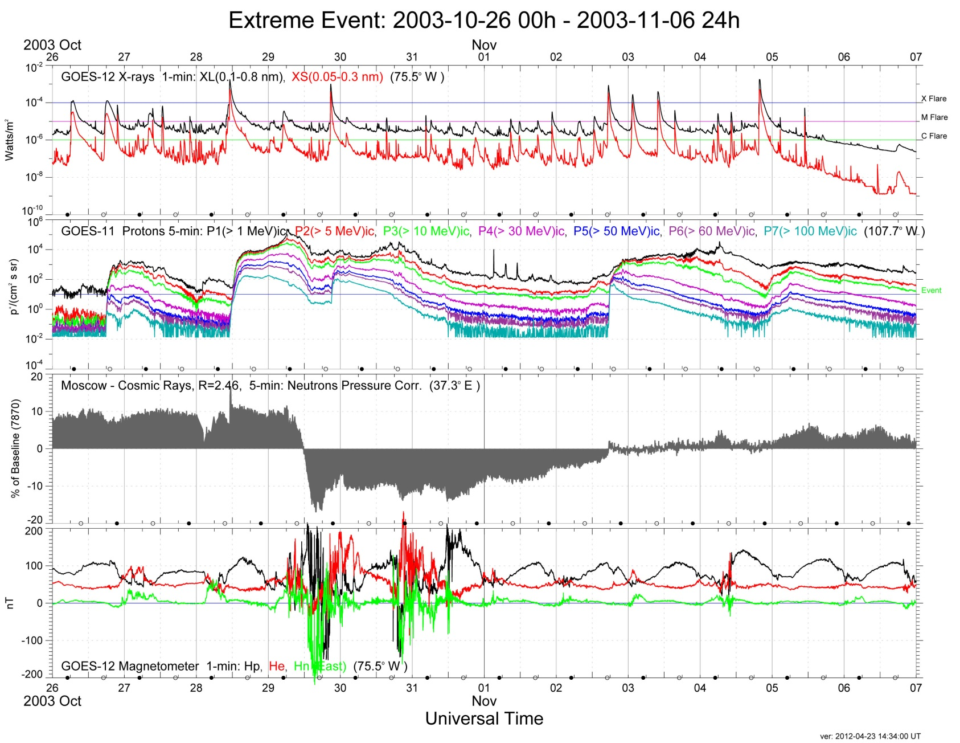
Solar-Terrestrial Physics
How Bad Can It Get?
GOES
Composite
X-ray Flares
Solar Protons
Ground Level
Event
(non-GOES)
Magnetic
Field

Slide 11
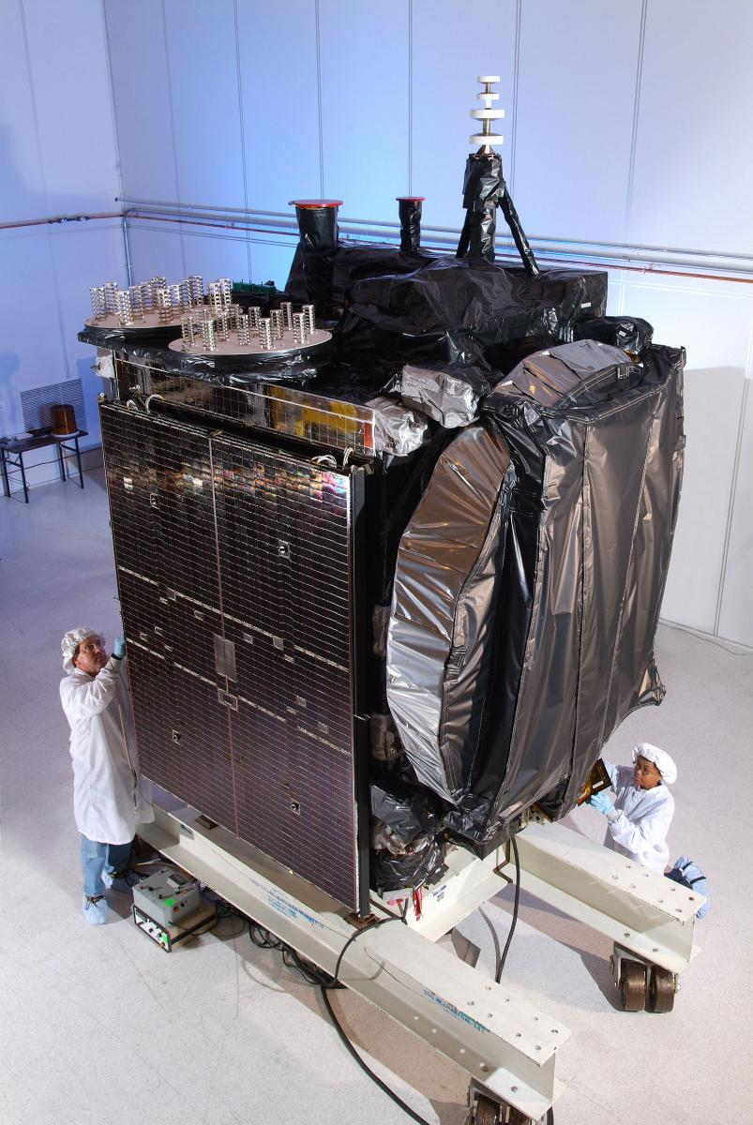
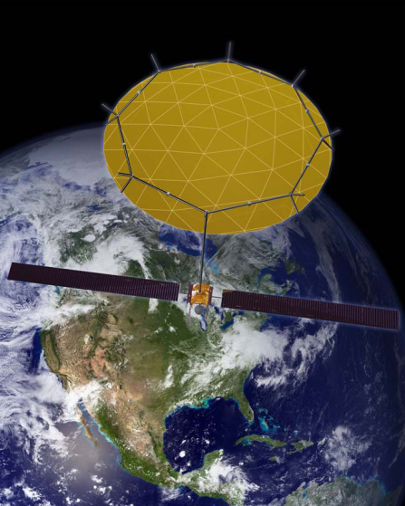
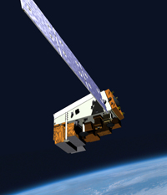
Solar-Terrestrial Physics
The Squiggles Mean What??
Case 1 – Galaxy-15
Orbit: Geosynchronous
Anomaly Date:
05 April 2010 @09:48
Probable Cause:
Internal Charging/ESD
Case 2 – SkyTerra-1
Orbit: Geosynchronous
Anomaly Date:
07 March 2012 @14:43
Probable Cause:
Single-Event Upset
Case 3 – NPP/VIIRS
Orbit: Polar LEO
Anomaly Date:
Various
Probable Cause:
Single-Event Upsets
Notes:
Important Points:
These examples are event reports put out by NOAA-SAIS showing how space weather data and tools can be used to define the relationship between space weather and satellite anomalies.
The goal for the future is to automate and present these tools so that anyone can get a complete environmental assessment with just a date, time, and location

Slide 12
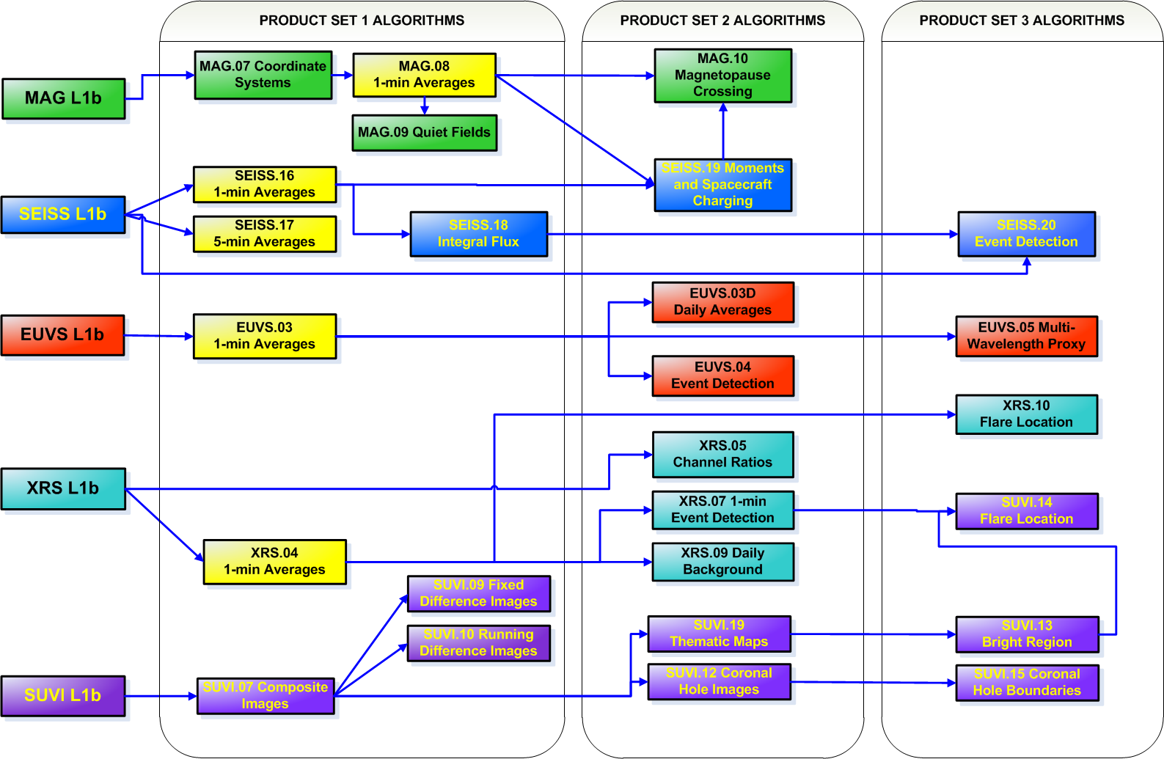
Solar-Terrestrial Physics
GOES-R Space Weather Algorithms
Notes:
Important Points:
These examples are event reports put out by NOAA-SAIS showing how space weather data and tools can be used to define the relationship between space weather and satellite anomalies.
The goal for the future is to automate and present these tools so that anyone can get a complete environmental assessment with just a date, time, and location

Slide 13
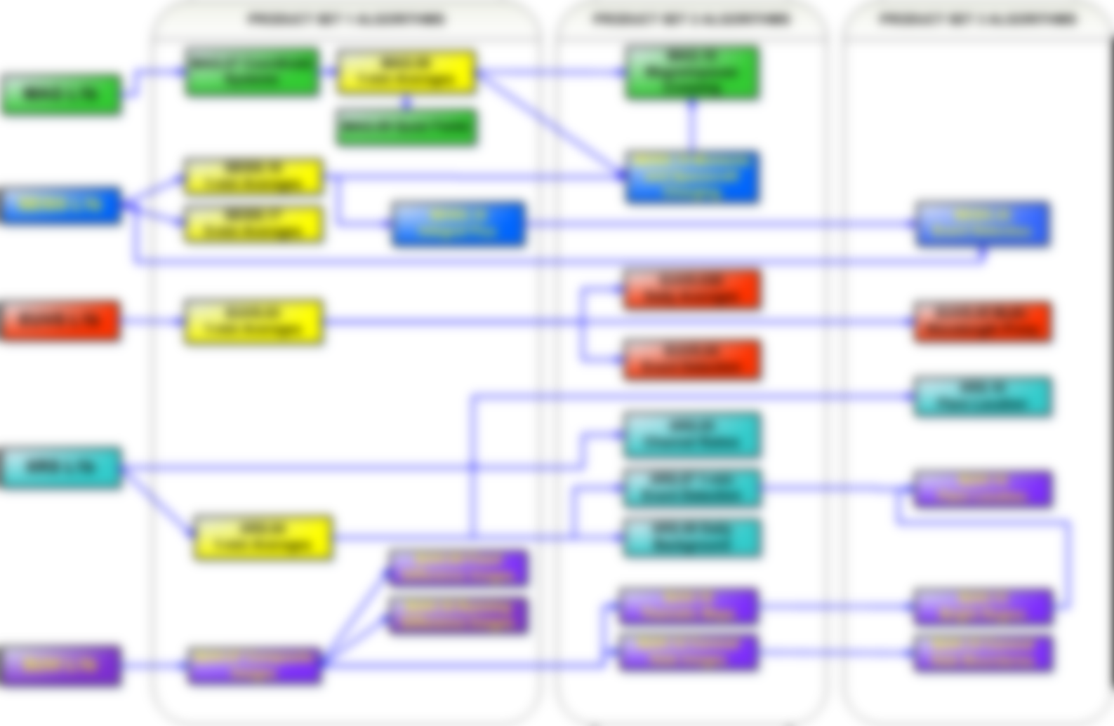
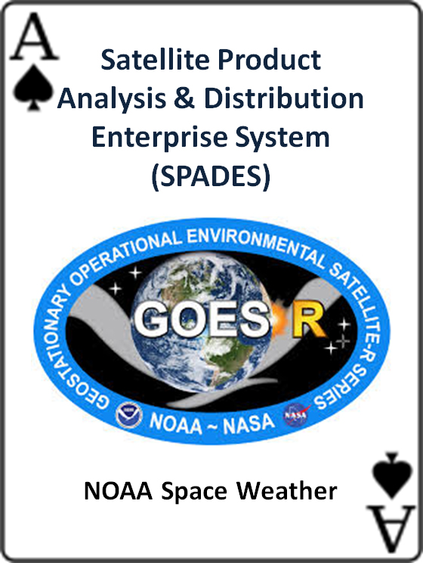
Solar-Terrestrial Physics
GOES-R Space Weather Algorithms
Notes:
Important Points:
These examples are event reports put out by NOAA-SAIS showing how space weather data and tools can be used to define the relationship between space weather and satellite anomalies.
The goal for the future is to automate and present these tools so that anyone can get a complete environmental assessment with just a date, time, and location

Slide 14
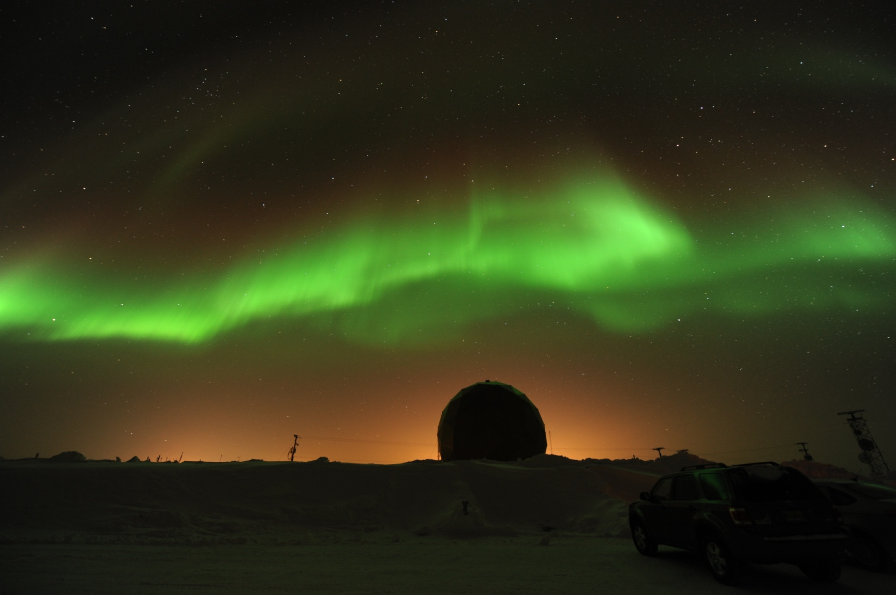
Solar-Terrestrial Physics
Space Weather = Aurora
Location: Fairbanks, AK Date: 02 Mar 11 Photo by: Jim Spann (NASA)
Notes:
Points to make:
The arctic regions (in the north and the south) are home to the aurora borealis and aurora australis
In the northern hemisphere the aurora borealis are commonly referred to as the “Northern Lights”. The aurora australis occurs in the southern hemisphere.
The aurora is a beautiful and clear manifestation of the causal relationship of the sun to earth
The best auroral viewing occurs for a clear, dark sky during periods of enhanced geomagnetic activity near local midnight.
The color image (above) is an auroral curtain of luminosity where the specific colors result from the de-excitation of mostly oxygen and nitrogen at specific wavelengths.

Slide 15
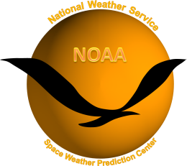
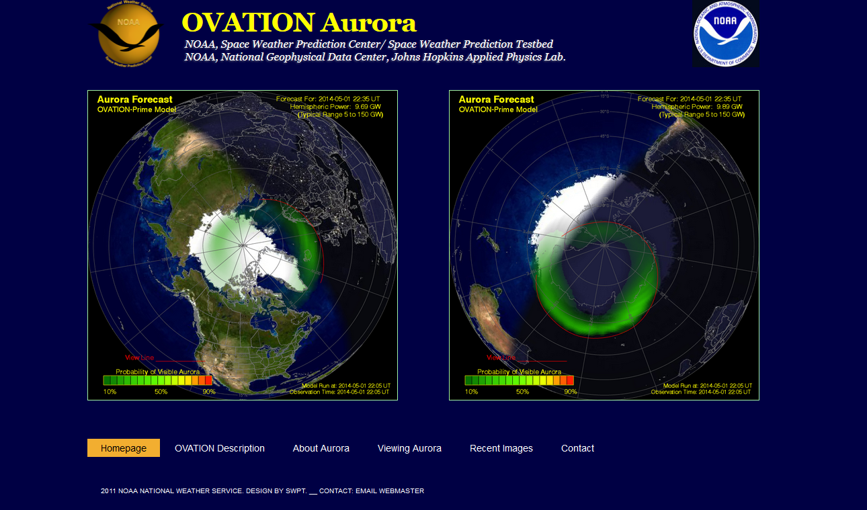
Solar-Terrestrial Physics
But Fairbanks is Really Cold!!
Live Link

Slide 16
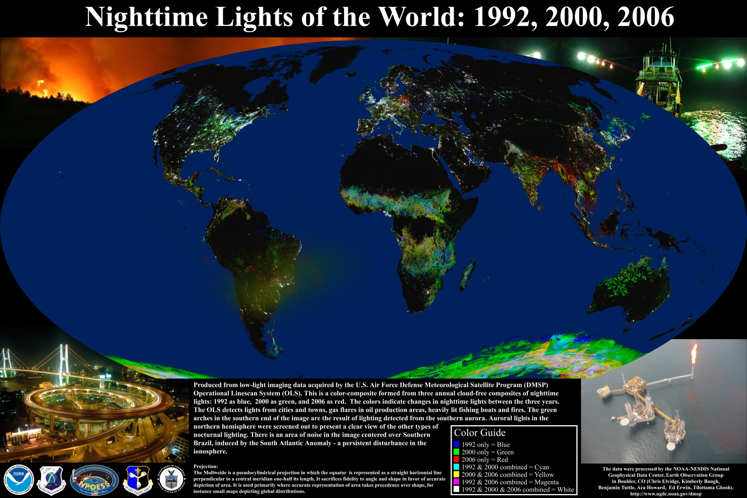
Solar-Terrestrial Physics
What Else Do You Guys Do?

Slide 17
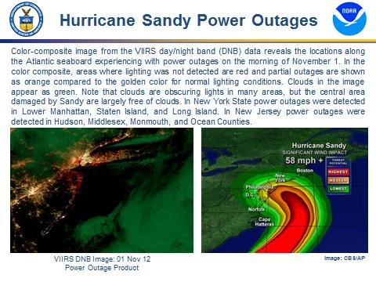
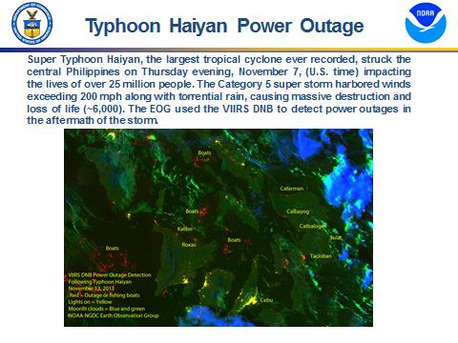
Solar-Terrestrial Physics
What Else Do You Guys Do?

Slide 18
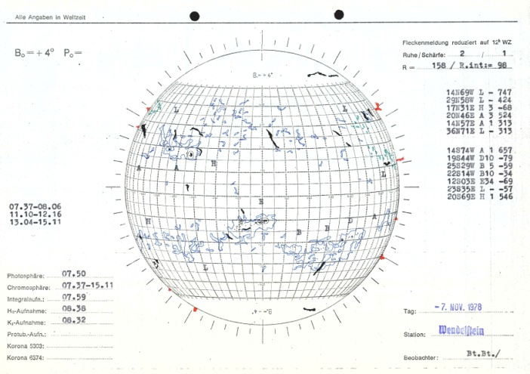
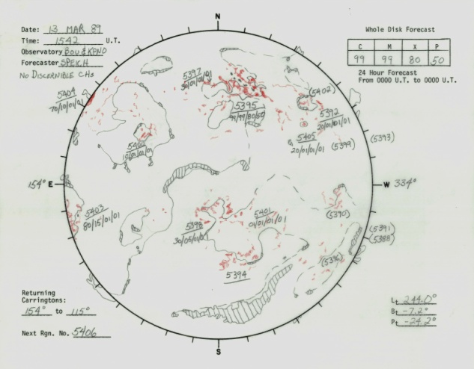
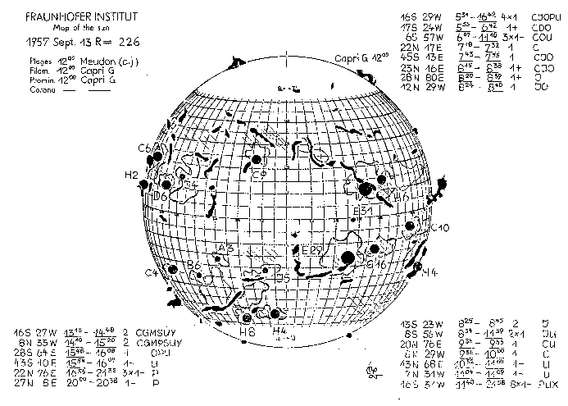
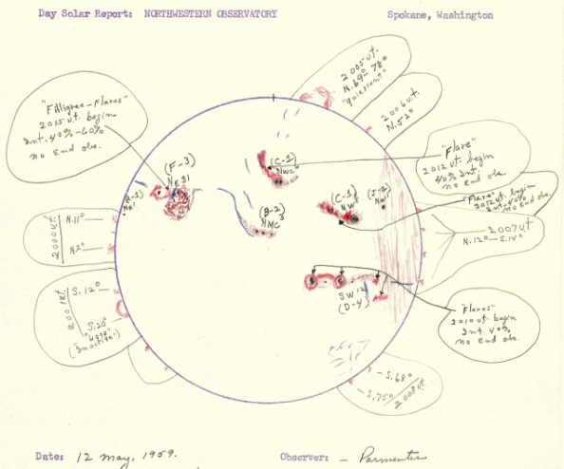
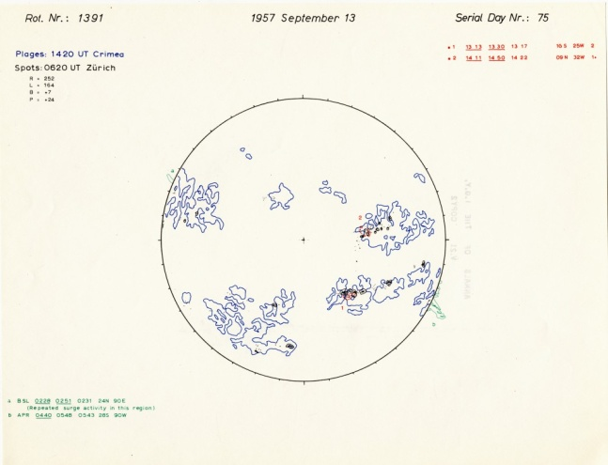
Solar-Terrestrial Physics
World Data Service for Geophysics
A Legacy from the 1957-58 International Geophysical Year
Wendelstein Observatory
(1947-1987)
Boulder Daily Composites
(1972-present)
Fraunhoffer Institute
(1956 - 1973)
Northwestern Observatory
(1958 -1970)
Drawings from the IGY
(1957 - 1958)

Slide 19
Questions?

