Slide 1
Operational Space Weather Data
COSPAR 2012
W. Denig, J. Green, J. Rodriguez & R. Viereck
U.S. Department of Commerce
National Oceanic and Atmospheric Administration (NOAA)

Slide 2
Abstract
PSW.3-0020-12 – 18 Jul 12 @ 10:25
Operational Space Weather Data Available from the National Geophysical Data Center
The National Geophysical Data Center (NGDC) provides scientific data stewardship for space weather data and environmental products acquired from U.S. operational satellites in accordance with National Oceanic and Atmospheric Administration (NOAA) Administrative Order 212-15, Management of Environmental Data and Information. The civilian Polar and Geostationary Operational Environmental Satellites, POES and GOES respectively, and the Defense Meteorological Satellite Program (DMSP) spacecraft have provided continuous measurements of the near-earth space and solar environments since the early 1970’s. These data are available online at the NGDC website. While the performance of the space weather sensors on the POES, GOES and DMSP have evolved over time the basic datasets and many available products have remained largely unchanged. Heliophysics research benefits greatly from the availability of these long-term and consistent space environmental records that can be used for stand-alone research; that is, single-satellite studies, and as contributors to larger, multi-platform investigations that include other satellites and ground assets. In this talk I will provide an overview of these retrospective datasets and products available to the scientific community. Additionally I will briefly discuss other space weather data, indices, models, and tools available from NGDC. Finally, I will cover the uses and availability of real-time operational data and products from the NOAA Space Weather Prediction Center (SWPC) and planned improvements to NOAA’s space weather monitoring program.

Slide 3
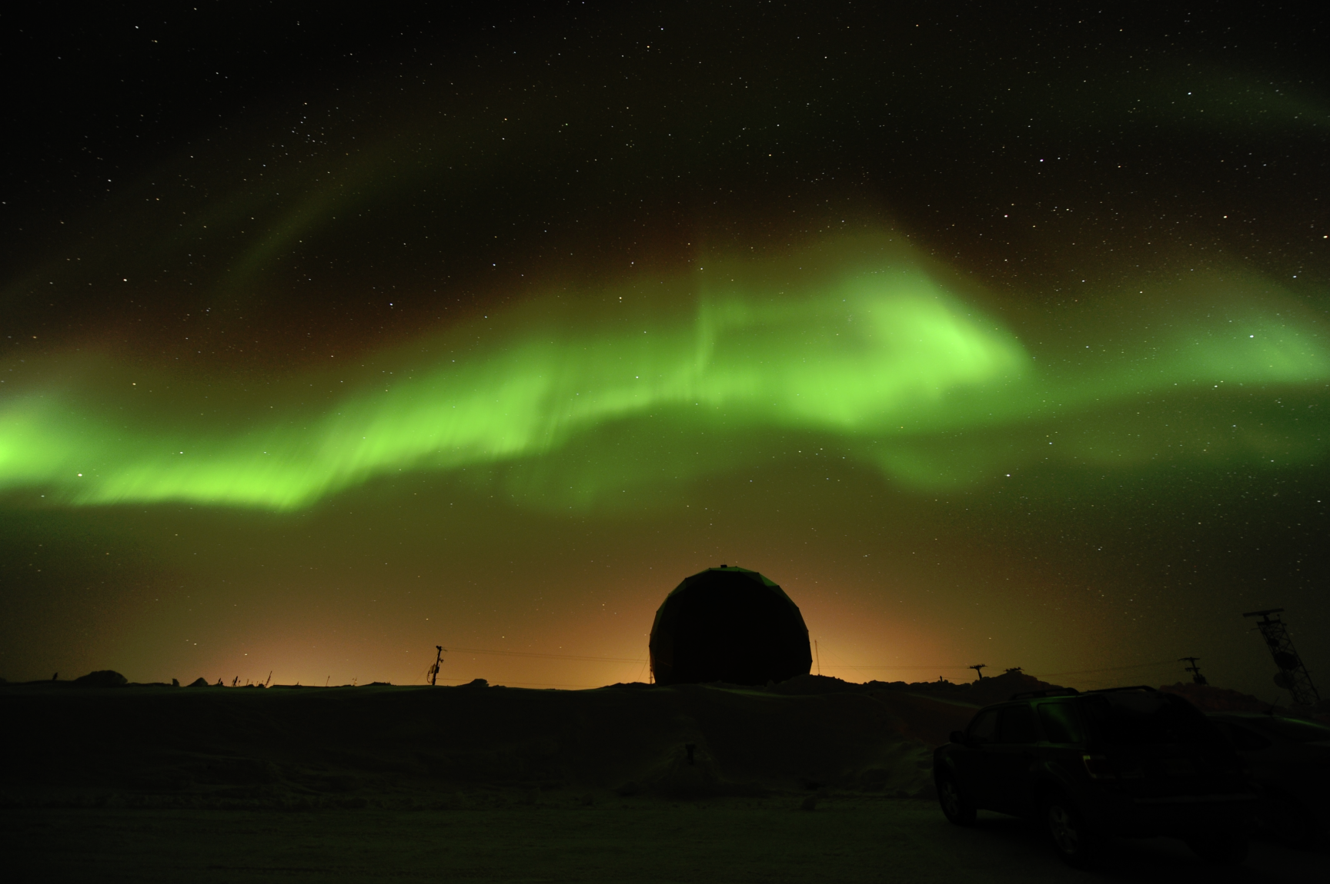
Operational SWx Data
Topics
Operational Satellite Datasets +
Environmental Impacts on Satellites
Where Have All the WDCs Gone?
Auroral Photograph by Jim Spann
Chapman Conference, Fairbanks (AK) 2011

Slide 4
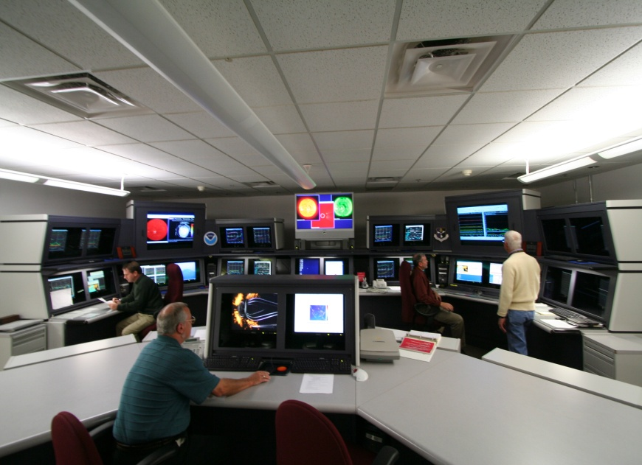
Operational SWx Data
Topics
Operational Satellite Datasets
Environmental Impacts on Satellites
Where Have All the WDCs Gone?
Space Weather Forecast Office
Boulder, Colorado

Slide 5
Operational SWx Data
Nighttime Light Change - India
Non Space Weather Use of Operational Data
Color composite of DMSP-OLS nighttime lights of India.
1992 blue
1998 green
2003 red
Contrast enhanced. Colors indicate changes in lighting among the three years. Indications are that between 1992 and 2003 there was a substantial expansion in nighttime lighting, particularly in rural areas and the outer extents of cities.
2003
Key
1998
1992

Slide 6
Operational SWx Data
Nighttime Light Change – Karnataka
You are here
Narayana Murthy
Center of Excellence
2003
Key
1998
1992

Slide 7
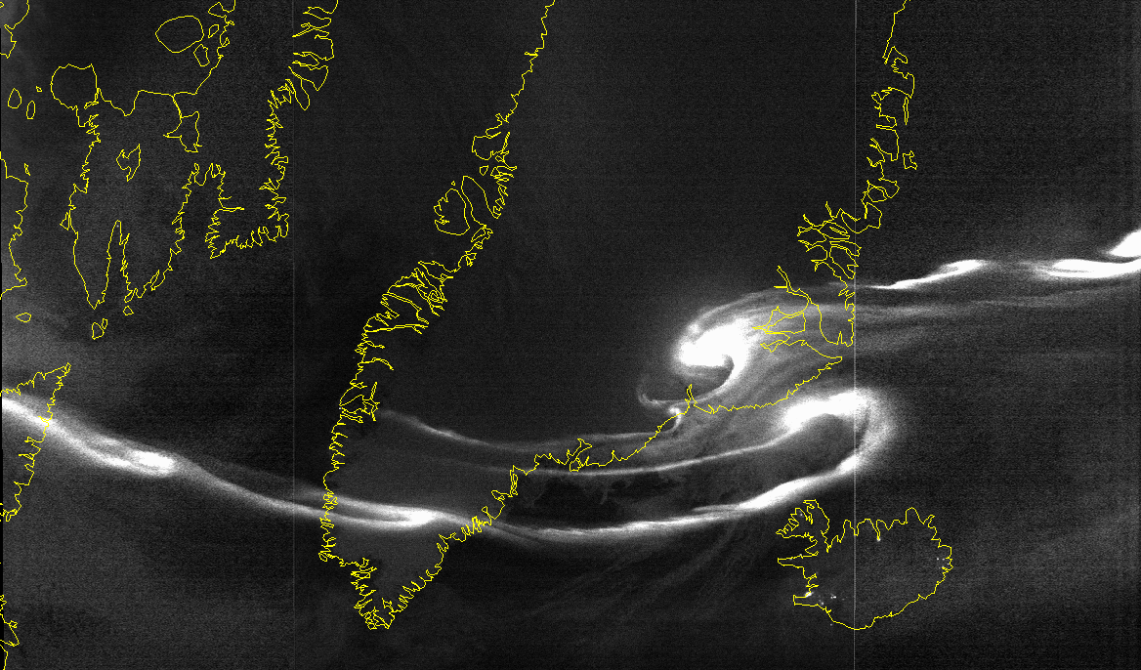
Operational SWx Data
Same Sensor – Different Application
White light auroral image (westward traveling surge) from the Operational Linescan System (OLS) on the Defense Meteorological Satellite Program (DMSP). OLS was originally designed to image clouds.

Slide 8
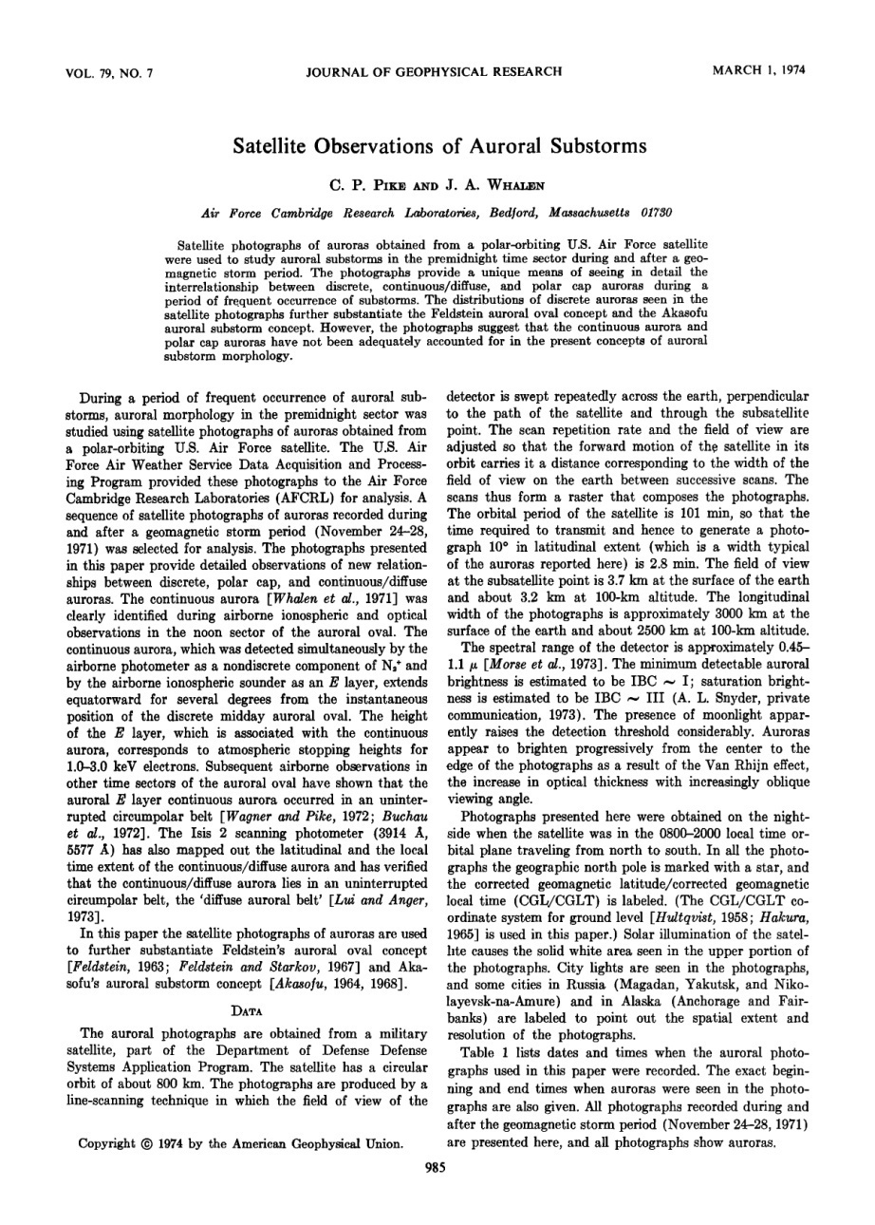
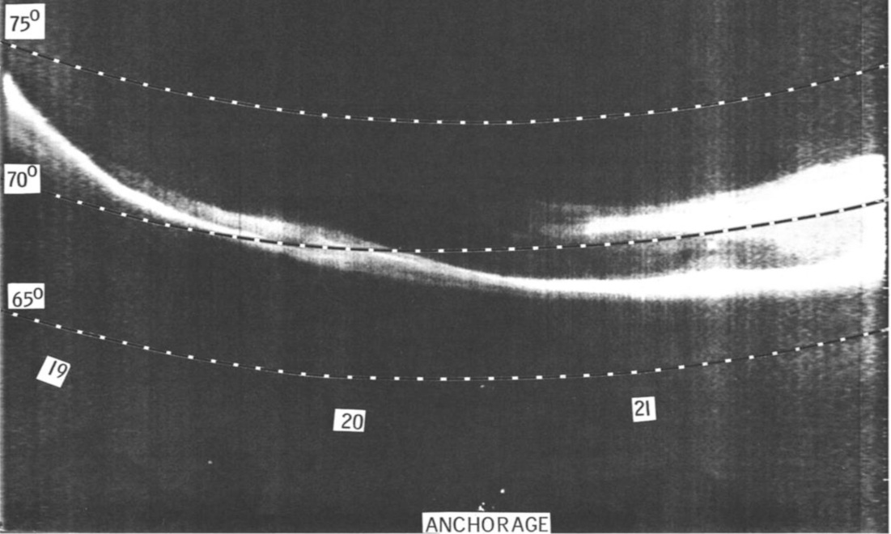
Operational SWx Data
Same Sensor – Different Application
First use of operational data for space research
Nighttime imagery from the OLS was used to study the morphology of substorms in the pre-midnight time sector. Imagery was used to substantiate the Feldstein auroral oval and the Akasofu auroral substorm concepts. JGR reprint on the left is from Pike and Whalen [1974].
From Pike & Whalen, 1974
Notes:
Rogers et al., Science, 1974

Slide 9
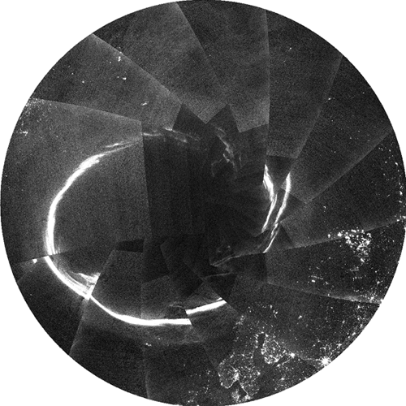
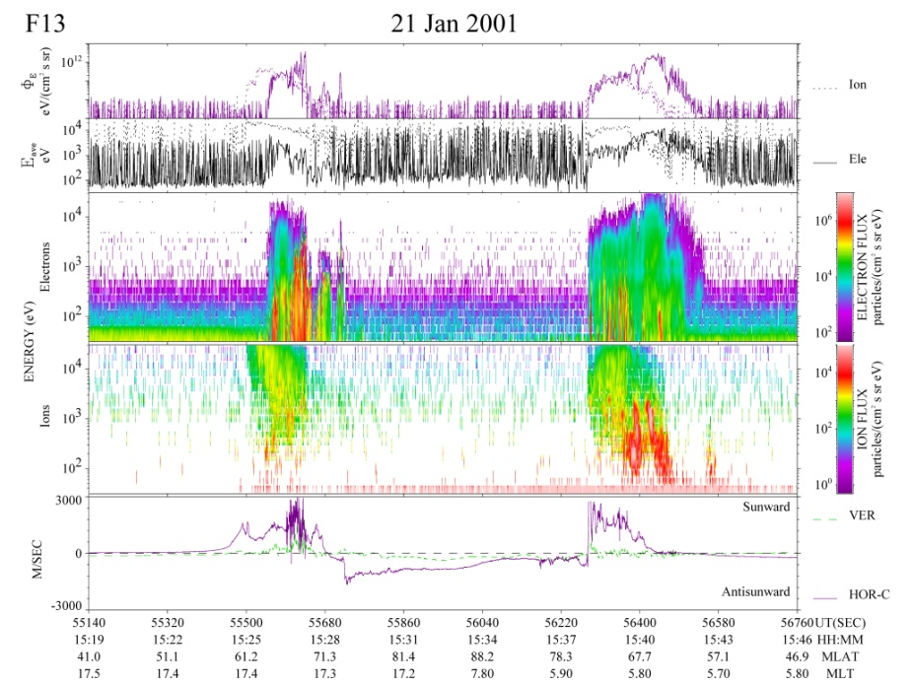
Operational SWx Data
OLS Used to Identify the Auroral Boundary
Historical operational methods used white-light imagery data from the DMSP Operational Linescan System (Pike & Whalen [1974] see also Meng [1976]).
Auroral boundary identification monitoring has now transitioned to a particle-based approach using the DMSP SSJ series of sensors (see Gussenhoven et al. [1987]).
Current alternative approaches include ultra-violet (UV) imaging of the auroral zone.
DMSP polar pass using the SSJ
24-hour auroral composite from DMSP OLS
AB
NP
AB
Credit: Elvidge, NOAA/NGDC
Credit: Denig, AFRL
AB = Auroral Boundary NP = ~North Pole
Notes:
Key:
DMSP Defense Meteorological Satellite Program
OLS Optical Linescan System
SSJ Special Sensor Auroral Particle Sensor
SSUSI Special Sensor Ultraviolet Spectrographic Imager
According to Gussenhoven et al (1983) the auroral boundary is determined at the point when the electron particle flux exceeds 10E7/(cc-sec-ster)

Slide 10
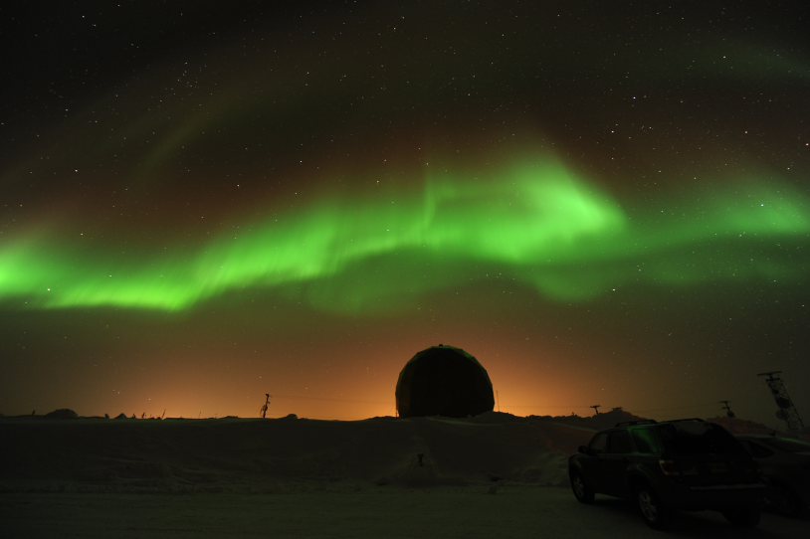
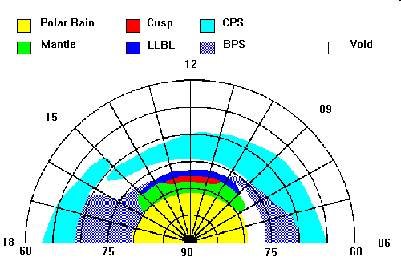
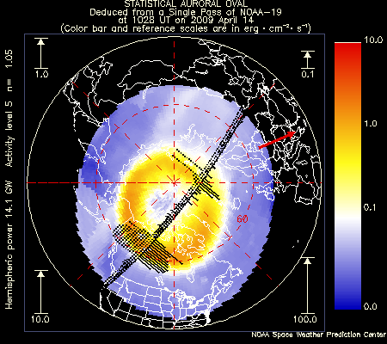
Operational SWx Data
LEO Measurements – Auroral Morphology
Auroral Energy Particles
Measure the energy spectrum and distribution of particles precipitating into the high-latitude ionosphere. Discern magnetospheric source regions in magnetic latitude - magnetic local time plots.
Credit: Newell, JHU/APL

Slide 11
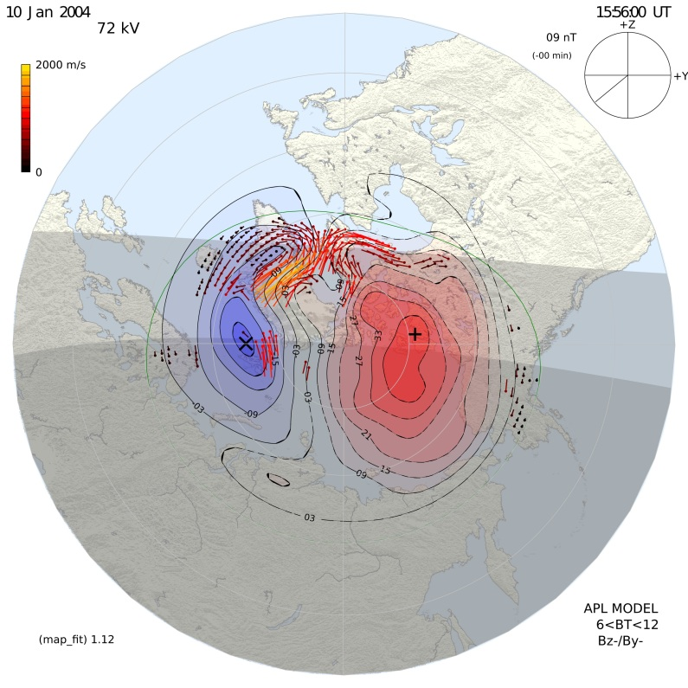
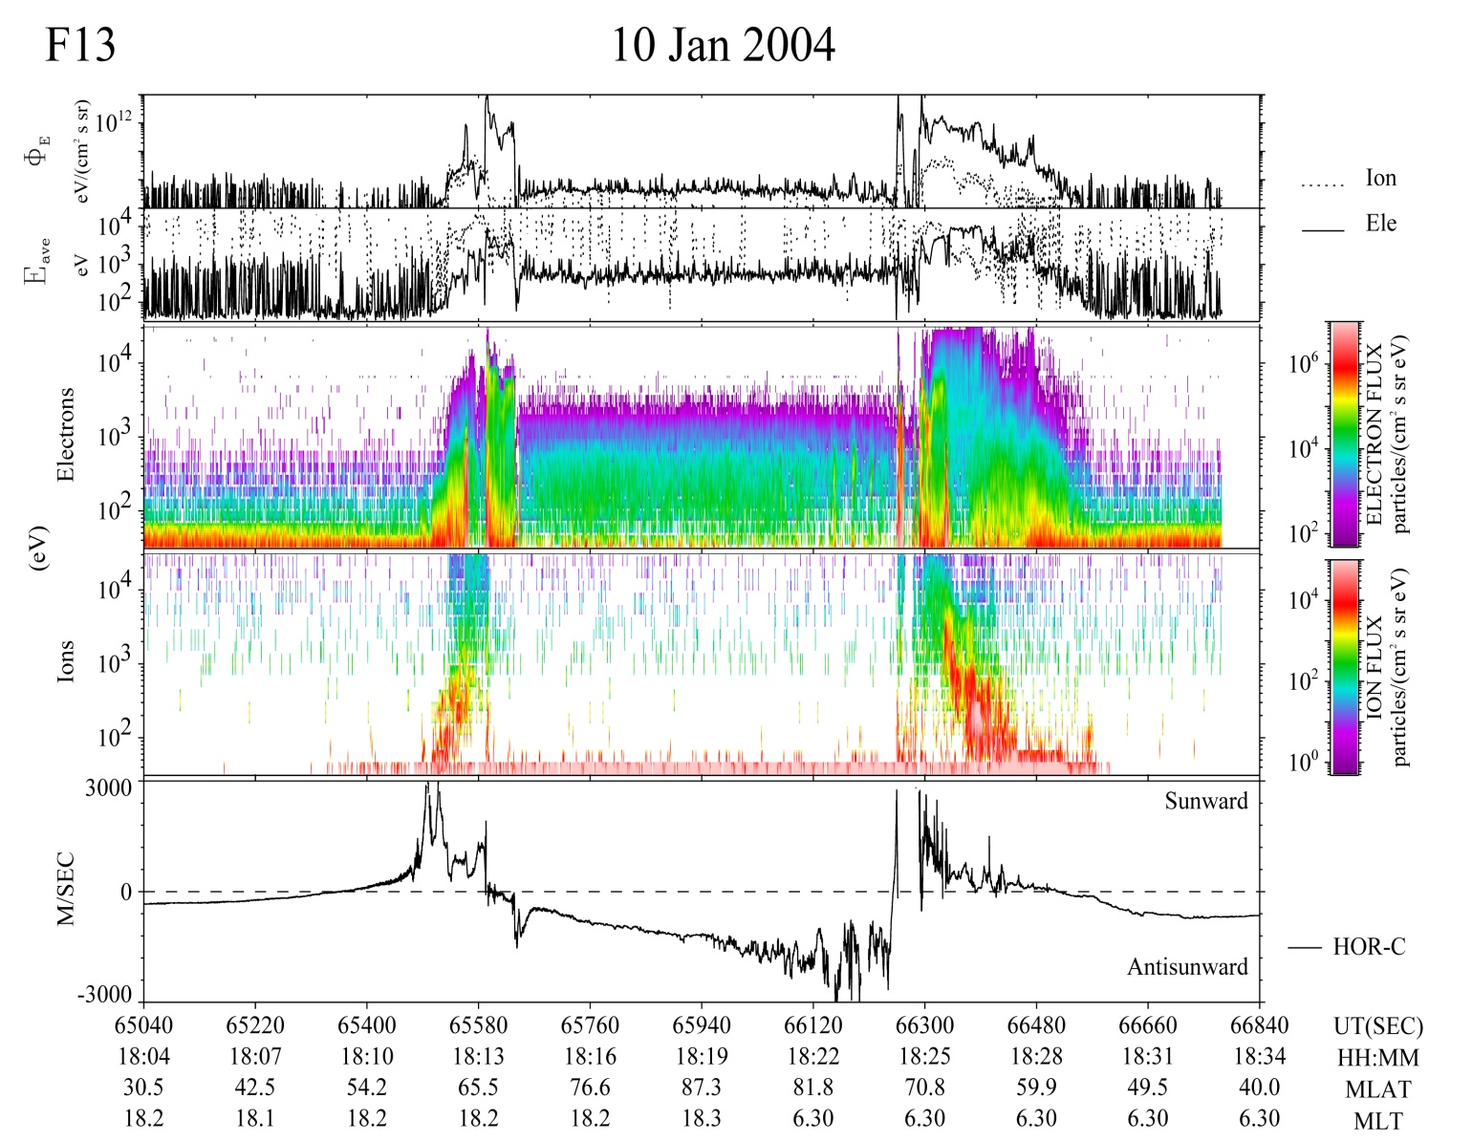
Operational SWx Data
Extended Capabilities – LEO Data
Auroral Zone
Auroral Zone
Particles
Andalsvik et al., 2011
LEO measurements
SWx data from the DMSP are used to determine the electrodynamics of the high-latitude space environment.
Convection
Field
Aligned
Currents

Slide 12
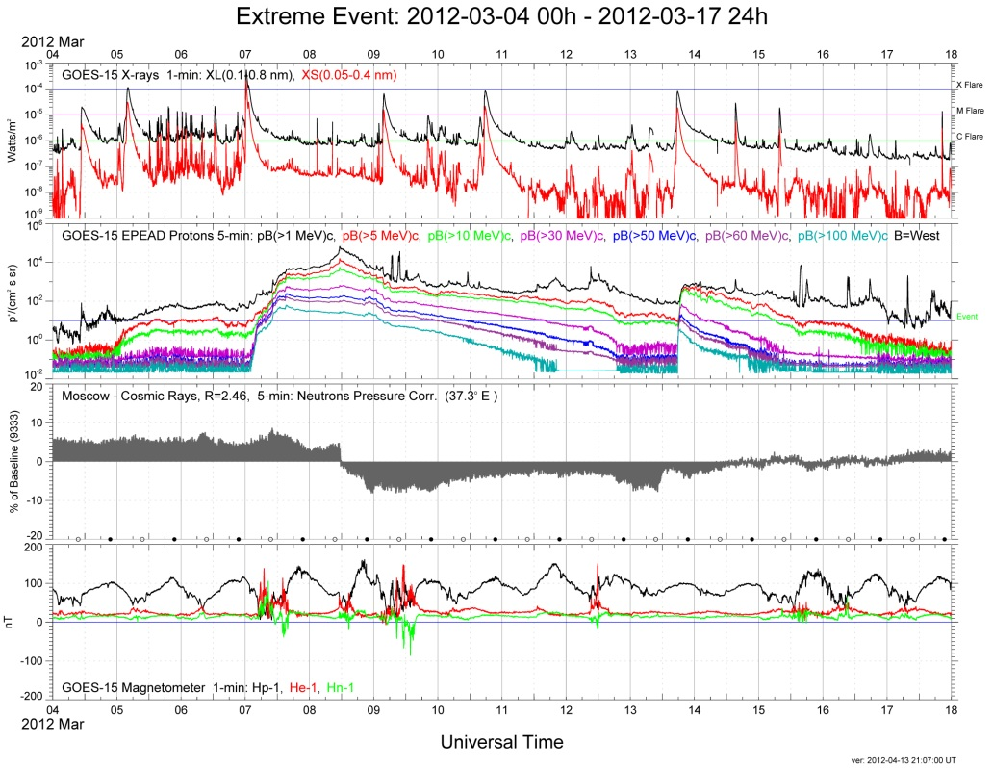
Operational SWx Data
GOES SWx Data – March 2012
GEO Measurements
Space weather data from Geostationary Operational Environmental Satellites (GOES) include space particle and field measurements plus solar observations.
All data and plots are available at: http://www.ngdc.noaa.gov/stp/satellite/satdataservices.html

Slide 13
Operational SWx Data
A closer look at the 07 March event

Slide 14
Operational SWx Data
Over 35 Years of Operational SWx Data
Over 35 years of operational satellite space environmental data are available for heliophysics research. For the most part the measurement parameters have remained the same except for some improvements in sensor design and performance.
NOAA GOES – particles, fields, solar observation
Date range: 1976 – present
# of satellites: 15 (not counting 1 failure)
http://www.ngdc.noaa.gov/stp/satellite/goes/index.html
http://sxi.ngdc.noaa.gov/
NOAA POES (also MetOp) – energetic charged particles
Date range: 1978 – present
# of satellites: 12 (not counting 1 launch failure)
http://www.ngdc.noaa.gov/stp/satellite/poes/index.html
USAF DMSP – energetic particles & fields
Date range: 1976 – present
# of satellites: 13
http://www.ngdc.noaa.gov/nndc/struts/results?t=102827&s=1&d=1001,1002,9
It keeps going and going and going
Data available through the NOAA National Geophysical Data Center (http://www.ngdc.noaa.gov/ngdc.html)

Slide 15
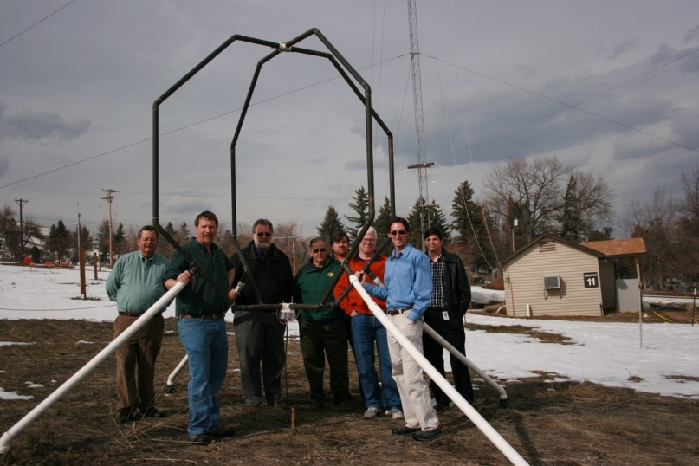
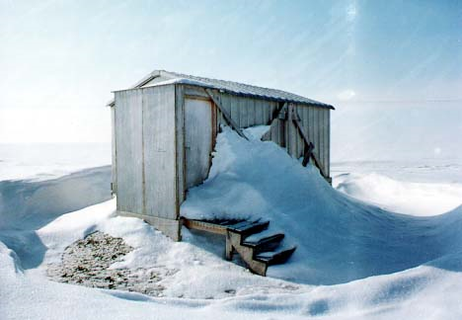
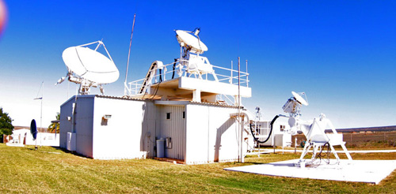
Operational SWx Data
Other Ground Assets
USAF Ionosonde Network (MIRRION) – Boulder, CO
http://www.ngdc.noaa.gov/stp/iono/ionohome.html
USGS Magnetic Observatories¹ (INTERMAGNET) – Barrow, AK
http://spidr.ngdc.noaa.gov/spidr/
USAF Solar Electro-Optical Network (SEON)
http://www.ngdc.noaa.gov/stp/spaceweather.html
¹INTERMAGNET home page: http://www.intermagnet.org/
USGS Geomagnetism: http://geomag.usgs.gov/

Slide 16
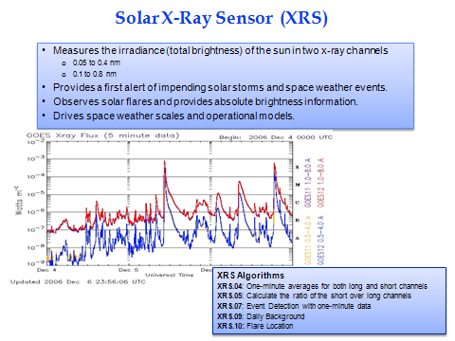
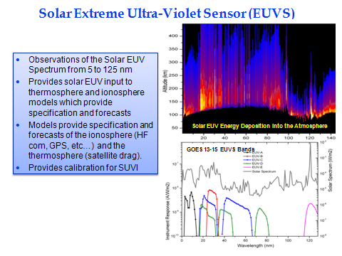
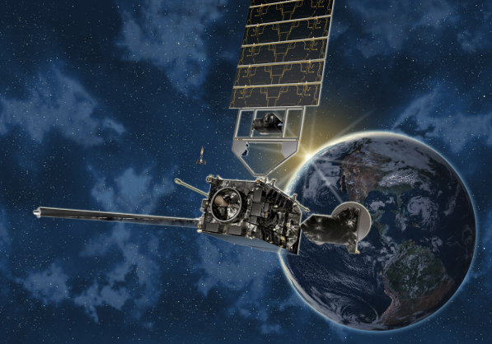
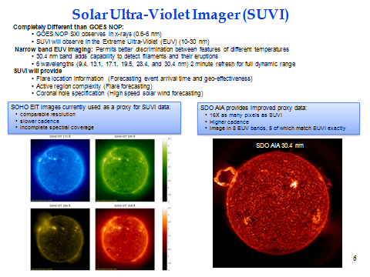
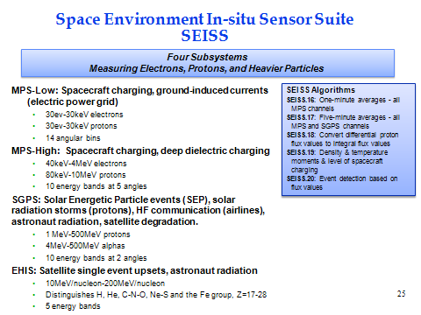
Operational SWx Data
Future Capabilities – GOES-R
The GOES-R series space/solar sensors provide an incremental improvement to current NOAA GEO space weather monitoring. The first launch date of the GOES-R series is 2015.
Increased # of wavelength bands
Credit: Lockheed-Martin
Solar UV imagery versus soft x-rays
Improved particle energy coverage

Slide 17
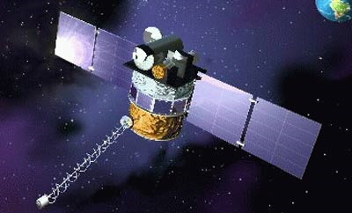
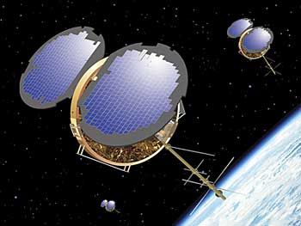
Operational SWx Data
Future Datasets – DSCOVR & COSMIC-2
DSCOVR
COSMIC-2
Credit: NASA
Credit: Orbital Sciences Corp
Deep-space Climate Observatory
Operational replacement for ACE
Partnership with NASA and U.S. Air Force
Solar-wind & magnetic field measurements @ L1
Data stewardship & archive: NGDC
Scheduled launch: 2014
Constellation Observing System for Meteorology, Ionosphere and Climate-2
Operational replacement for COSMIC
Partnership with Tiawan and the U.S. Air Force
Improved weather forecasting drives the need
Ionospheric specification and scintillation
Data Stewardship and archive: NGDC/NCDC
Scheduled launch: 2015
ACE – Advanced Composition Explorer (NASA)
COSMIC – Constellation Observing System for Meteorology, Ionosphere and Climate

Slide 18
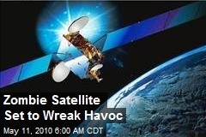
Operational SWx Data
Topics
Operational Satellite Datasets
Environmental Impacts on Satellites
Where Have All the WDCs Gone?
Galaxy15 Satellite Anomaly 05 April 2010
Photo Credit: Business Wire

Slide 19
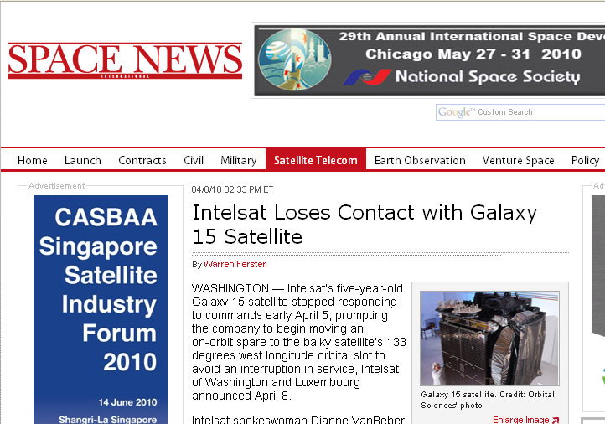
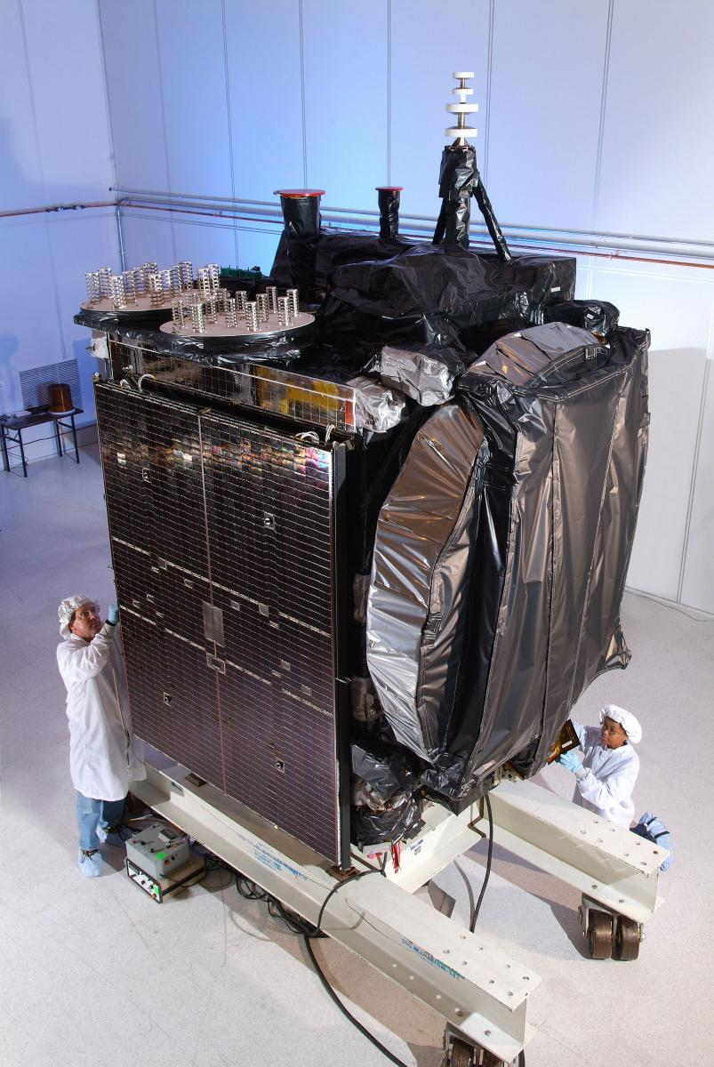
Operational SWx Data
Environmental Impacts – Case 1
Galaxy 15 Geostationary Satellite Anomaly – 05 April 2010
Galaxy 15 satellite. Photo Credit: Orbital Sciences

Slide 20
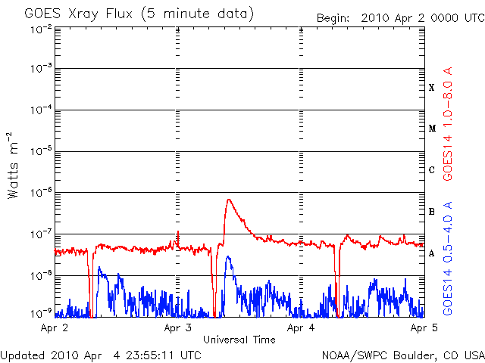
Operational SWx Data
Environmental Impacts – Case 1
Galaxy 15 Satellite – Solar Observations
The initiation of the “solar storm” was a modest B7 solar flare from region 11059 (S22W15) that was observed on 02 April by the GOES X-Ray Sensor (XRS) and Solar X-ray Imager (SXI)
Satellite Eclipse
B7 FLARE
Additional data for this event available at: http://sxi.ngdc.noaa.gov/sxi_greatest.html

Slide 21
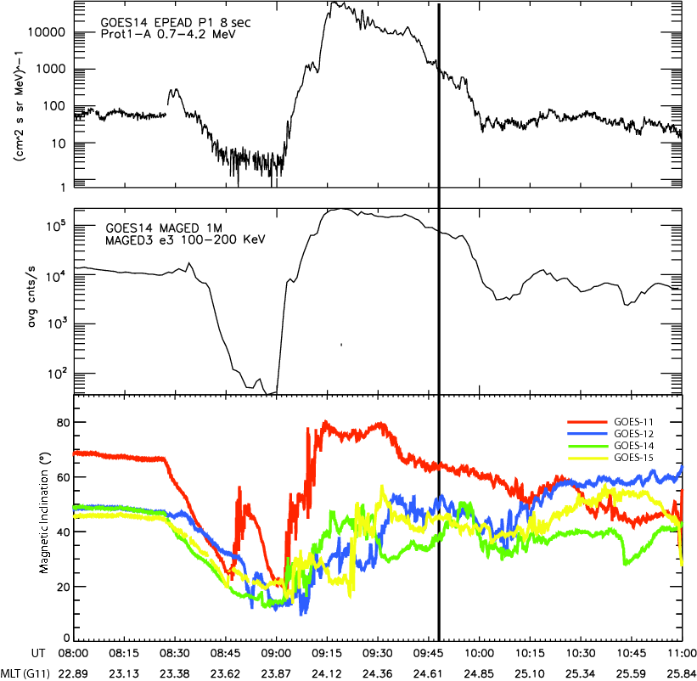
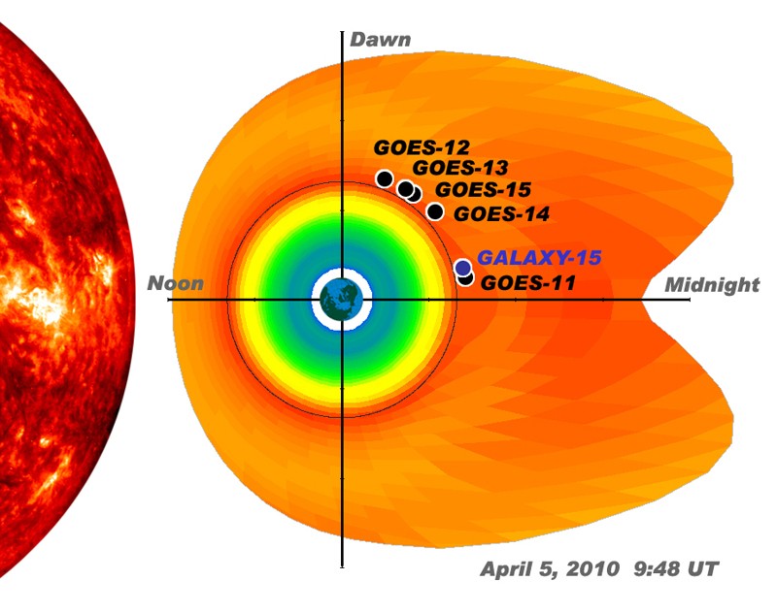
Operational SWx Data
Environmental Impacts – Case 1
Galaxy 15 Satellite – Local GEO Environment
Satellite Anomaly @ 9:48 UT
April 05 @ 09:00 UT: GOES sensors detected a major reconfiguration of the magnetosphere indicative of a magnetic storm.
Satellite Locations
Eclipse

Slide 22
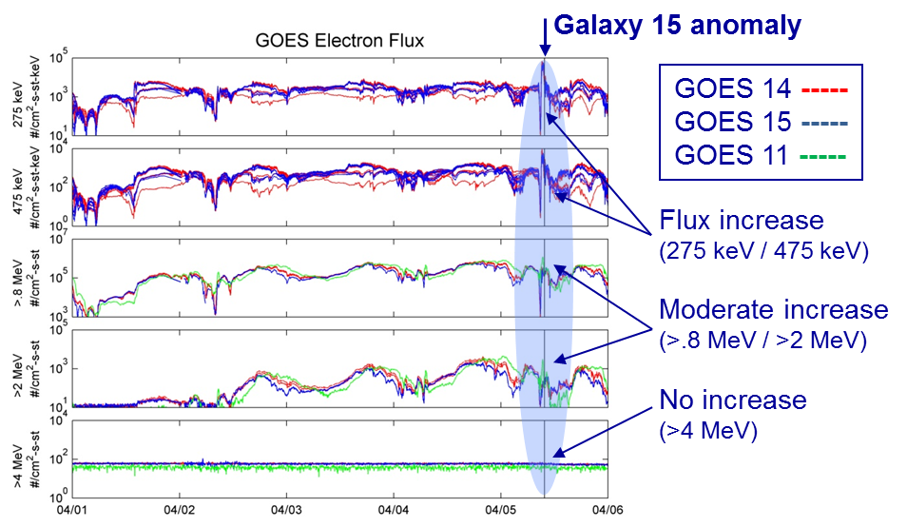
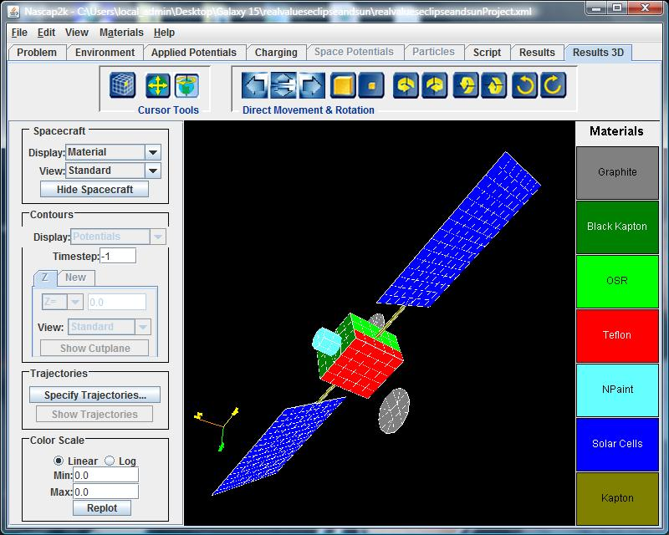
Operational SWx Data
Environmental Impacts – Case 1
Causal Indications – Internal Charging by Enhanced Electron Environment
Flux of 275-475 keV electrons was the highest observed since GOES 14 was turned on in July 2009 and GOES 15 since April 2010. GOES particle data used to model the charging environment experienced by the Galaxy 15 satellite noted extreme charging levels.
In-situ Particle Data
Use in Spacecraft Charging Models

Slide 23
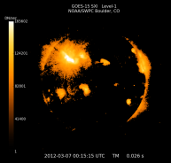
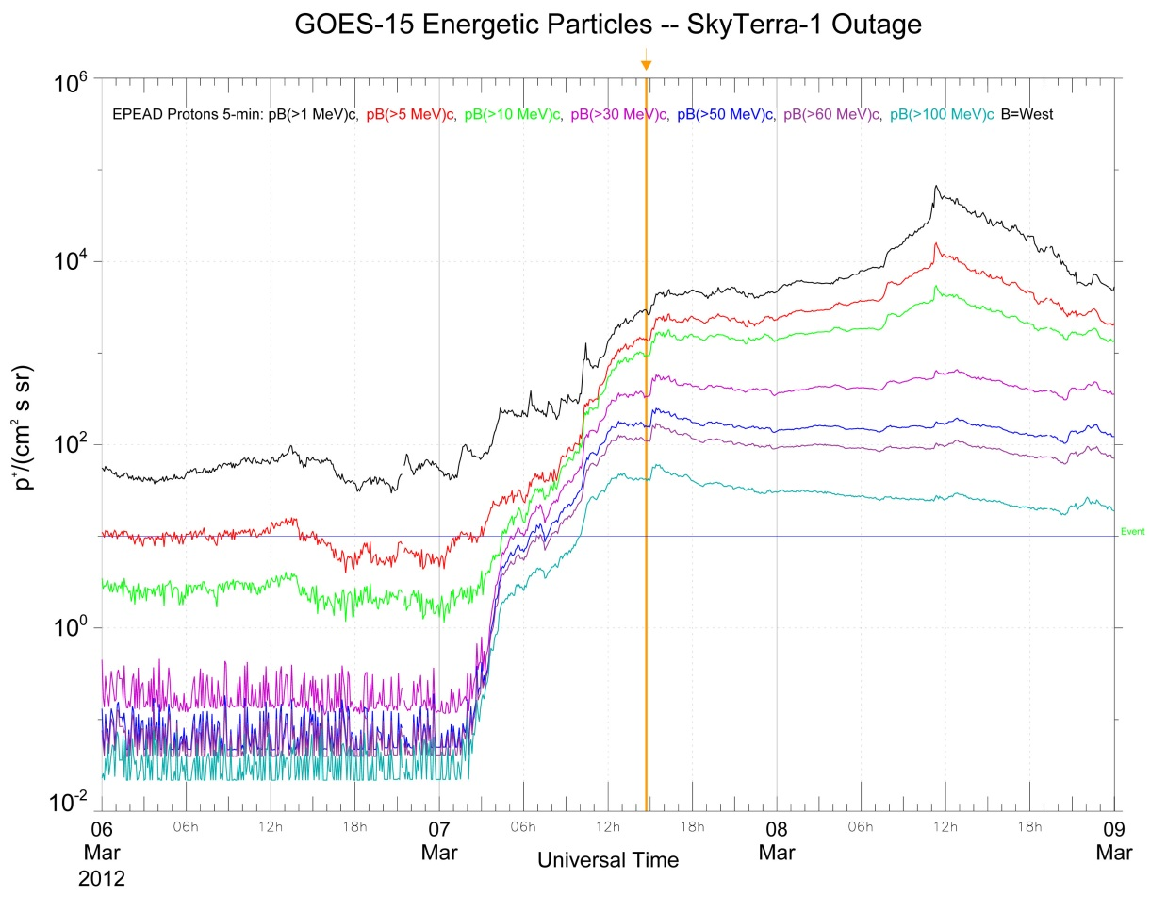
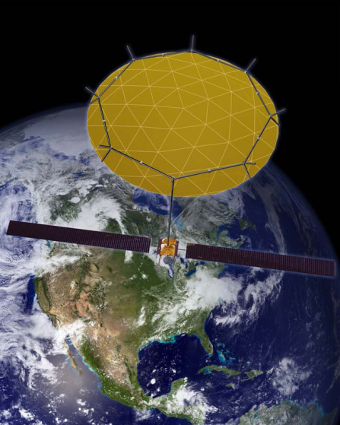
Operational SWx Data
Environmental Impacts – Case 2
News Report: Skyterra 1 satellite has been out of service since the solar storm on March 7
http://mobile.slashdot.org/story/12/03/15/199252/lightsquared-satellite-disabled-by-last-weeks-solar-storm
NOAA SXI
The probable cause of the 07 March (2012) anomaly was a Single Event Upset (SEU) caused by a solar energetic proton (SEP) event from the X5 solar flare at active region 1429. An associated coronal mass ejection reached earth on 09 March.
Solar Flare – 00:02 UT
Skyterra 1 anomaly
(14:43 UT)
Event
Note the enhanced flux of very energetic >100 MeV protons

Slide 24
Operational SWx Data
Topics
Operational Satellite Datasets
Environmental Impacts on Satellites
Where Have All the WDCs Gone?
World Data Centers (1957 – 2008)

Slide 25
Operational SWx Data
World Data System
In 11/2008 the World Data Center (WDC) structure was officially disbanded and replaced by the World Data System (WDS). At that time, the WDC for Solar-Terrestrial Physics (WDC-STP, Boulder) transitioned into the WDS for Geophysics. For over 50 years the WDC-STP assembled environmental data on solar, ionospheric and geomagnetic observations, cosmic rays and related atmospheric phenomena. The WDS-Geophysics will continue to maintain and manage the unique environmental datasets collected since the International Geophysical Year (1957-58).

Slide 26
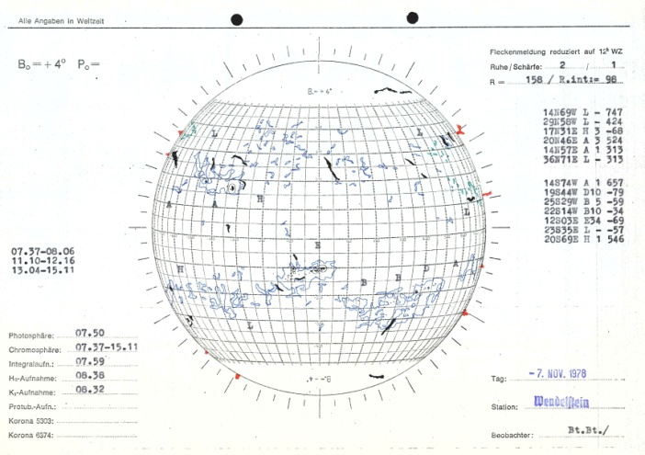
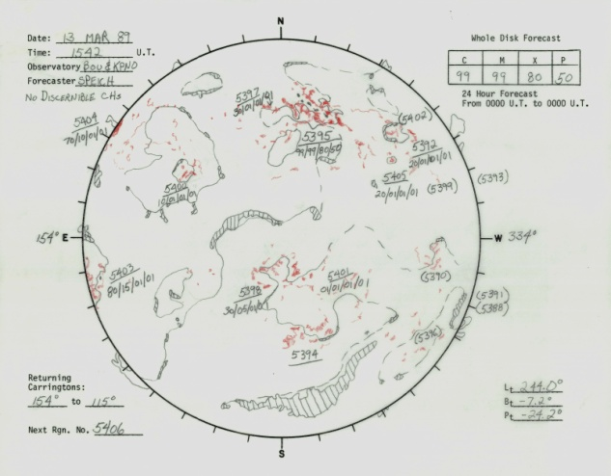
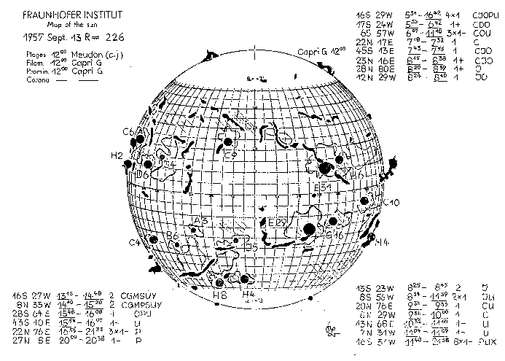
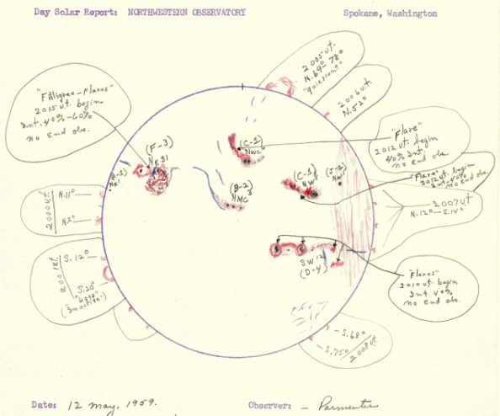
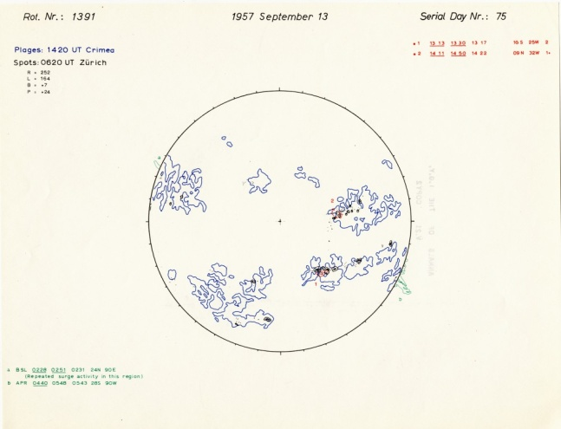
Operational SWx Data
WDS-STP – Solar Drawings & Images
Historical solar archives assembled through the WDC-STP provide an historical record of the sun from 1947 to the present. Included are solar synoptic drawings, sunspot drawings, solar photographs, and other relevant data.
Wendelstein Observatory
(1947-1987)
Boulder Composite Drawings
(1972-present)
Fraunhoffer Institute
(1956 - 1973)
Northwestern Observatory
(1958 -1970)
Drawings from the IGY
(1957 - 1958)
Online Access: http://www.ngdc.noaa.gov/stp/spaceweather.html

Slide 27
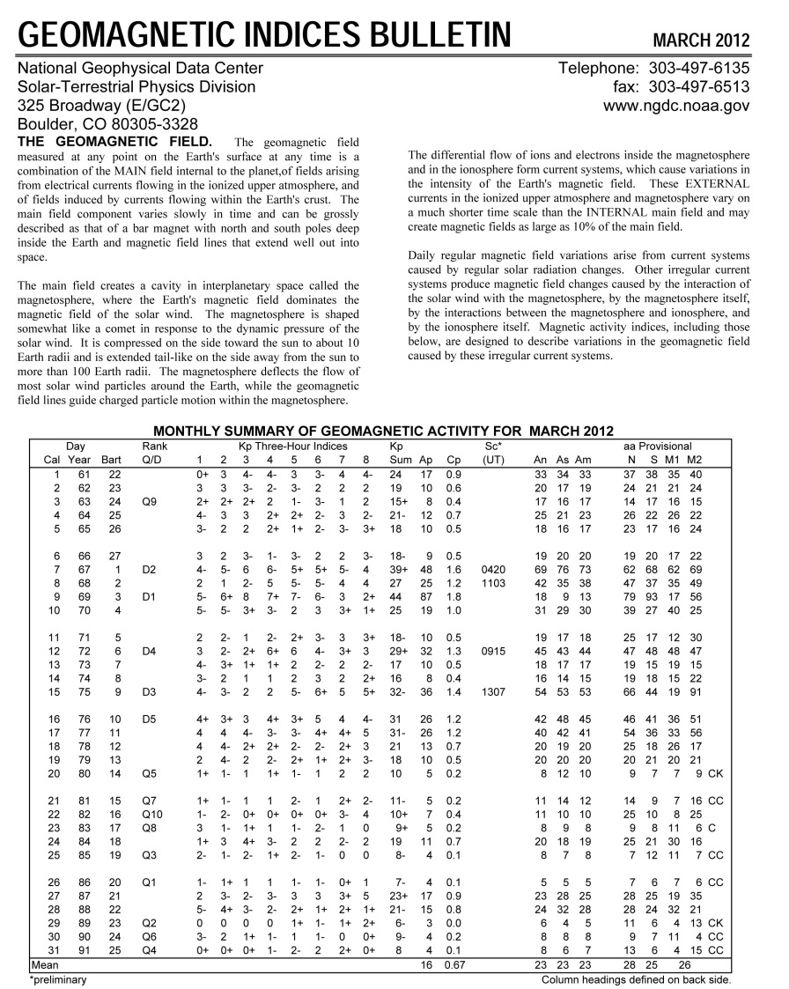
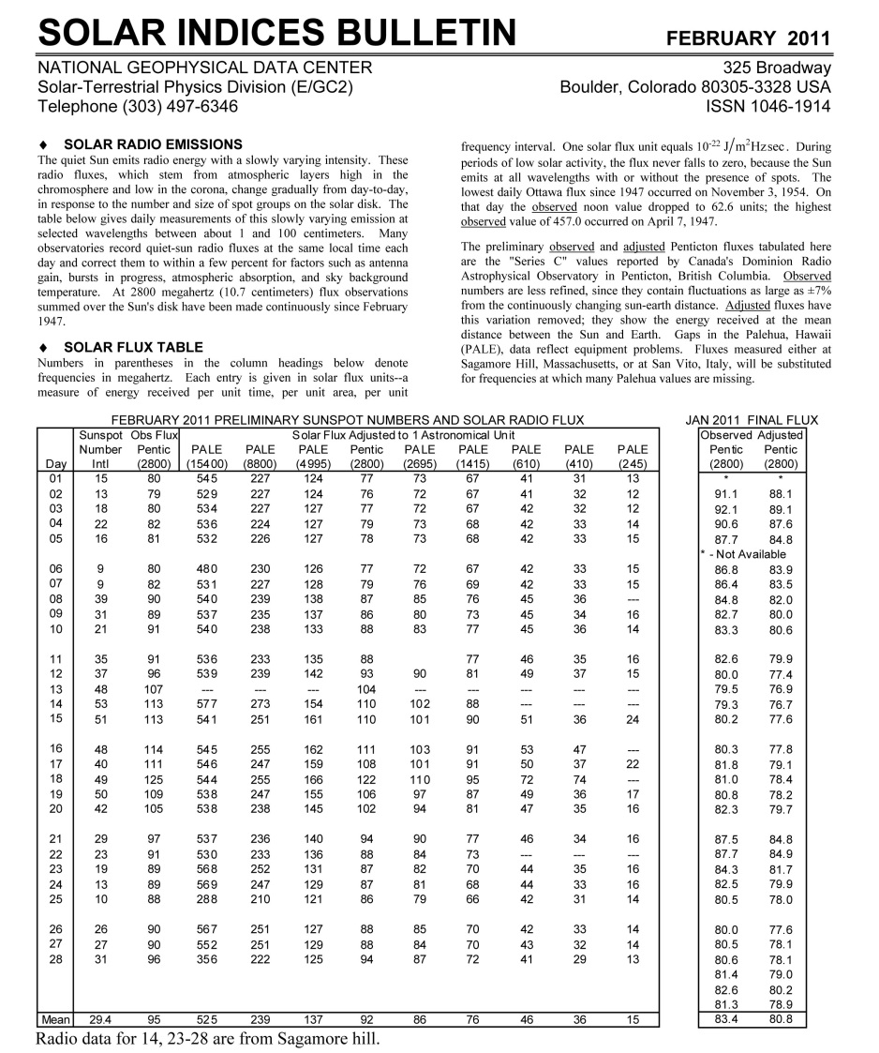
Operational SWx Data
WDC-STP – Indices
Geomagnetic Indices Bulletin: http://www.ngdc.noaa.gov/stp/geomag/geoib.html
Solar Indices Bulletin: http://www.ngdc.noaa.gov/stp/solar/sibintro.html

Slide 28
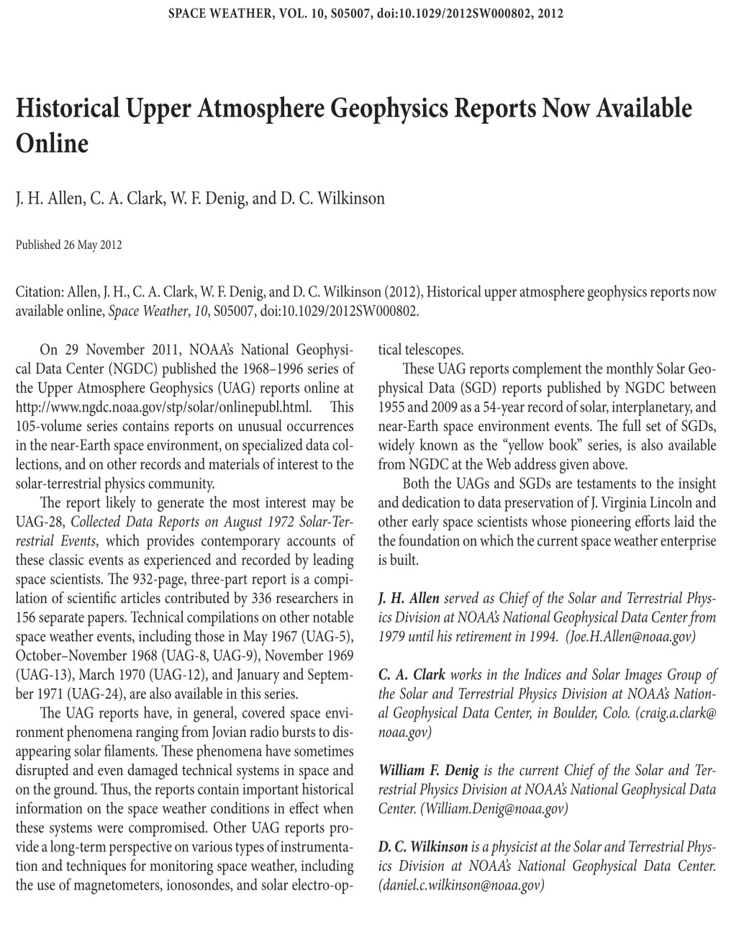
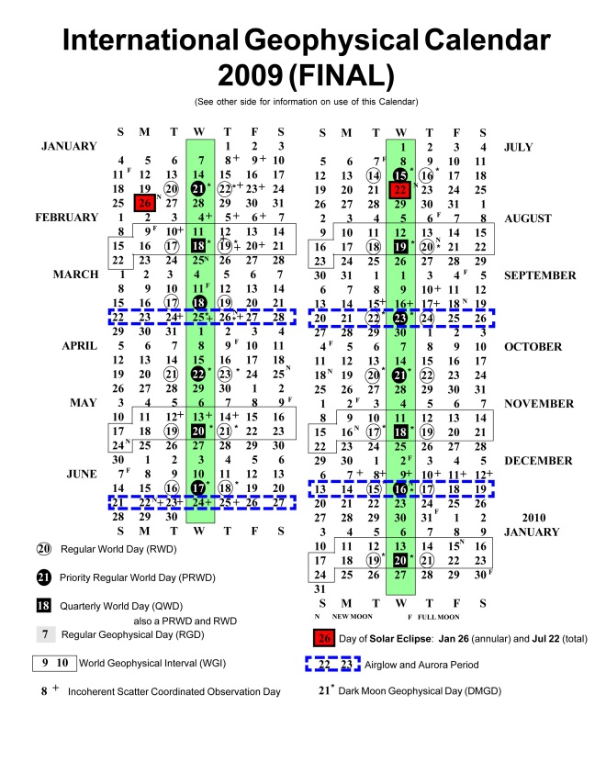
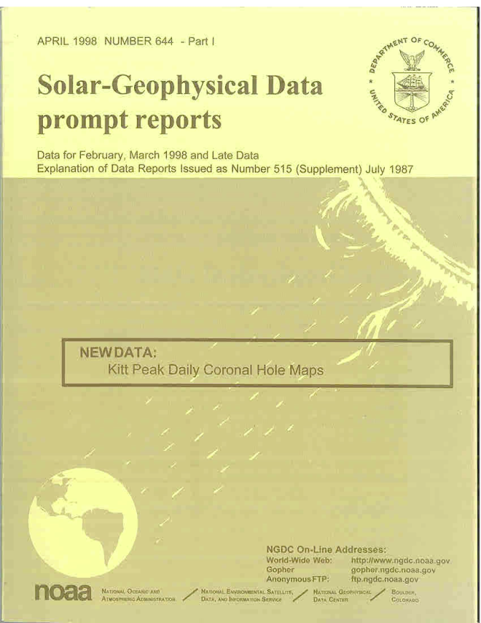
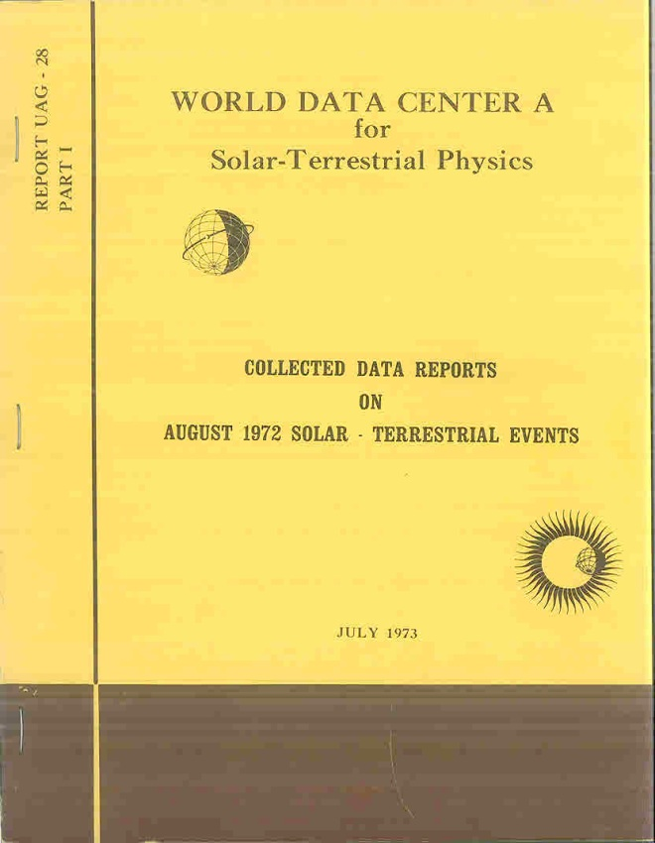
Operational SWx Data
WDC-STP – Historical Documents
Access: http://www.ngdc.noaa.gov/stp/solar/onlinepubl.html

Slide 29
Operational SWx Data
Summary
Space environmental data available from operational satellites and other platforms can be leveraged for space weather research
Available environmental data can be used for post event analysis of spacecraft anomalies
World Data System has now replaced the World Data Centers and is responsible for continued historical data preservation

