Slide 1
National Centers for Environmental Information (NCEI)
GOES 40 Years of Satellite Space Environmental Monitoring
W.F. Denig
National Centers for Environmental Information (NCEI)
NOAA/NESDIS
Boulder, Colorado
26 April 2016
Notes:
1

Slide 2
Abstract
GOES - 40 Years of Satellite Space Environmental Monitoring
For more than 40 years the Geostationary Operational Environmental Satellite (GOES) system has been the backbone of NOAA's space weather program by providing the data required by forecasters to issue alerts and warnings of potentially disruptive space weather. Prior to GOES space weather forecasters were forced to relied on a variety of ground-based assets and limited satellite data to provide assured radio communications and, as time evolved, numerous other dependent users. While the capabilities of the GOES spacecraft and sensors have steadily evolved over time, the program has remained the stalwart provider of solar and space environmental information that currently drives two of the three NOAA Space Weather Scales. The GOES-R series of spacecraft is the next phase of geostationary weather satellites for NOAA. The first in the series satellite, GOES-R, will launch in late 2016 and the projected lifetime of the series will continue out through 2036. The GOES-R space weather sensors will provide unprecedented capabilities for operations and research. In this talk I will trace the history of the GOES program starting from its humble beginnings to the premier space weather monitoring program that serves the needs of NOAA and, in many respects, the world-wide community of space weather forecasters and others.

Slide 3
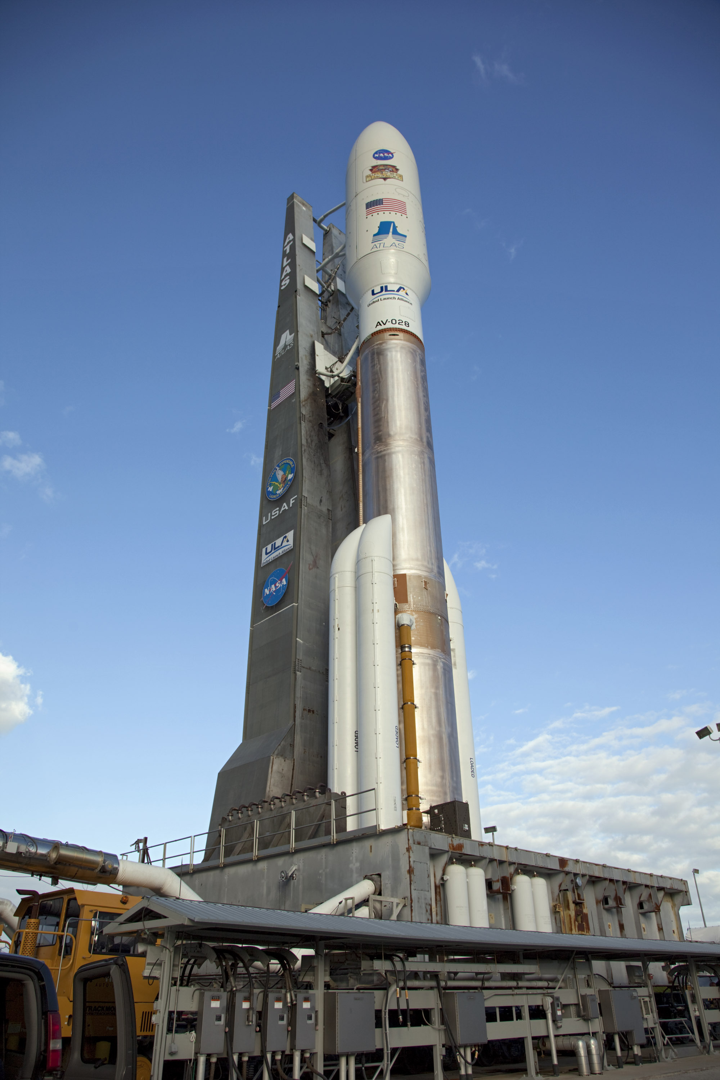
Upcoming GOES-R Launch
GOES-R is scheduled for a 13 Oct 2016 launch 21:43 GMT (17:43 EDT) from the Cape Canaveral Air Force Station. The GOES-R series of spacecraft will offer unprecedented operational capabilities for serving NOAA’s space weather mission.

Slide 4
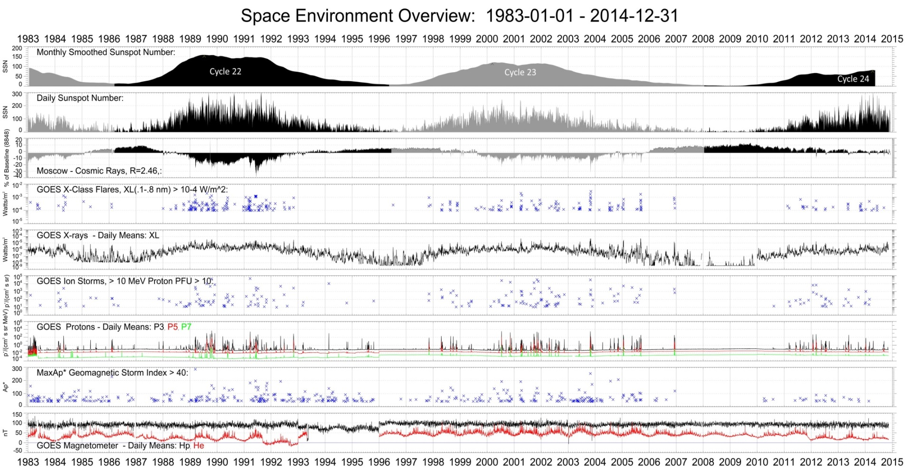
GOES-R – 40+ Years of SWx

Slide 5
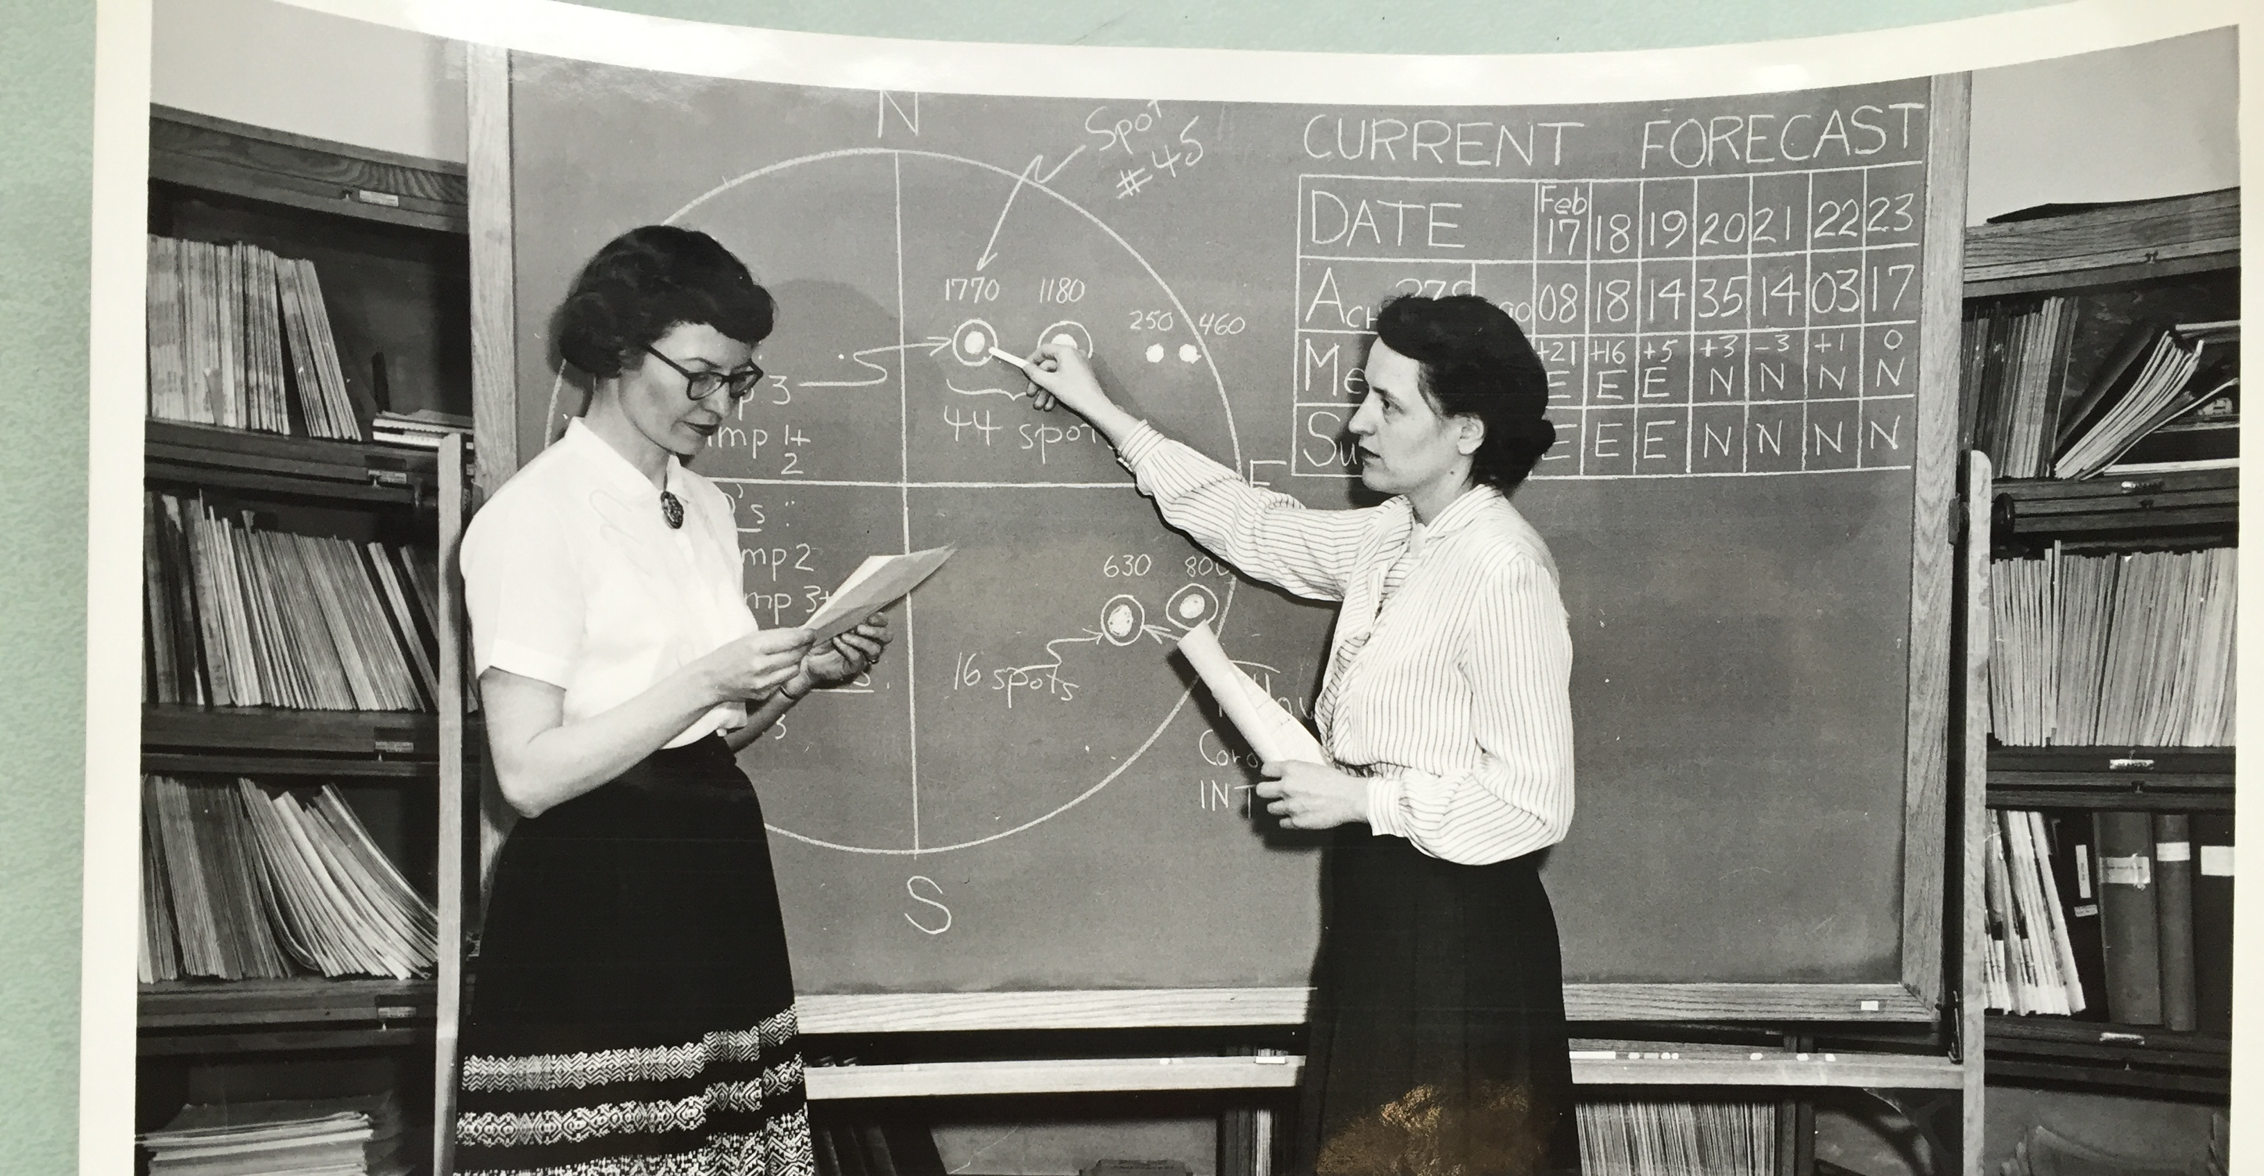
Long Range Communications
Marion Wood (left) and Hope Leighton (right) preparing the North Pacific Radio Propagation Forecast
Public Law 619 (July 22, 1950) – “authorizes the DOC to investigate conditions which affect the transmission of radio waves from their source to a receiver, the compilation and distribution of information on such transmission of radio waves as a basis for choice of frequencies to be used in radio operation, the prosecution of such research in engineering, mathematics, and the physical sciences.” See also 15 USC Section 1532 and DOO 10-15. (Reference the DOC’s High Latitude Monitoring Station)
Notes:
With the advent of radiowave communications in the 1900s both the presence and structure of the earth’s ionosphere were recognized as being vital to long-range communications as radiowaves were reflected, refracted and absorbed by the ionospheric medium. In 1929 the National Bureau of Standards (NBS) within the U.S. Department of Commerce (DOC) initiated a research program to study the vertical structure of the ionosphere. Radiowave communications became critical to the war effort during World War II which led to the formation of the NBS Inter-Service Radio Propagation Laboratory in 1942 [Gladdin, 1959]. It was known at the time that disturbances in the geospace originating from the sun affected technology systems such as communications but also power distribution, telegraphs and transportation systems [Odenwald, 2015]. The Central Radio Propagation Laboratory (CRPL) was created within the DOC in 1946 to centralize research and predictions in the field of radio propagation, investigating solar and geophysical effects and ionospheric data responsibilities [Norton, 1947]. Figure 2 is an undated NBS photograph depicting sunspot analysists preparing the North Pacific Radio Propagation Forecast (H. Coffey, private communication, 2016)
15 U.S.C. § 1532 - authorizes the DOC to conduct research on all telecommunication sciences, including wave propagation and reception, predictions of electromagnetic wave propagation condition and disturbances in such conditions, disseminating general scientific and technical data relating to these functions.“
DOO 10-15 - directs the NOAA Administrator to "observe, collect, communicate, analyze, and disseminate comprehensive data and information about the state of the upper and lower atmosphere, . . . and of the Earth, the Sun, and the space environment" and "operate and maintain a system for the storage, retrieval and dissemination of data regarding . . . the Earth, the Sun, and the space environment."
On 2/25/2016 1:07 PM, Helen Coffey wrote:
Hi Bill,
Re Sunspot Ladies -- Marion Wood and Hope Leighton -- preparing the North Pacific Radio Propagation Forecast
I talked with Hope Leighton about identifying the women in the sunspot ladies photo. She said the lady on the left is Marion Wood who worked with her back in the 1960s(?). Hope is indeed the woman on the right. Hope came to Boulder in 1954, after spending some years in Alaska doing the NPRP forecasts for J. Virginia Lincoln beginning in 1951. She worked for JVL in Boulder, first in CRPL and later ESSA, then NOAA.
From the information on the blackboard in the photo, I'm trying to determine a date of the Forecast (February). The daily sunspot drawings are scarce back then, but I'll keep looking. I almost think it's 1959, but want to look further.
Also, there may be some information about the North Pacific Radio Propagation data in the NGDC archives (maybe SGD Descriptive Texts). I'll try checking for this. It's probably a one week forecast. Hope is going blind and had some help from her nephew, but she is sure about the identification of the women.
--Helen

Slide 6
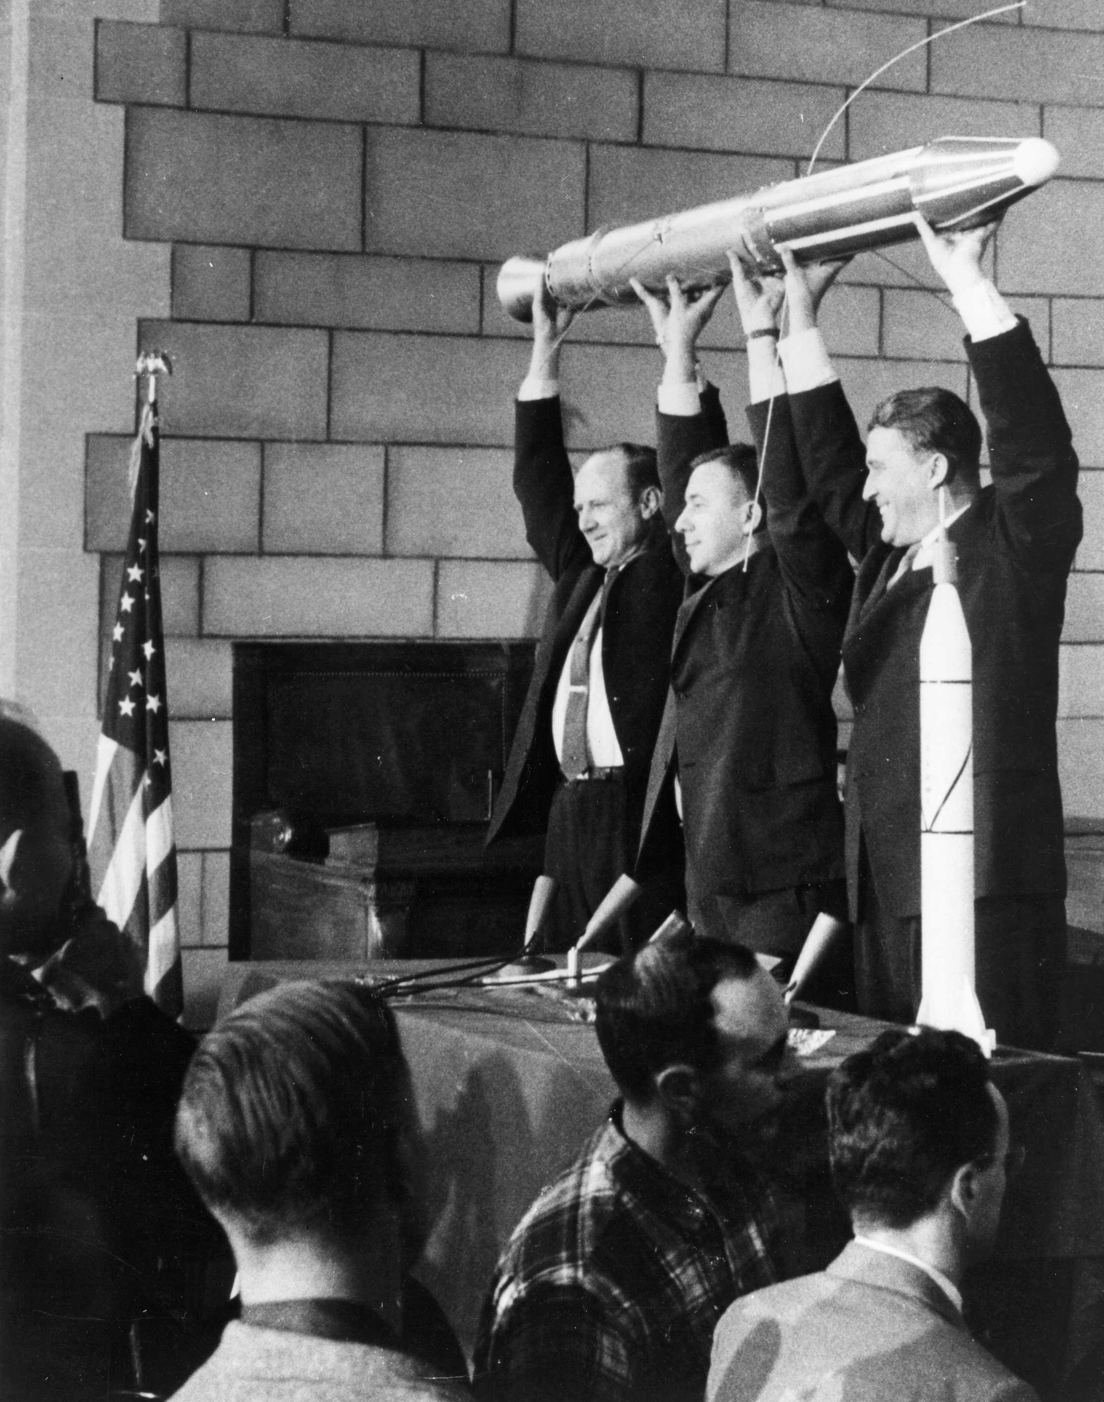
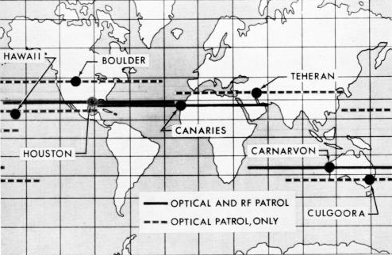
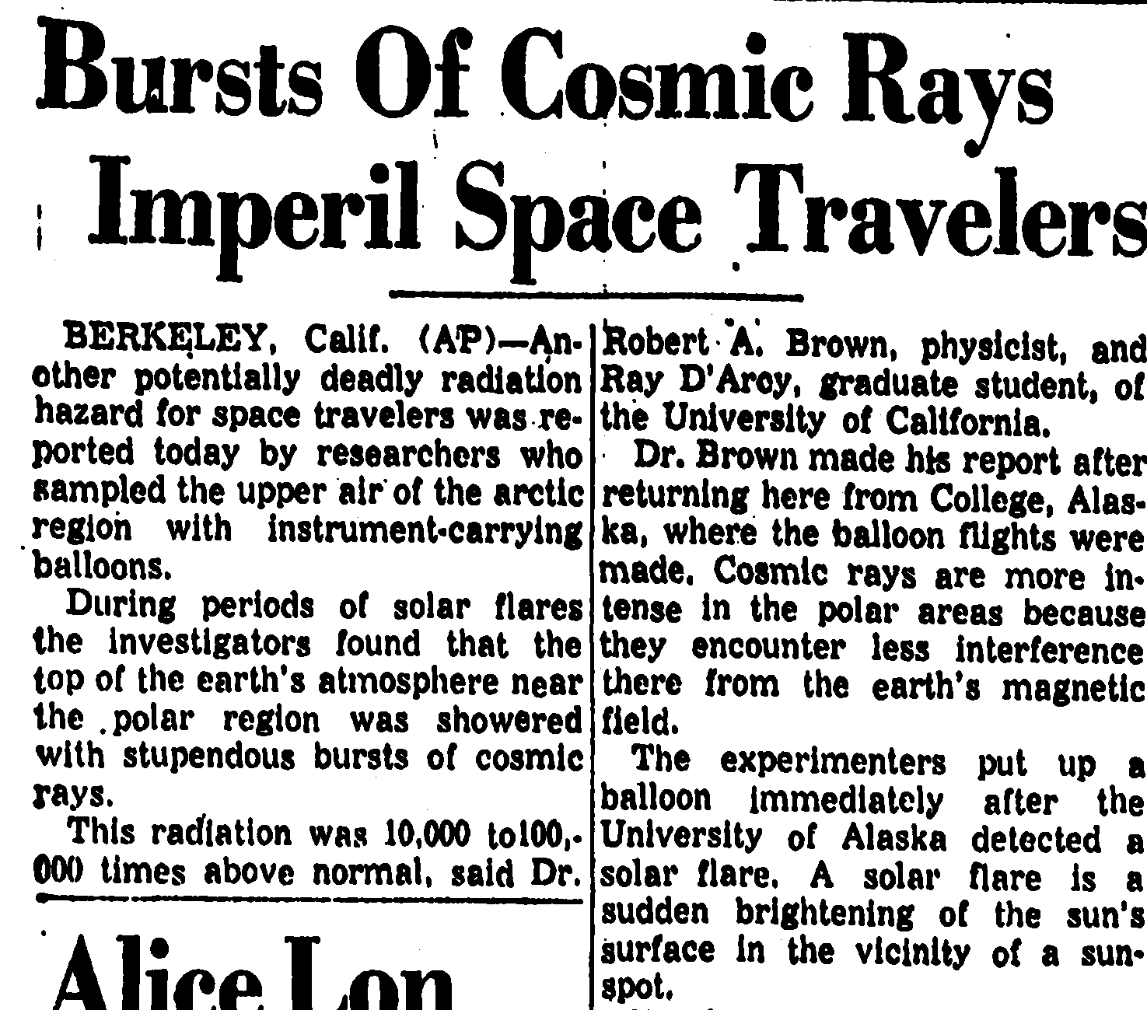
Astronaut Health and Safety
Space radiation exposure was recognized as a risk that needed to be considered for manned spaceflight. In 1960 NASA established the Solar Particle Alert Network (SPAN). During Apollo missions SPAN data were relayed to the Space Environment Console at the Mission Control Center in Houston, Tx. (also AF SOFNET/SEON)
William Pickering
James Van Allen
Wernher von Braun
Trenton Times
(15 Oct 1959)
Robbins and Reid (1969)
Notes:
In 1958, at the dawn of the space age, rocket scientists made another startling discovery that the space environment was “radioactive” in the sense that energetic charged particles were an inherent and ubiquitous feature of space [McDonald and Naugle, 2008]. Figure 3 is a popular photograph depicting James Van Allen (center) between William Pickering (left) and Wernher von Braun (right) holding a replica of the Explorer I satellite. Using data from Explorer 1 satellite Dr. Van Allen theorized the existance of the Earth’s radiation belts that now bear his name. Following this discovery it was soon recognized that space radiation would have an impact on manned spaceflight and that real-time monitoring of the near-earth space environment was necessary to safeguard astronaut health and safety. As our knowledge of space weather matured we came to understand that the near-earth space environment was enveloped in various sources and levels of energetic charged particle radiation and that the terrestrial magnetic field provided a protective shield that blocked most, but not all, of the incoming radiation at the surface. NASA’s main concern at the time was that Apollo astronauts traveling outside this protective shield would be exposed to elevated fluxes of particles emitted from the sun during solar flares. A goal for space weather operations at the time was to monitor and forecast the occurrence of solar particles events in order to minimize astronaut risk.

Slide 7
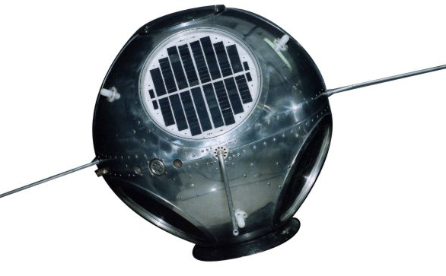
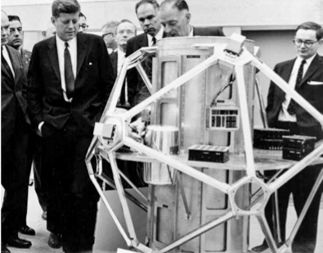
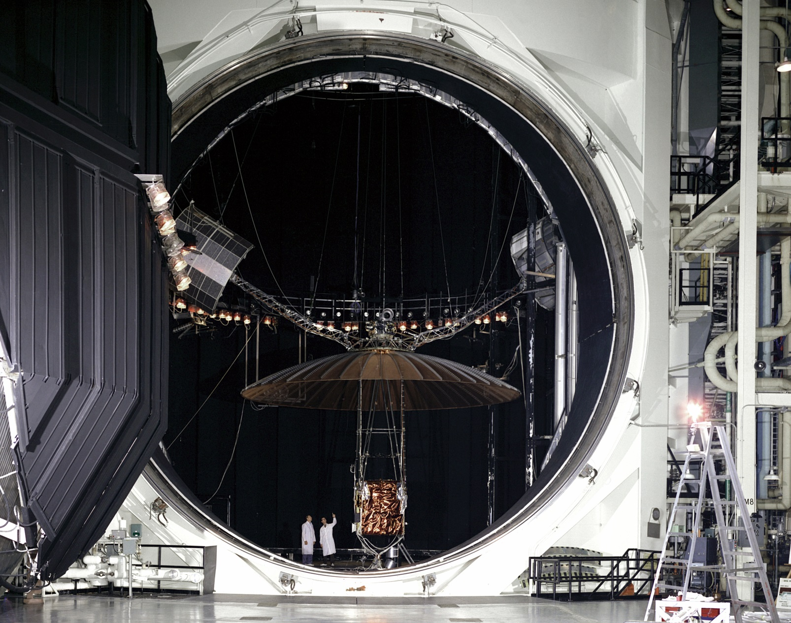
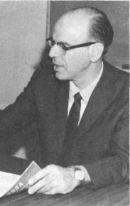
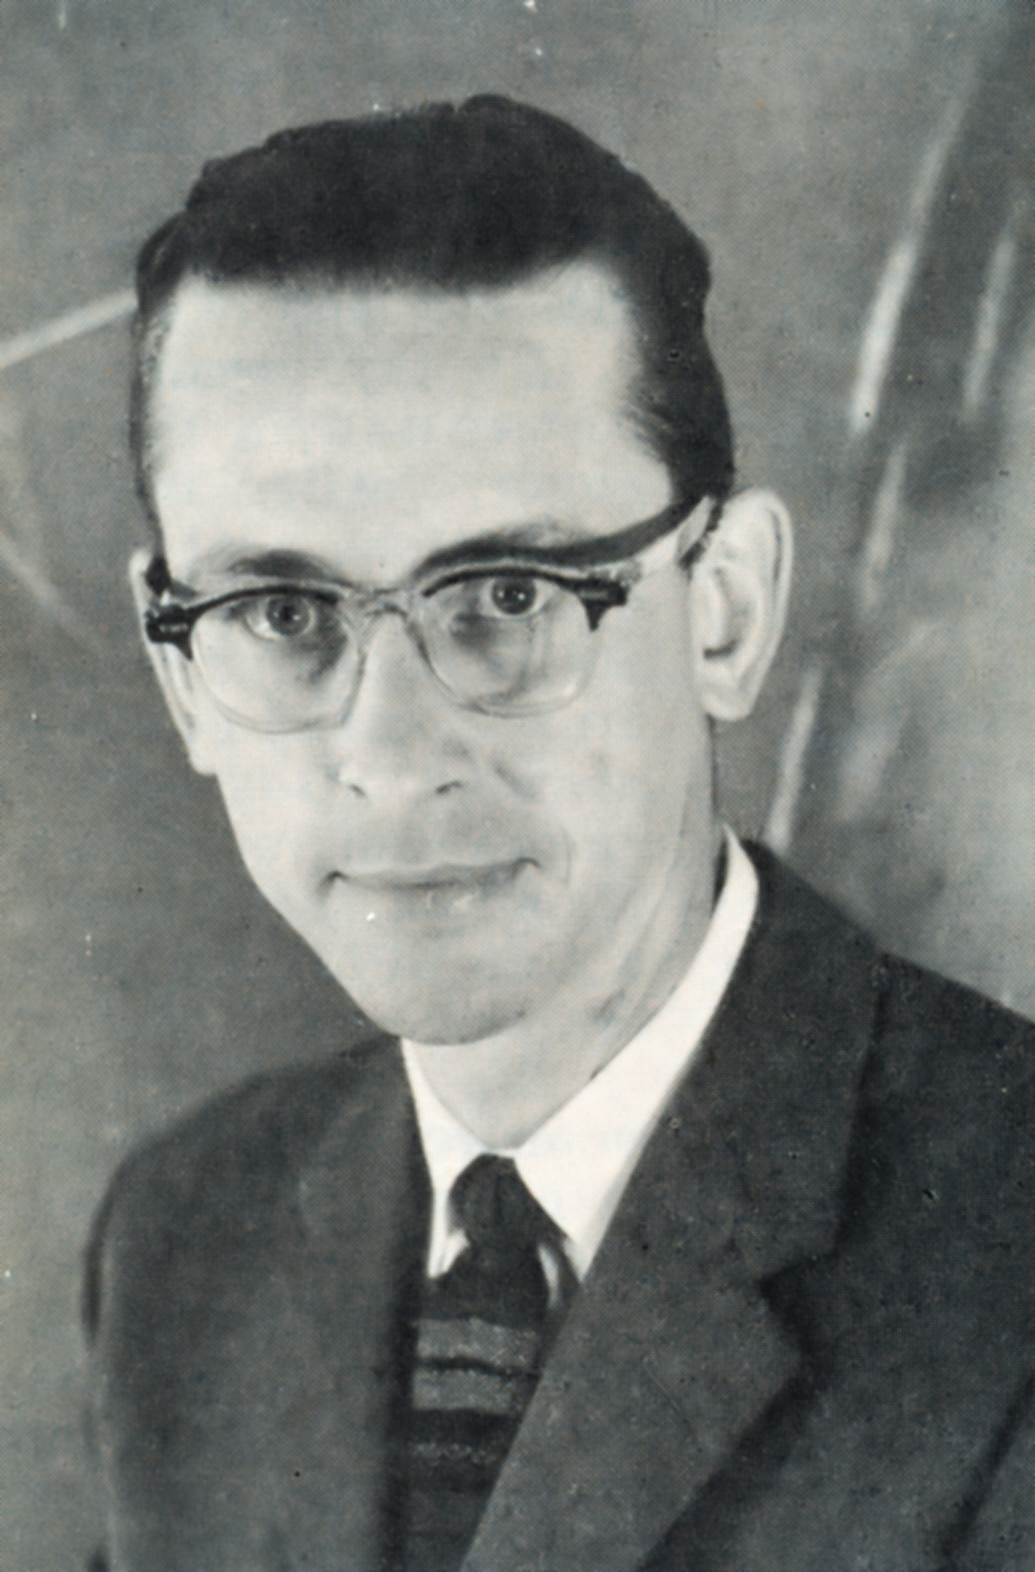
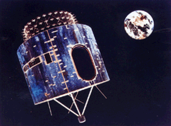
Before GOES – Early Satellites
SOLar RADiation (SOLRAD, 1960-1976) – Determined relationship between solar x-rays and radio-wave fadeouts. Non operational.
Memorandum to David Johnson from George Benton (04 Mar 1969)
NRL
“I am pleased to submit to you in outline our firm requirements for operational space disturbance monitoring from the first GOES satellite. These are for operational monitoring of energetic protons, alpha particles and solar x-rays in the 1 – 8 and 0.5 – 3 Angstrom bands.”
Vela Hotel (She Watches Over, 1963-1971) – 1963 Partial Test Ban Treaty compliance but detected solar events.
Sandia
Advanced Technology Satellites (ATS, 1966-1977) – Demonstrated utility of geosynchronous orbit for meteorological monitoring.
Synchronous Meteorological Satellites (1974-1979) – Immediate predecessor to GOES; Identical to GOES 1-3
Dr. George Benton
ESSA Research
Laboratories (ERL)
David Johnson
National Environmental
Satellite Center (NESC)
(unsigned file copy, courtesy Dick Grubb)

Slide 8
GOES Flyout Chart

Slide 9
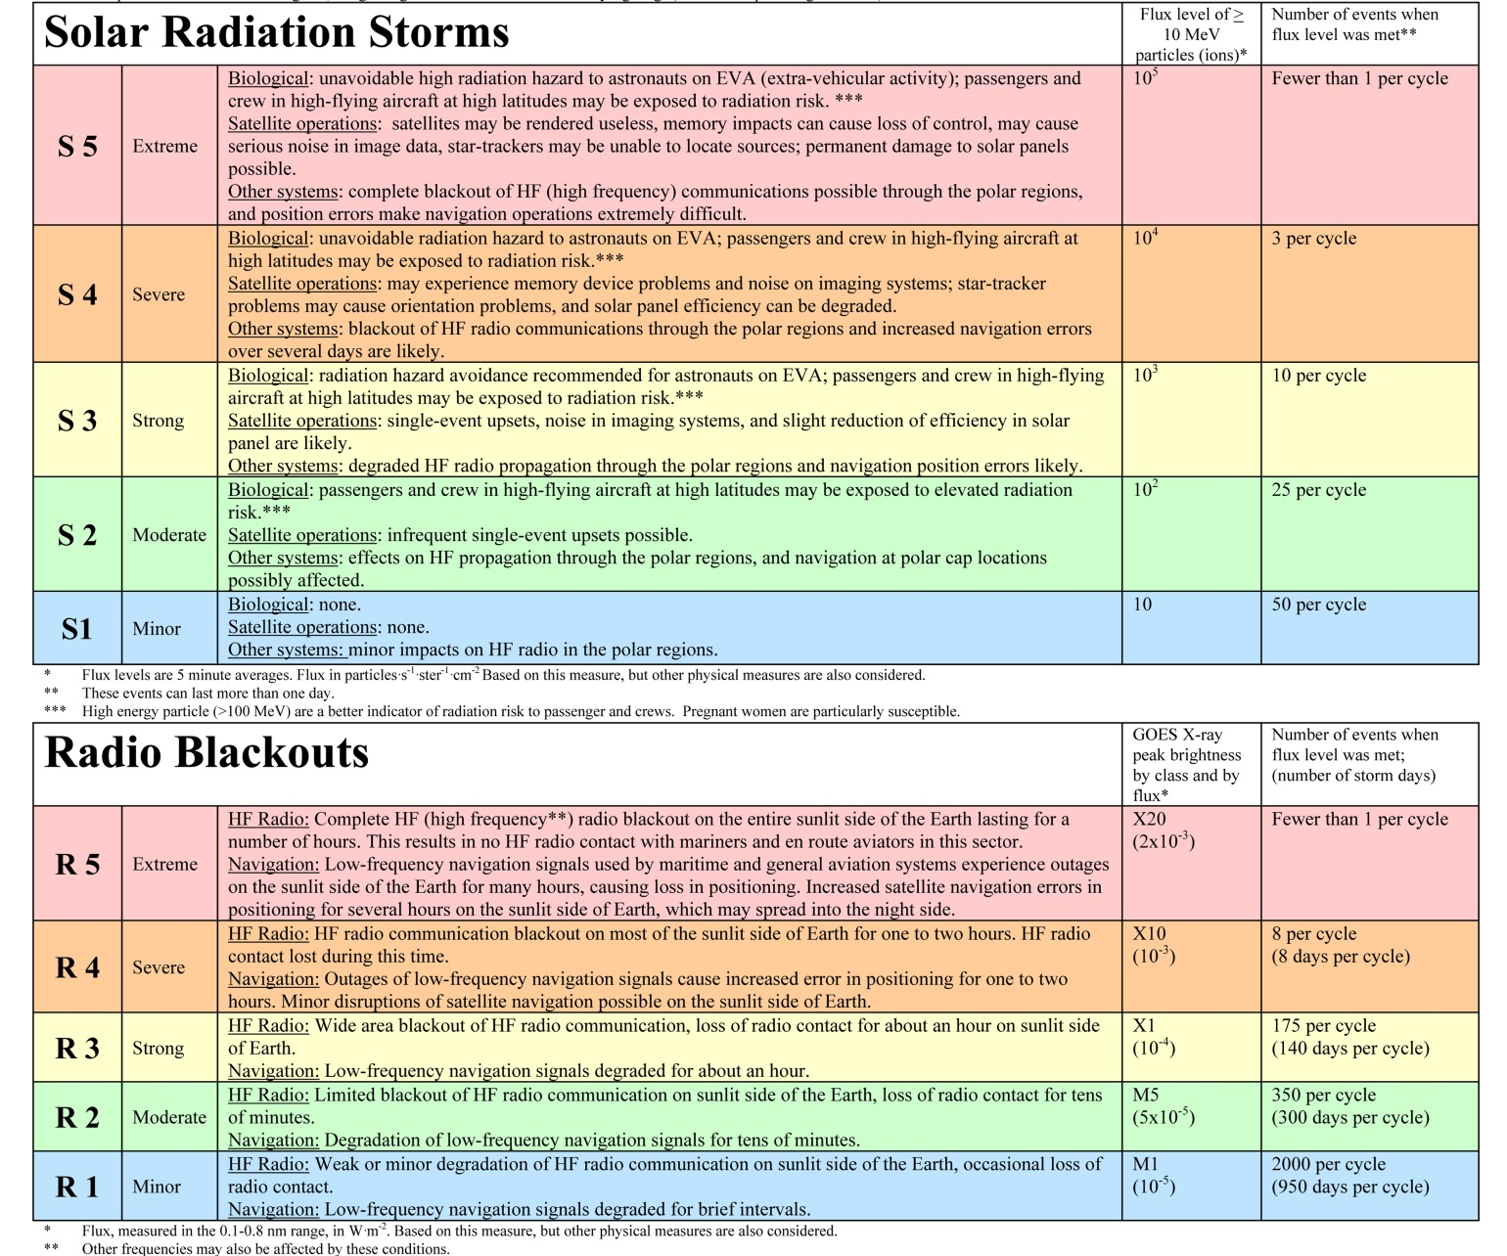
NOAA Space Weather Scales
GOES
Particles
GOES
X-rays

Slide 10
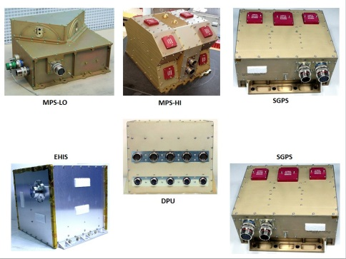
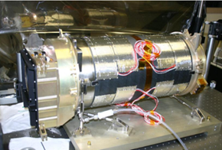
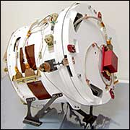
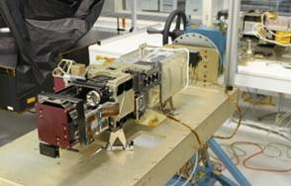
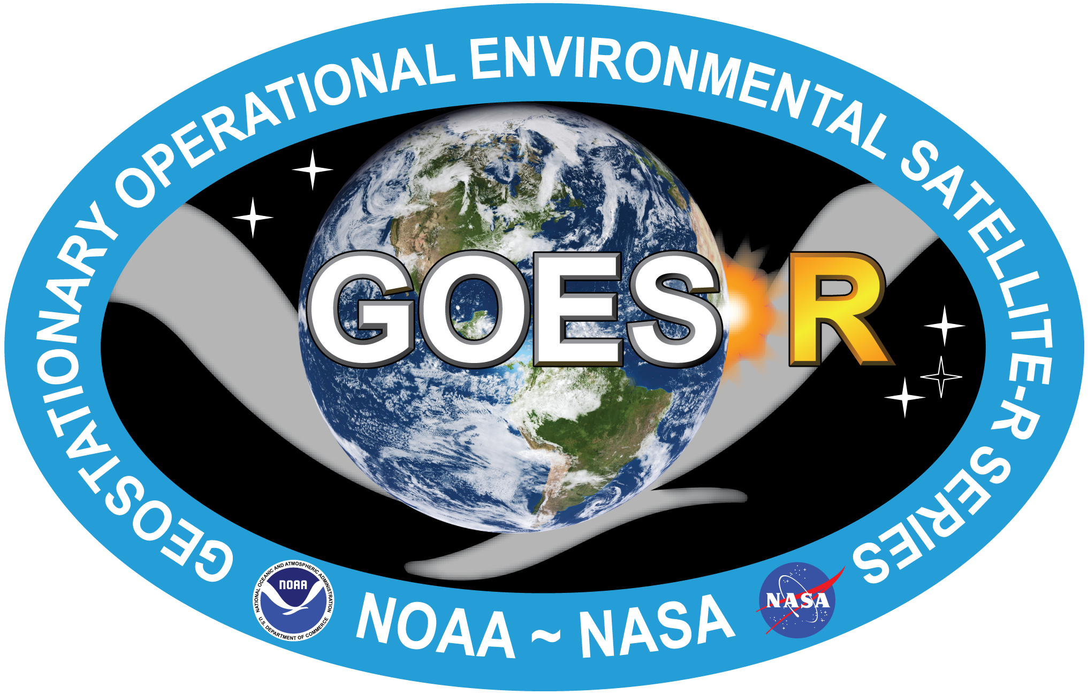
Space Weather Sensors
GOES-R
Space Environmental In-Situ Suite
(SEISS)
Solar Ultra-Violet Imager
(SUVI)
Magnetometer
MAG
EUV and X-ray Irradiance Sensors
(EXIS)

Slide 11
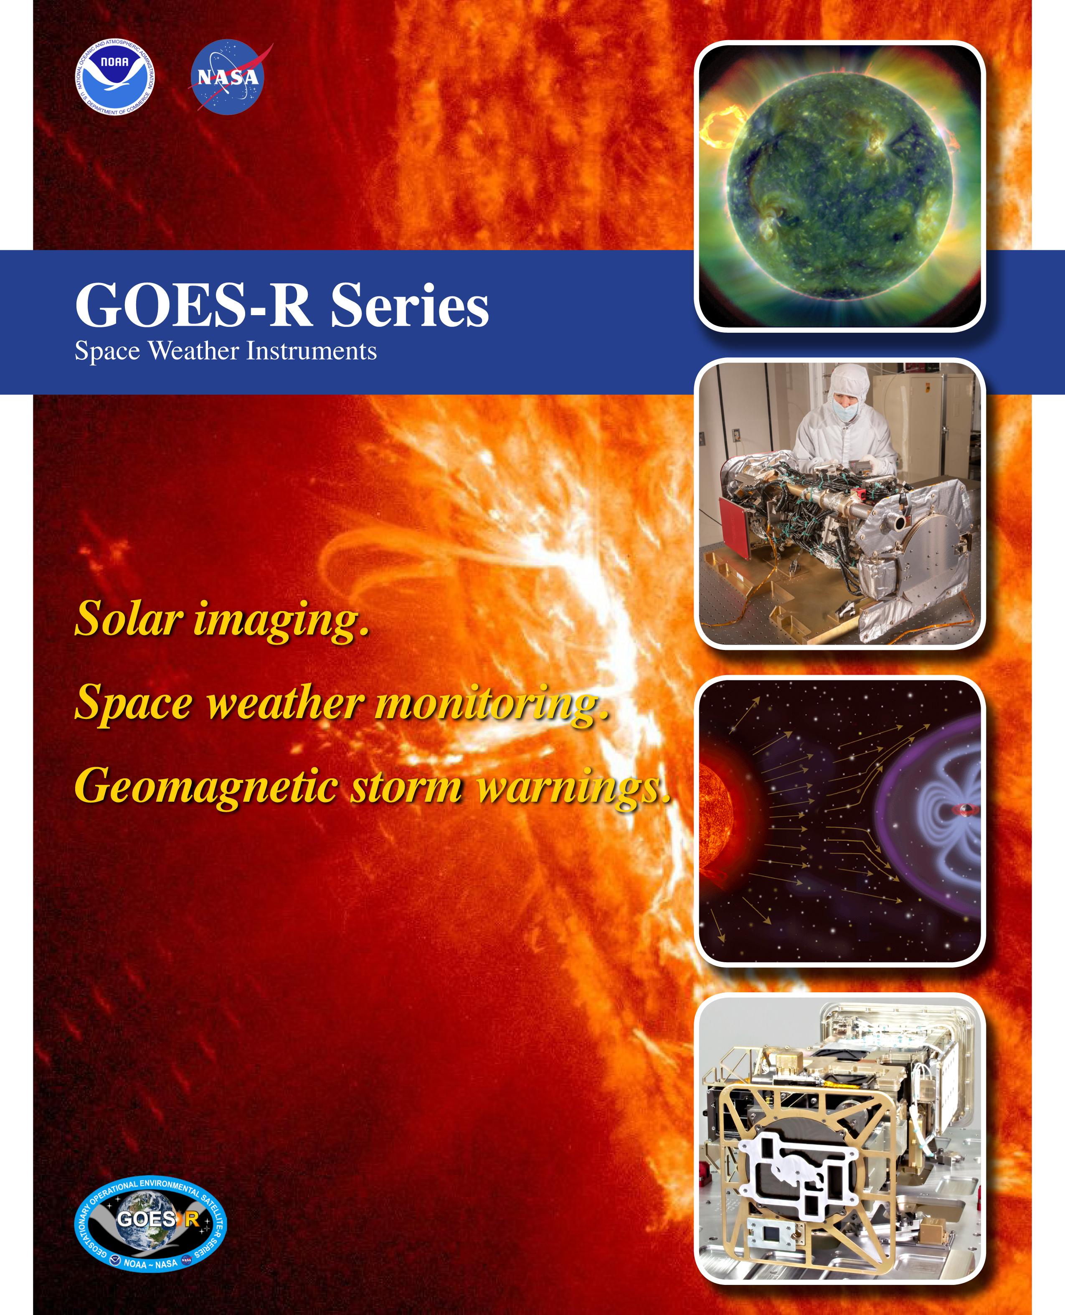
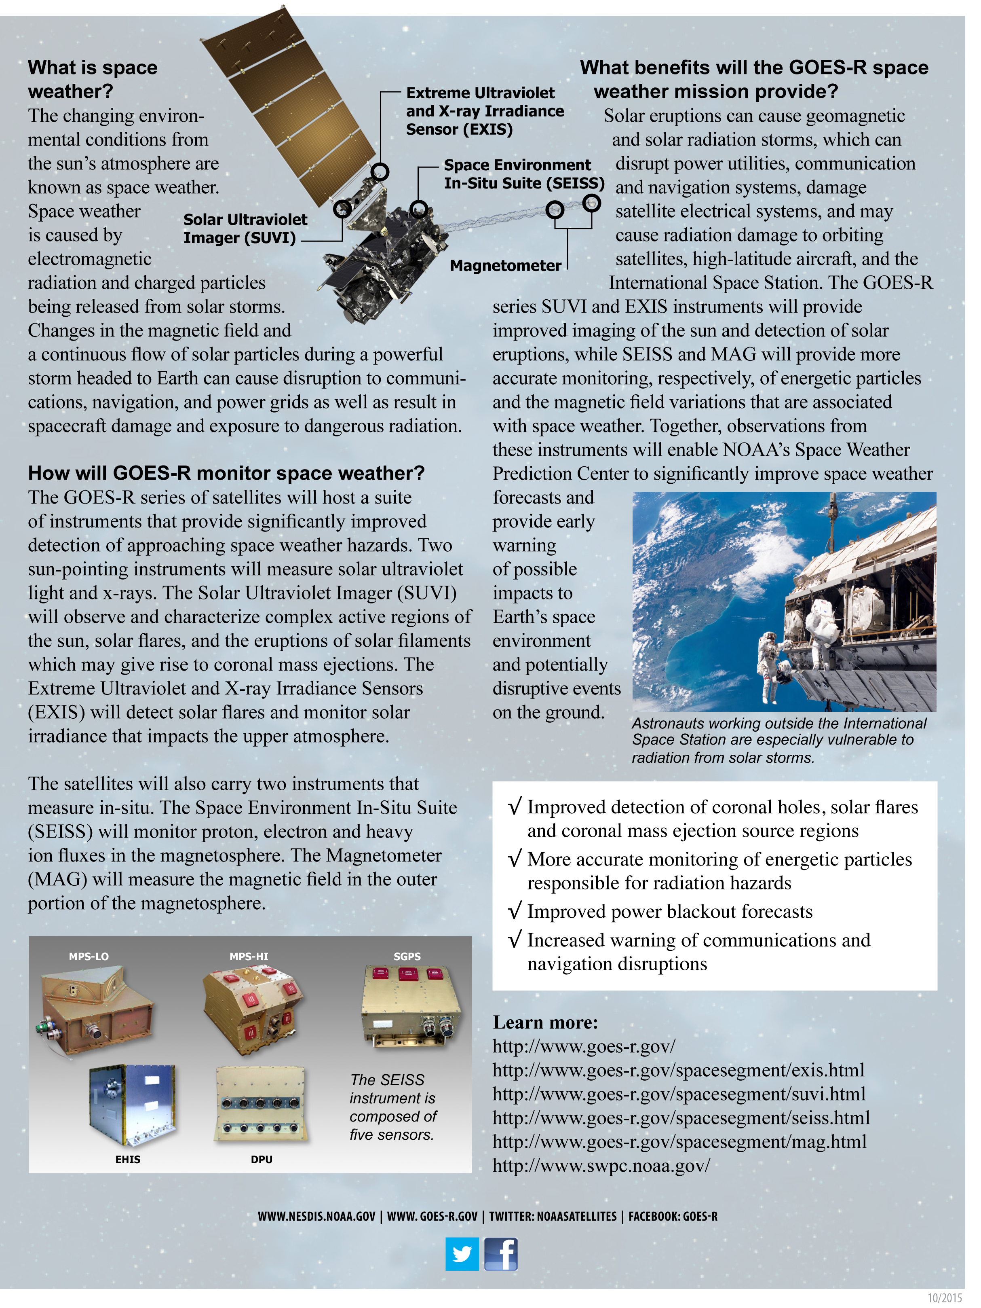
GOES-R SWx Handout

Slide 12
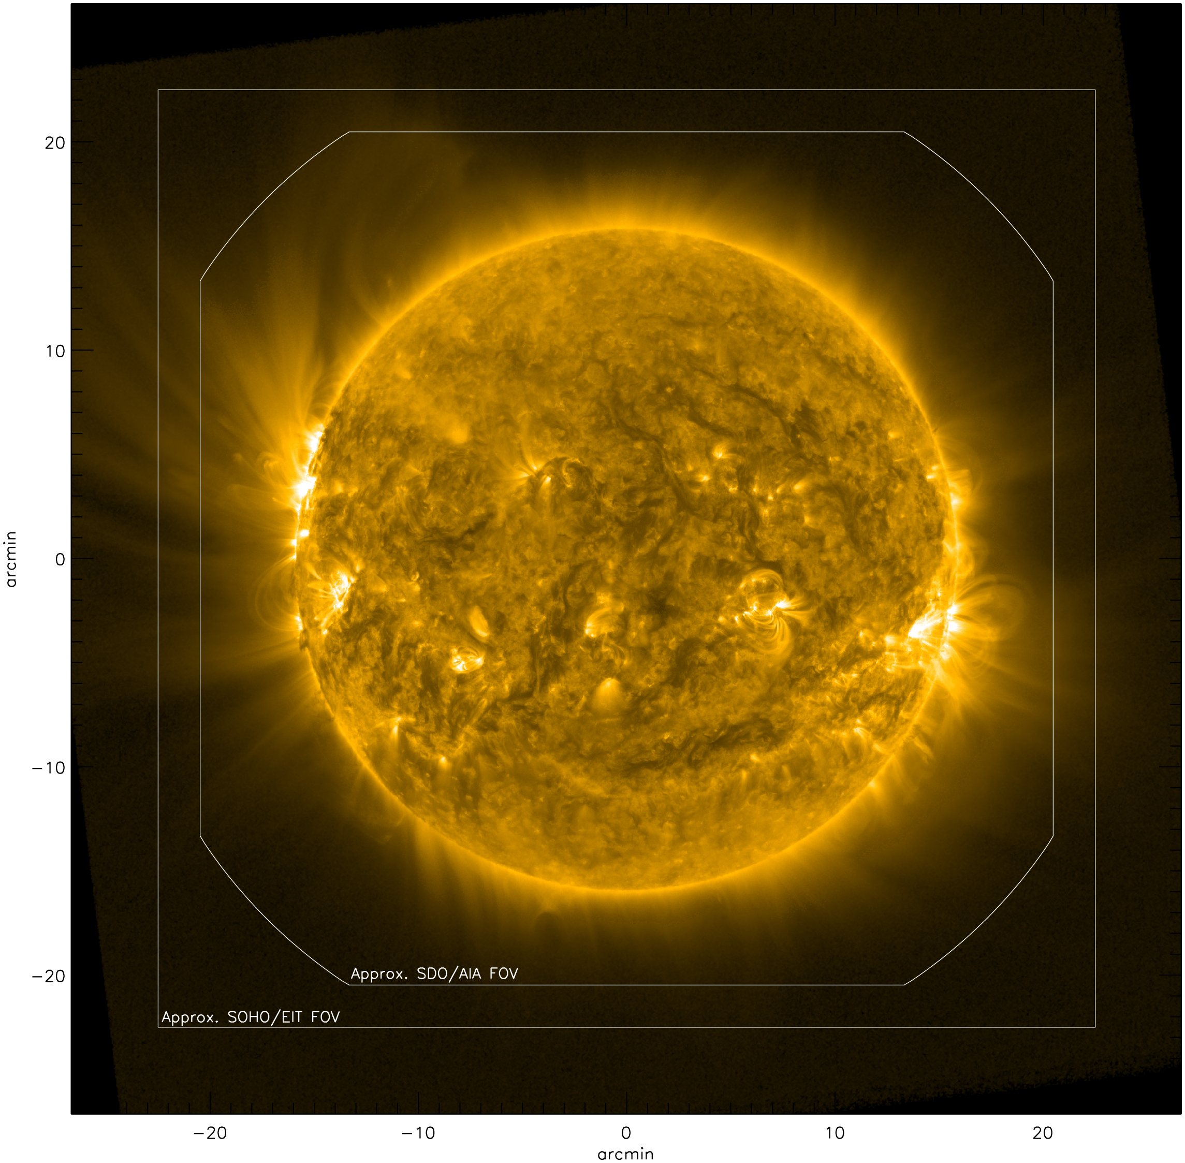
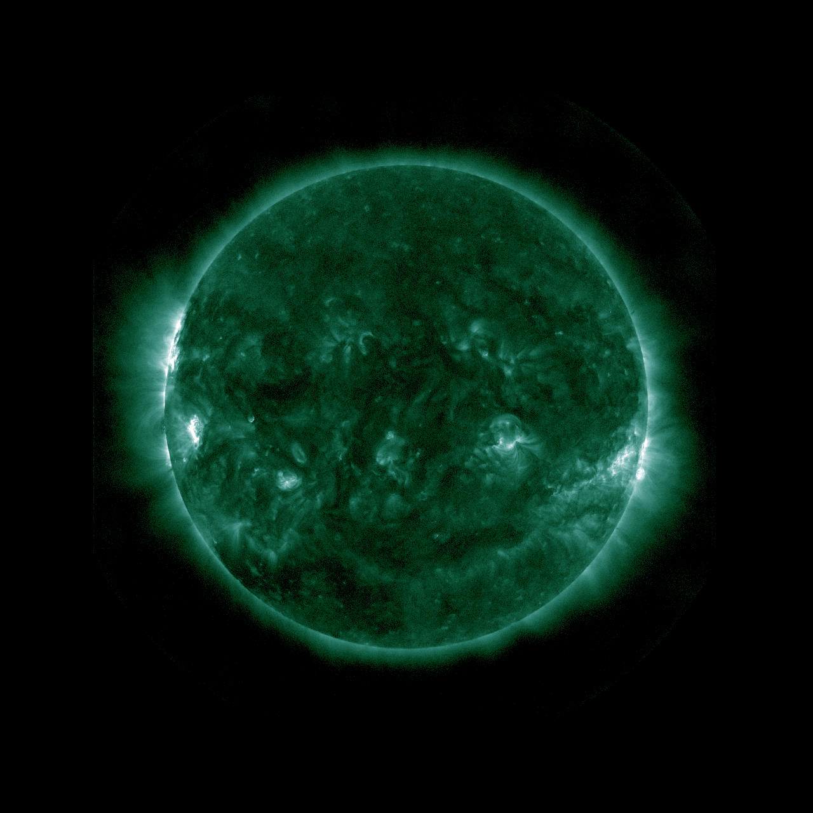
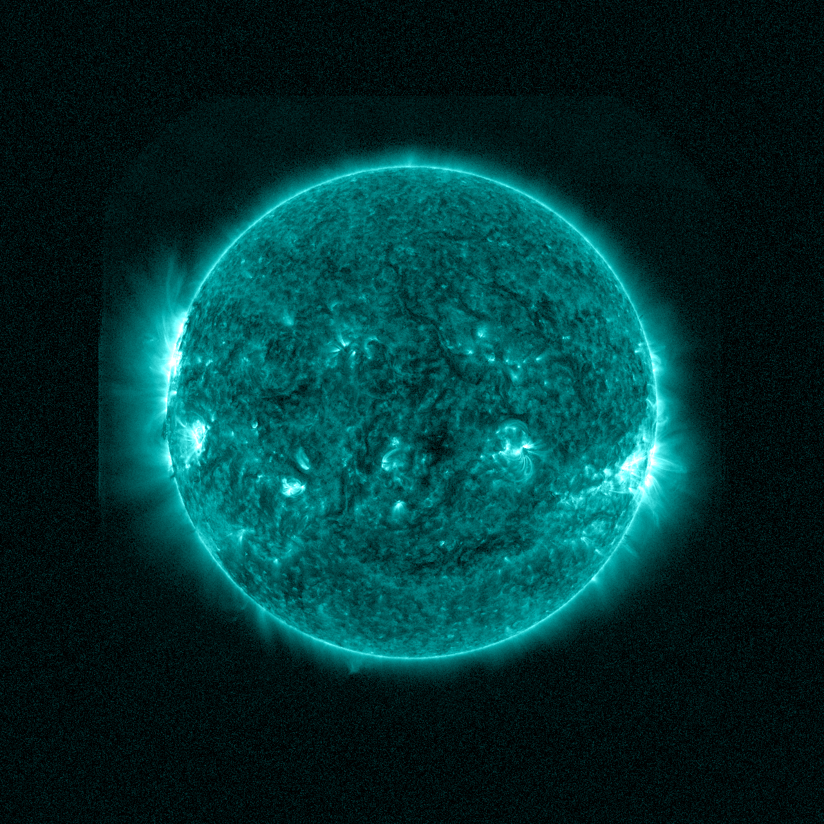
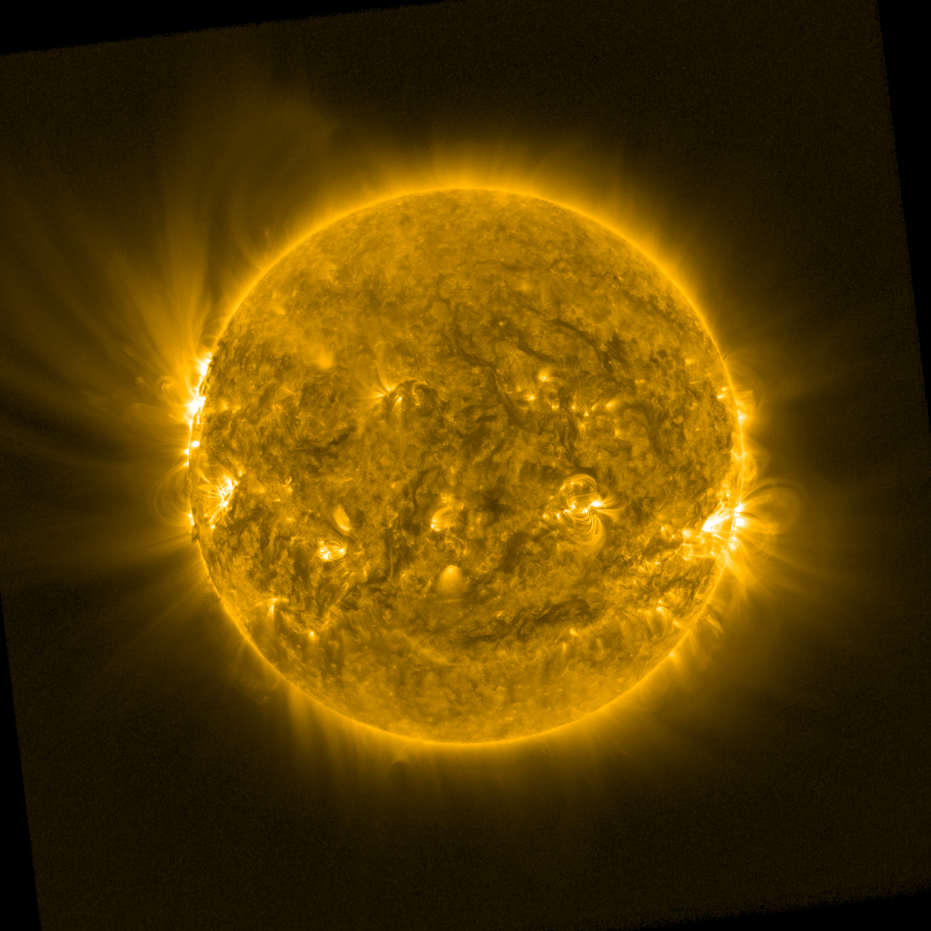
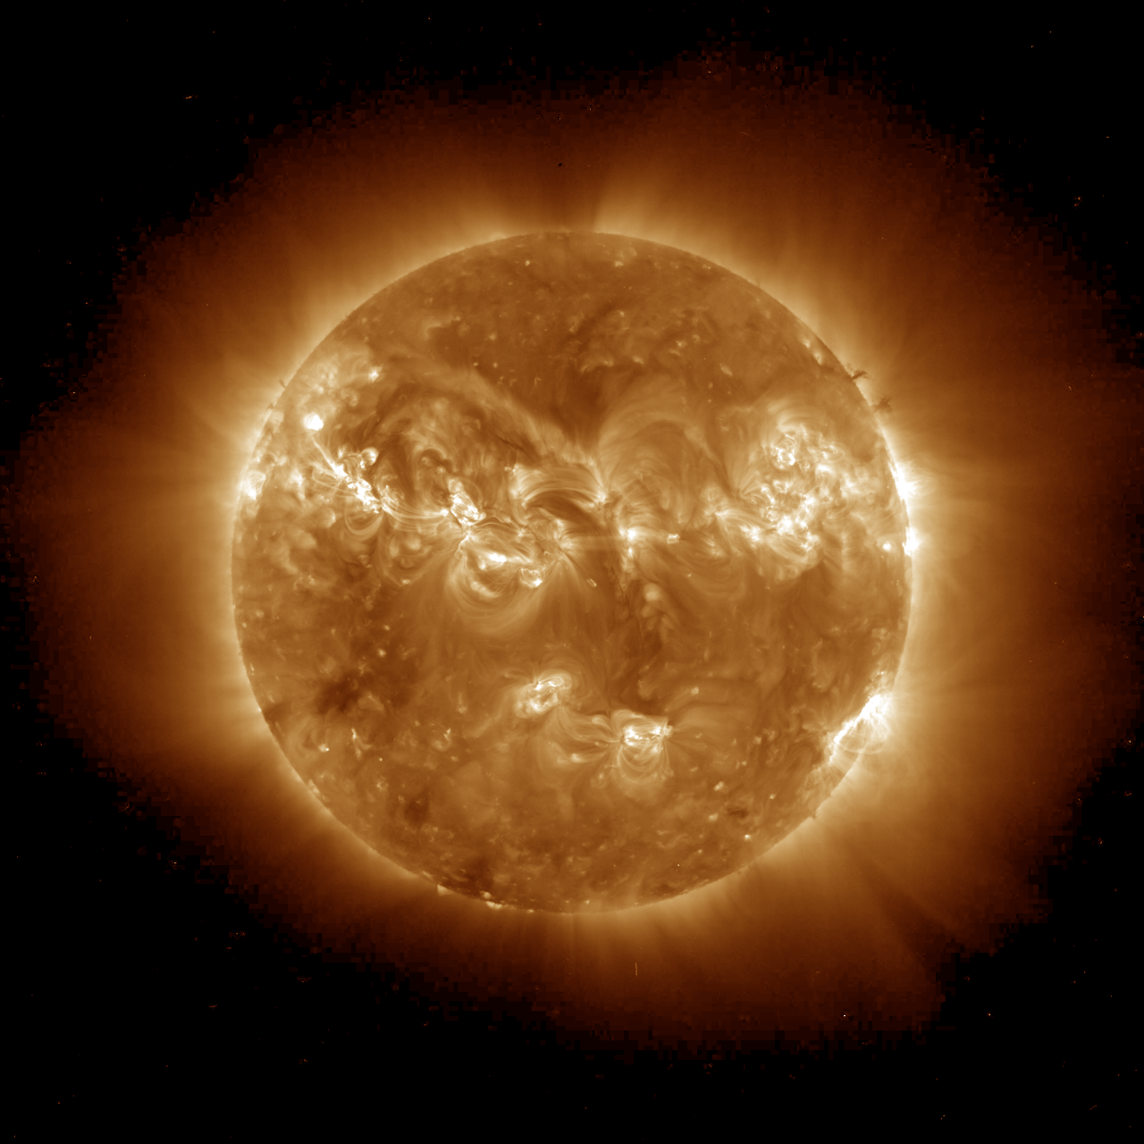
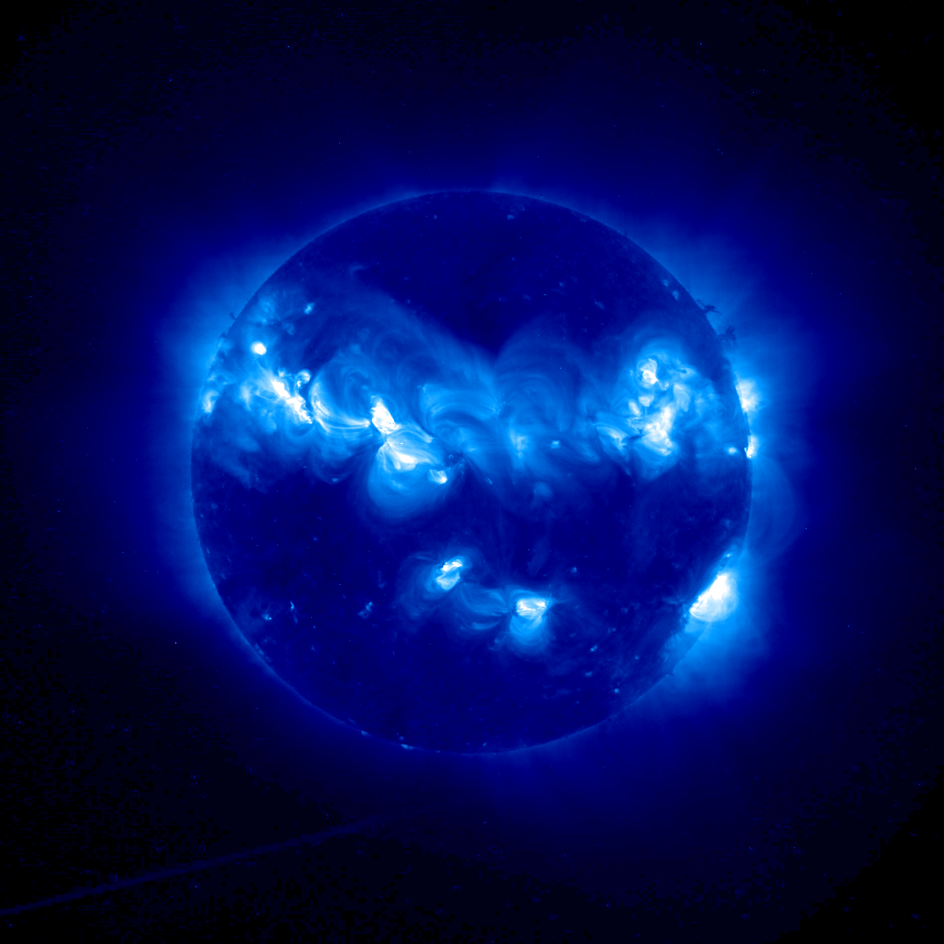
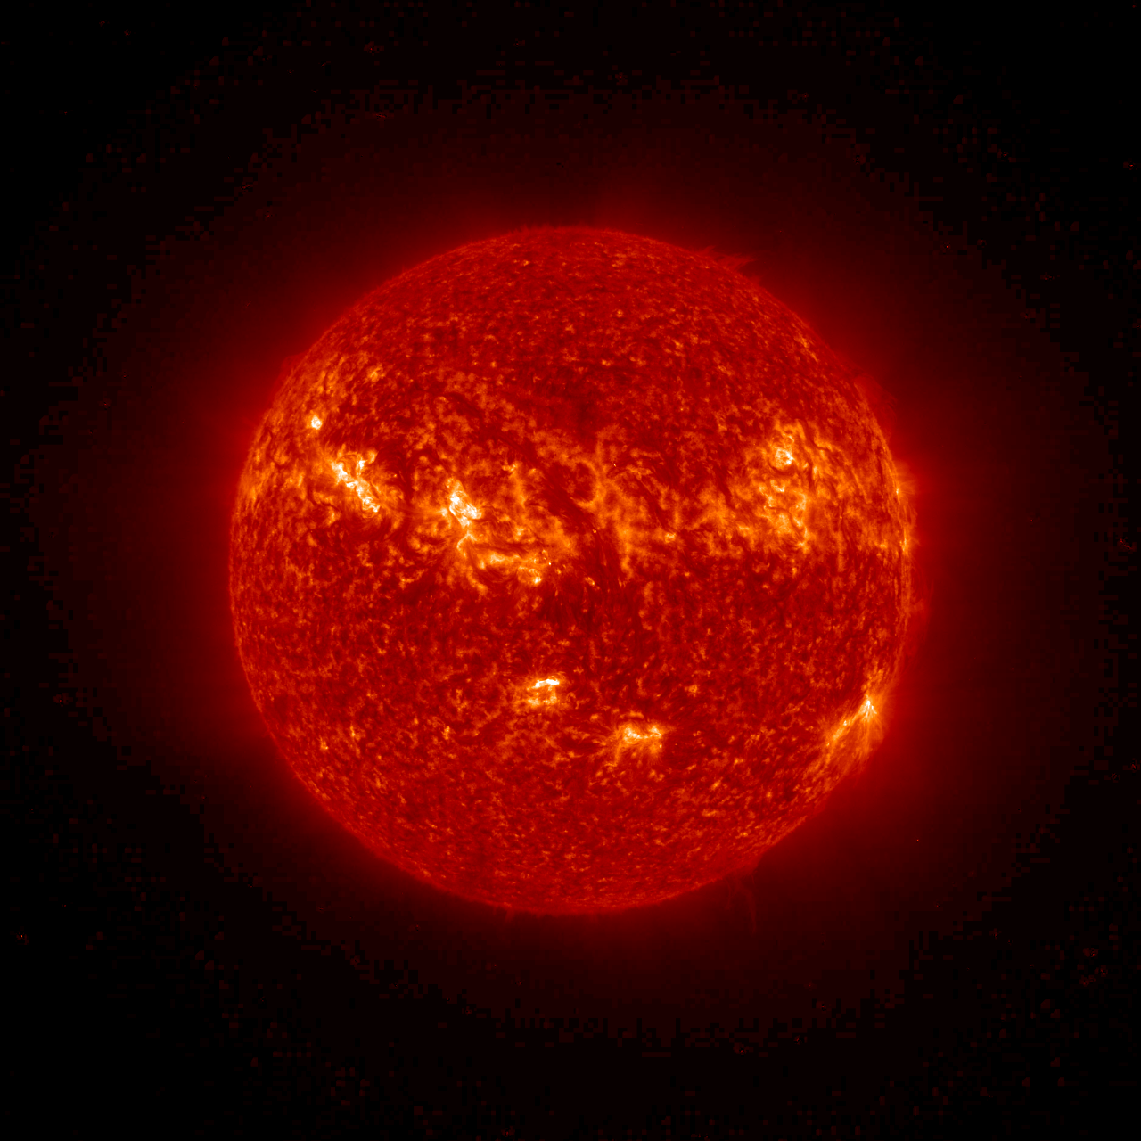
SUVI Overview
GOES-R shifts current x-ray imagery to the ultraviolet for improved solar feature characterization. Wavelength bands comparable to SDO/AIA.
Overlapping Fields of View
93 Å
131 Å
171 Å
Flaring Regions
(Fe XVIII)
Flaring Regions
(Fe VIII / XX / XXIII)
Transition Region
(Fe IX)
195 Å
284 Å
304 Å
Corona
(Fe XII / XXIV)
Flaring Regions
(Fe XV)
Chromosphere
(He II)
Simulated SUVI image at 171 Angstroms (Fe IX)
Transition Region (chromosphere-corona)
Notes:
SDO – Solar Dynamics Observatory “http://sdo.gsfc.nasa.gov/”
AIA - Atmospheric Imaging Assembly “http://aia.lmsal.com/”
SOHO – Solar & Heliospheric Observatory “https://www.nasa.gov/mission_pages/soho/index.html”
EIT - Extreme ultraviolet Imaging Telescope “http://umbra.nascom.nasa.gov/eit/’
Fe – Iron
A – Angstrom
He - Helium

Slide 13
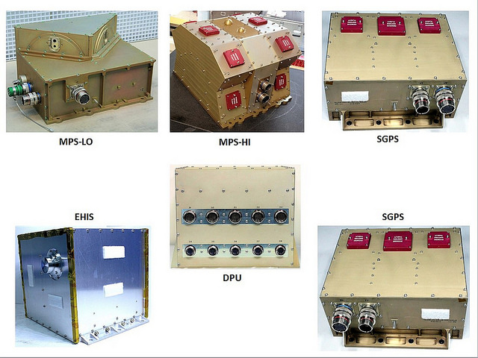
SEISS Overview
Instrument | Species | Energy Range
MPS-LO | Ions | 0.03-30 keV
MPS-LO | Electrons | 0.03-30 keV
MPS-HI | Protons (H+) | 80-10,000 keV
MPS-HI | Electrons | 50-4000 keV and >2000 keV
SGPS | Protons (H+) | 1-500 MeV and >500 MeV
EHIS | Ions (H through Ni, separately resolved) | 10-200 MeV/nucleon
Improvements over current SEM:
Low-energy range for surface charging.
Ion mass discrimination at high energies.
Overall improved energy resolution.

Slide 14
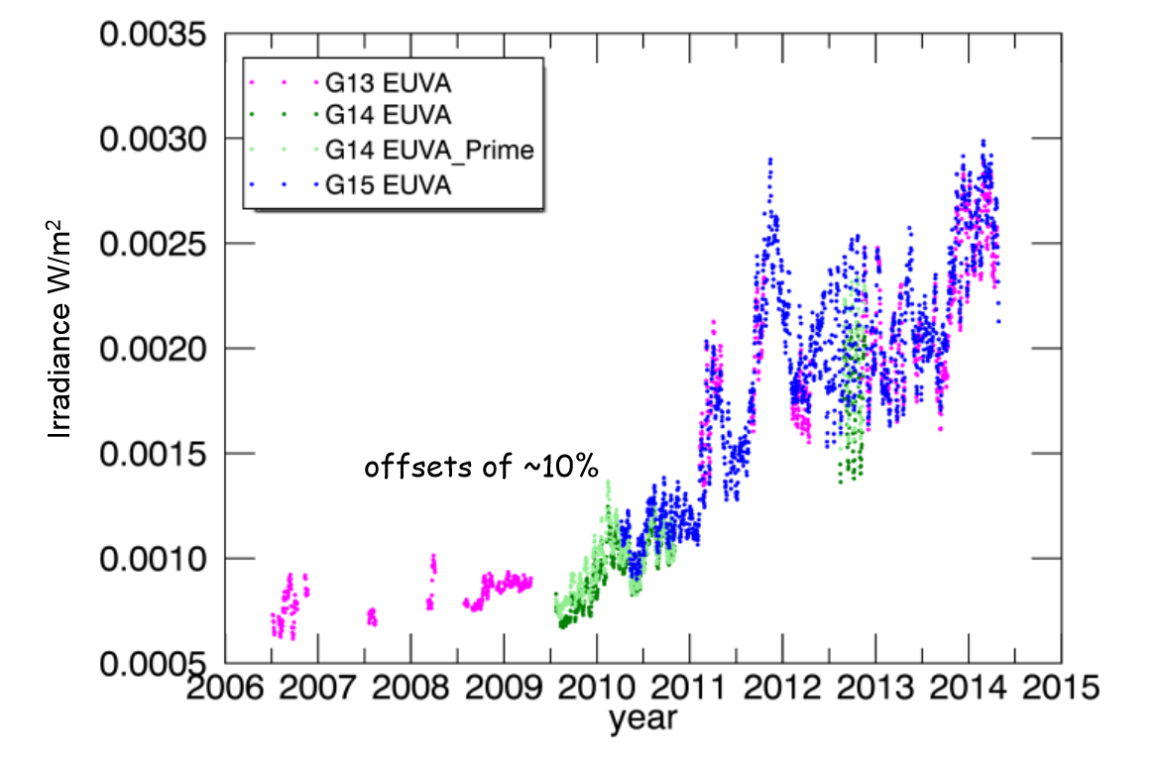
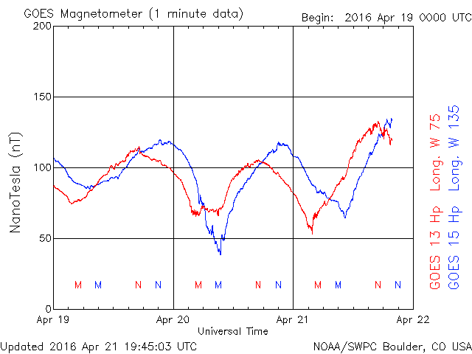
EXIS and MAG
Extreme Ultraviolet and X-ray Sensor
EUVS will set the standard for continuous monitoring of solar EUV irradiance.
Intensity and location of x-ray flares will be measured by the XRS.
EUVS (EUV sensor) // XRS (X-ray sensor)
Magnetometer¹
Dayside Measurements – MAG will detect magnetopause crossing events for standoff distances within the GEO orbit.
Nightside Measurements – Alert operators to the occurrence of geomagnetic substorms.
¹Boom-mounted gradiometer approach.
Diurnal variation of the terrestrial magnetic field at GEO
GOES 13 @ 75 W // GOES 15 @ 135W
Inter-calibration and Degradation Workshop Belgium Solar-Terrestrial Center of Excellence (10-13 June 2014).

Slide 15
Product Availability (L1b)
Nominal L1b Product Validation Schedule
Launch
2016/287
13 Oct 2016
Initial Product Release/L+139
Product Release
2017/60
01 Mar 2017
SEISS L1b
SUVI L1b
Initial Product Release/L+78
Beta
Provisiona;
Validated
2016/365
30 Dec 2016
EXIS L1b
Beta
Initial Product Release/L+90
Provisional
Validated
2017/11
11 Jan 2017
MAG L1b
Beta
Initial Product Release/L+92
Provisional
Validated
2017/13
13 Jan 2017
Beta
Provisional
Validated
AGU – 12-16 Dec 2016
AMS – 22-26 Jan 2017

Slide 16
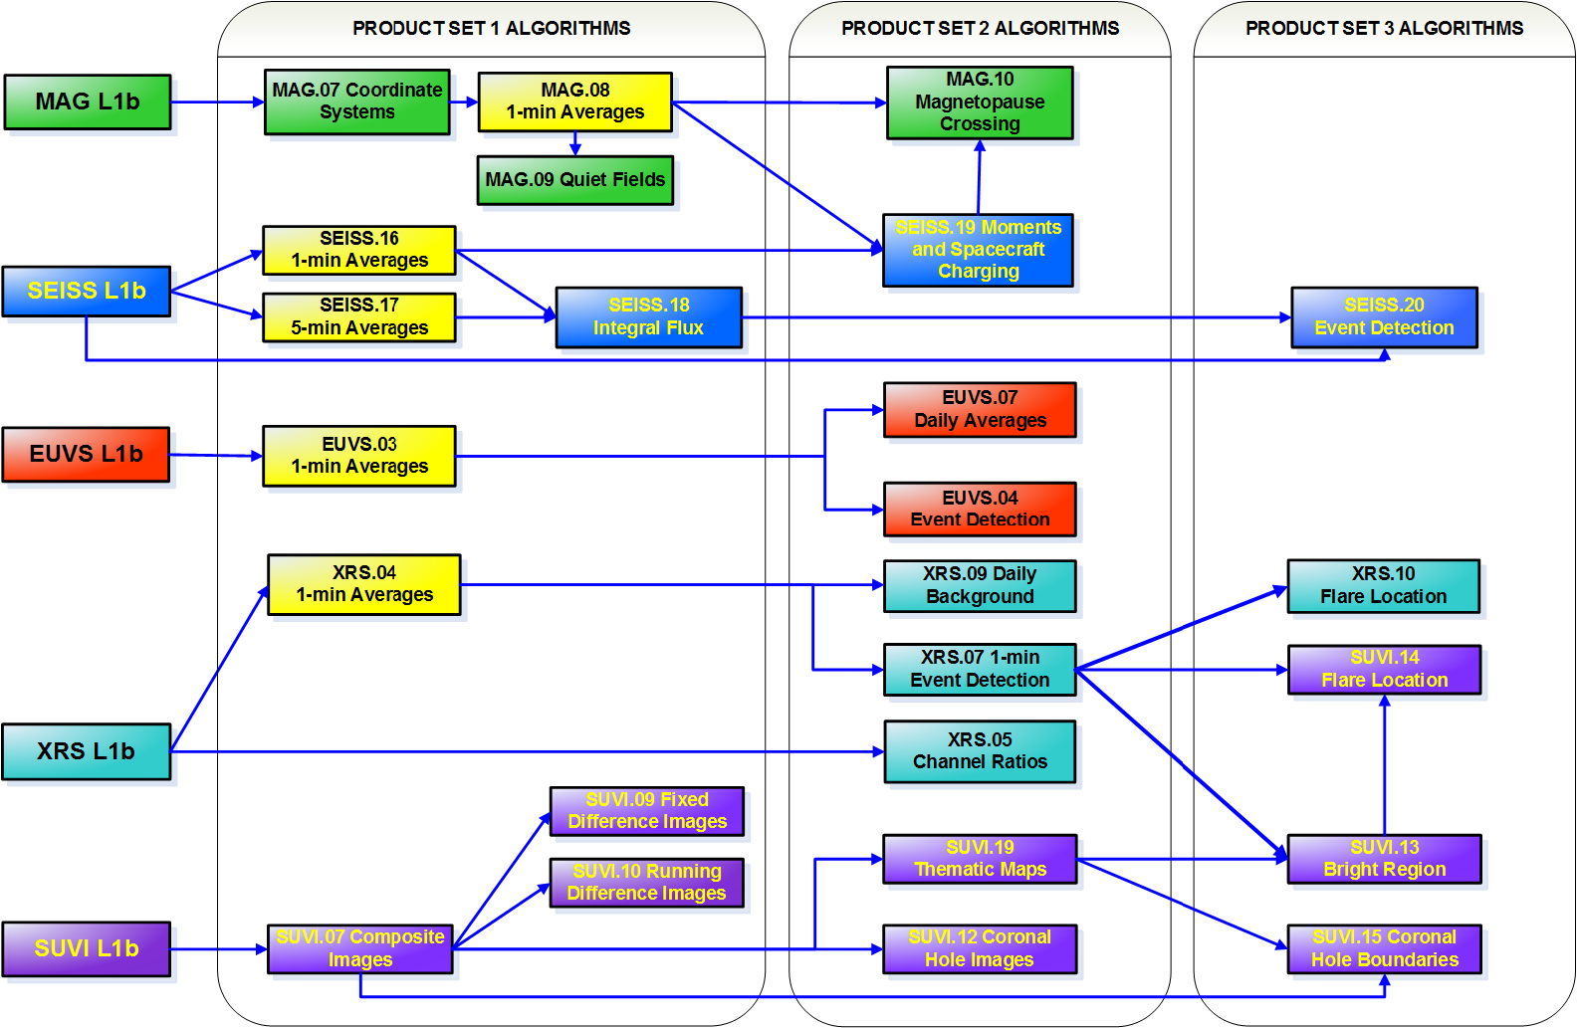
L2 Space Weather Products
Derived Operational Products (L2+)

Slide 17
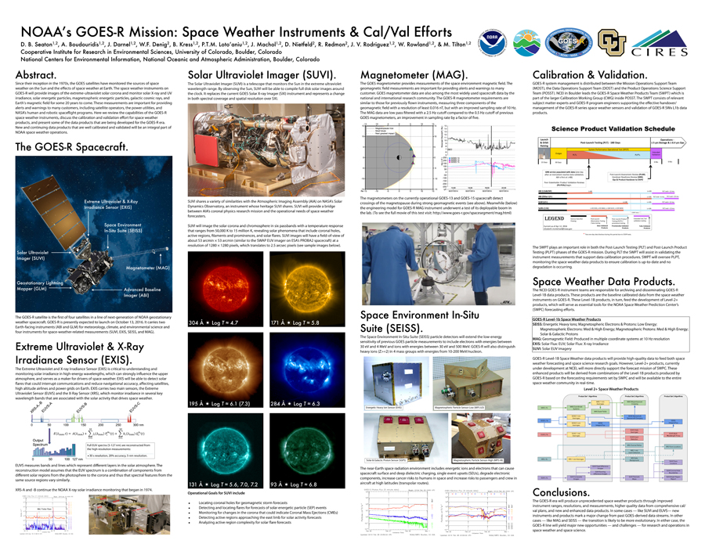
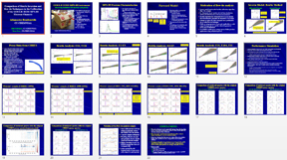
GOES-R Posters at SWW-2016
Dan Seaton – NOAA's GOES-R Mission: Space Weather Instruments & Cal/Val Efforts.
Meg Tilton – GOES-R Space Weather Data: Promoting Assess and Usability.
Liz McMichael – Preparing for GOES-R: Post-Launch Testing.
Thanasis Boudouridis – Comparison of Matrix Inversion and Bow-tie Techniques (SEISS).

Slide 18
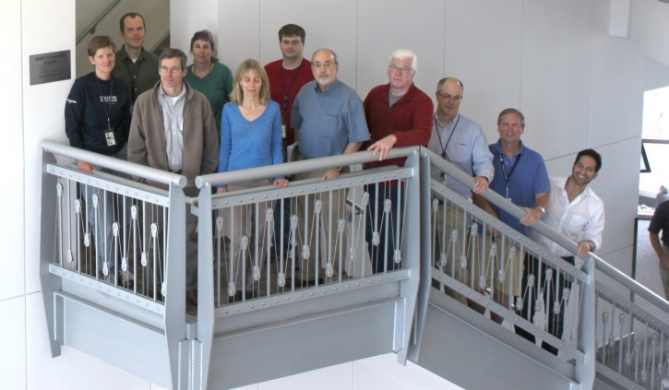
Summary
GOES-R Space Weather Team

