Slide 1
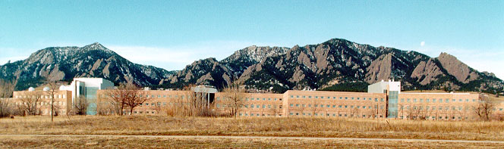

STP Quarterly Review
27 Jan 2015
1QFY15
William Denig
Solar & Terrestrial Physics Division
NOAA/NESDIS/NGDC
303 497-6323
William.Denig@noaa.gov

Slide 2
OUTLINE
Solar & Terrestrial Physics Division
STP Division Overview
Milestones & Metrics
Program Updates
Special Interest Items
Publications and Presentations
Issues & Summary

Slide 3
STP Division Overview
STP Organizational Chart
Solar & Terrestrial Physics Division
Bill Denig, Chief
Janet Brown, Admin
Key
F – Federal
C – CIRES
S – Student
V – Vacancy
Space
Weather
Earth
Observation
Group
CORS
GPS
Dan Wilkinson/F
Rob Redmon/F
Juan Rodriguez/C
Dominic Fuller-Rowell/S
Solar Physicist/F-V¹
Margaret Tilton/C
Stefan Codrescu/S
Chris Elvidge/F
Kim Baugh/C
Tilo Ghosh/C (remote)
Mikhail Zhizhin/C
David Hsu/C
Michael VonHendy/S
Fran Coloma/C
Ernie Joynt (ISD@35%)
Ionospheric
Sounding
GOES-R
WDS for Geophysics
DSCOVR
Terry Bullett/C
Jim Manley/C (80%)
Justin Mabie/C (50%)
Ray Conkright/C
W Rowland/C (75%)
Jonathan Darnel/C
Janet Machol/C
Paul Lotoaniu/C (50%)
Jim Manley/C (20%)
Brian Kress/C
Justin Mabie/C (50%)
Karen Horan/F
Craig Clark/F
W. Rowland/C (25%)
Paul Lotoaniu/C (50%)
Departures:
Rob Prentice
¹Pending FY15 Funding
3 Federal Vacancies

Slide 4

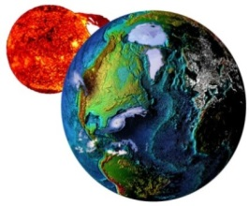


STP Division Overview
NOAA Affiliate of the Month
Dr. Juan Rodriguez
NOAA Affiliate of the Month
November 2014
Cited for
“Outstanding support of NOAA's
space weather mission”
Also featured in CIRES
(direct link:http://cires.colorado.edu/news/announcements/2014/rodriguez.html)

Slide 5
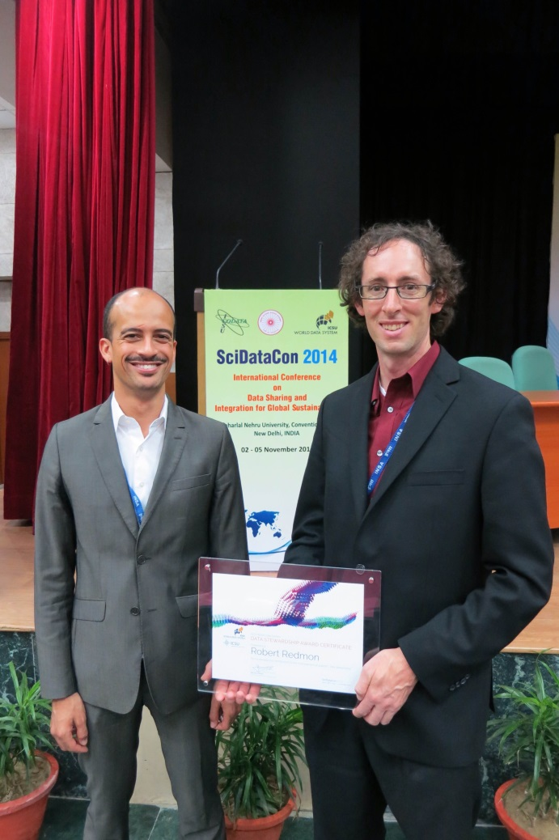

STP Division Overview
WDS Data Stewardship Award
Dr. Rob Redmon
WDS Data Stewardship Award
2014
Cited for
“Exceptional contributions to the improvement
of scientific data stewardship
by early career researchers”
Also
Notification of Rob’s award
included as a news item in the
Space Weather Journal
Rob received his award at the SciDataCon 2014, Jawaharlal Nehru University Convention Centre, New Delhi, India (November 2014)

Slide 6
STP Division Overview
Brief Retrospective
1942 Interservice Radio Propagation Laboratory (IRPL) formed at NBS (DOC) in Washington D.C.
1946 Central Radio Propagation Laboratory (CRPL) formed to replace IRPL
1957 World Data Center A (WDC-A) established in CRPL
1965 Environmental Sciences Services Administration (ESSA) formed to include CRPL and the Environmental Research Laboratories (ERL)
1966 Aeronomy and Space Data Center (ASDC) established under the Space Dynamics Laboratory (SDL) within ERL
1970 NOAA established within DOC
1972 National Geophysical and Solar and Terrestrial Data Center (NGSDC) formed to include the Solar and Terrestrial Physics (STP) Division
1973 NGSDC assigned responsibility for archive of GOES and TIROS space environmental data
1982 NGSDC renamed the National Geophysical Data Center (NGDC)
2011 WDC(-A) for STP merges with the WDC for Geophysics and Marine Geology to become the World Data Service for Geophysics
2012 STP assumes responsibilities from SWPC for supporting the GOES-R space weather sensors acquisition and operations
2014 NGDC assigned responsibility for the archive of DSCOVR solar wind data
2015 NGDC merges with other NOAA Data Centers to become the Nation Center for Environment Information (NCEI); STP transitions to the Solar Geophysics Branch (SGB) within the Geophysical Science Division (GSD) of the Center for Coasts, Oceans and Geophysics (CCOG)

Slide 7
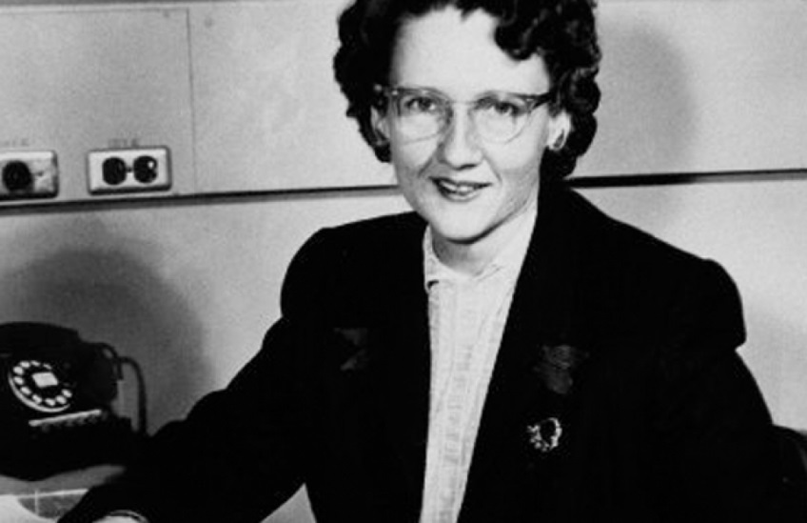


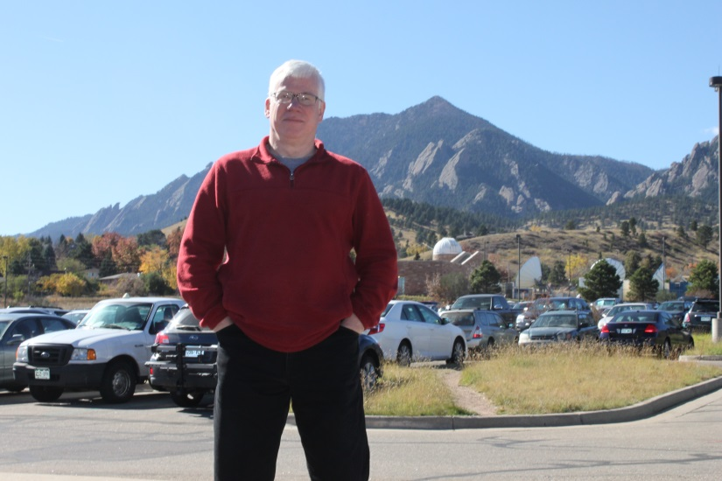
STP Division Overview
STP Chiefs / Directors WDC-A for STP
Virginia Lincoln (1972-1981)
Joe Allen (1981-1995)
Herb Kroehl (1995-2004)
Bill Denig (2005-2015)

Slide 8
OUTLINE
Solar & Terrestrial Physics Division
STP Division Overview
Milestones & Metrics
Program Updates
Special Interest Items
Publications and Presentations
Issues & Summary

Slide 9
Milestones and Metrics
STP FY15 Milestones

Slide 10
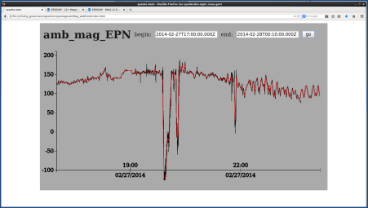
Milestones and Metrics
Milestone: SPADES PDR (AOP)
Milestone: Conduct a successful Preliminary Design Review (PDR) for the Satellite Product Analysis and Distribution Enterprise System (SPADES).
SPADES Working Demo
Storage Segment
Processing Segment
Visualization Segment
ERDDAP
L2+ Avg Algorithm
Browser
MAG-L1b-GEOF (L1b)
magn-l2-avg1m (L2+)
MAG-L1b-GEOF (L1b)
http, JSON
magn-l2-avg1m (L2+)
http, JSON
Completion: Planned: 31 Dec 2014 Actual: 30 Oct 2014
Status: SPADES PDR completed on 30 Oct. Still responding to panel questions.
C

Slide 11
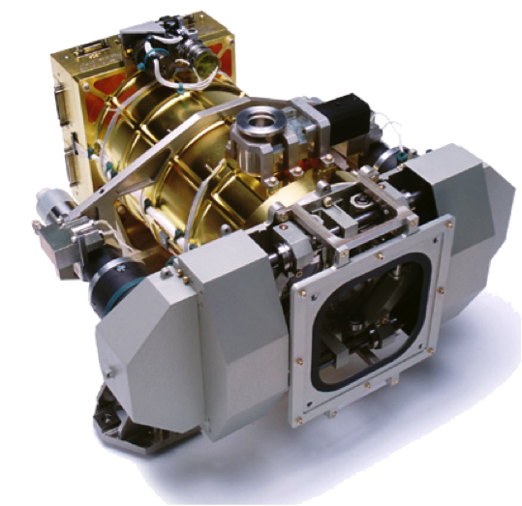
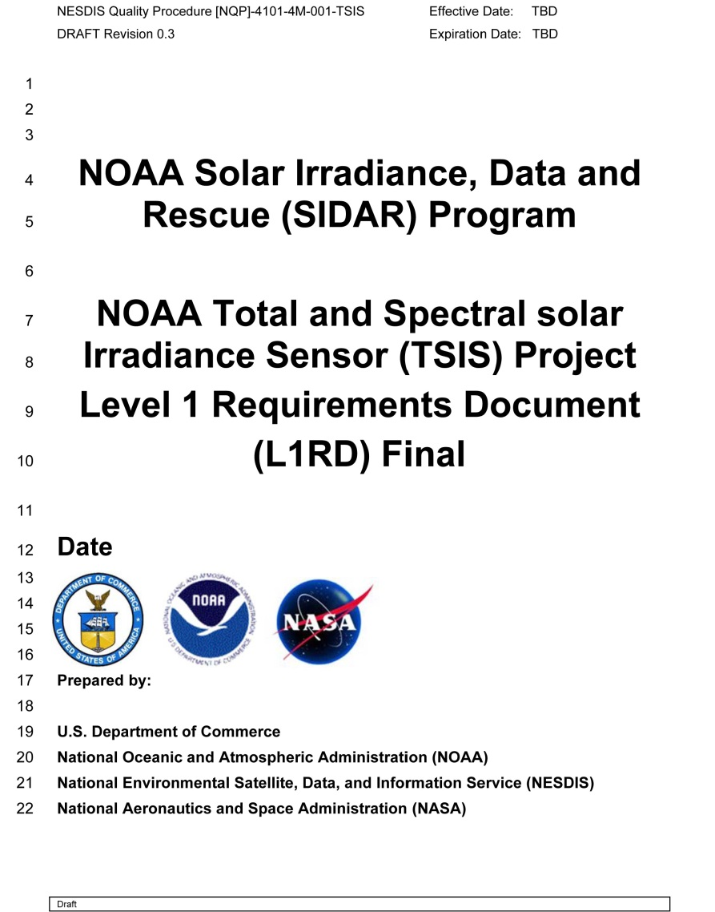
Milestones and Metrics
Milestone: TSIS L1RD
Milestone: Contribute to the development of the Level 1 Requirements Document (L1RD) for the Total and Spectral solar Irradiance Sensor (TSIS) project.
Total
Irradiance Monitor
Completion: Planned: 30 Dec 2014
Actual: 31 Oct 2014
Status: The L1RD has passed the Low earth Orbiting Requirement Working Group (LORWG). TSIS partly funded in FY15 exclusive of government support.
C

Slide 12
Milestones and Metrics
FY15 Metrics Overview
(See Note)
Greater than 99% (3-sigma) Cumulative Distribution
Greater than 97% (2-sigma) Cumulative Distribution
Greater than 84% (1-sigma) Cumulative Distribution
Below 84.1% (1-sigma) Cumulative Distribution
¹Bldg 11 Power Outage: 9:43PM 12/12/14- 5:41 PM 12/13/14

Slide 13
OUTLINE
Solar & Terrestrial Physics Division
STP Division Overview
Milestones & Metrics
Program Updates
Special Interest Items
Publication & Presentations
Issues & Summary

Slide 14
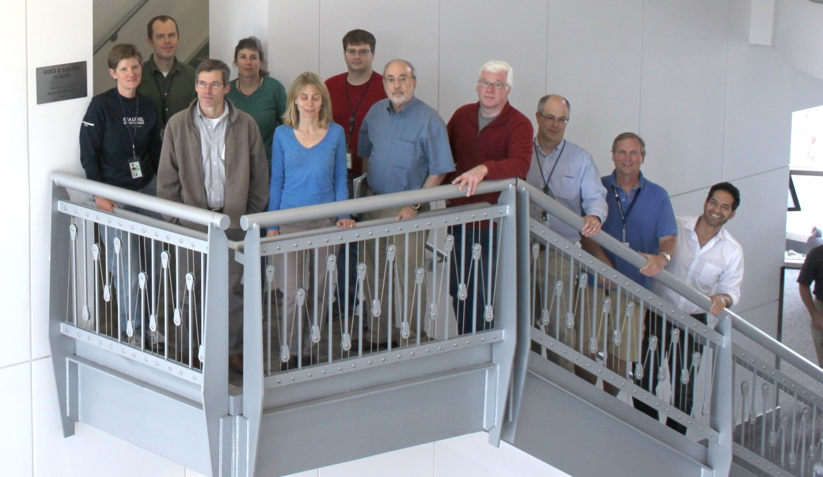
Space Weather Team
Roles and Responsibilities
Provide long-term scientific stewardship of NOAA’s SWx data
Assess and improve satellite operational environmental products
Monitor the performance of current geostationary/polar SWx sensors
Support the acquisition/execution of the GOES-R & DSCOVR satellites

Slide 15

Space Weather Team
Status: GOES-R Status – SME Assessments
EXIS
H/W
L1b
L2+
MAG
H/W
L1b
L2+
SEISS
H/W
L1b
L2+
SUVI
H/W
L1b
L2+
Products
L0
L1b
L2+
Access
PDA, SPADES
GRB, SPADES
CLASS
SPADES
GRB&PDA, PLT
(G) No Issues
(G) No Issues
(G) No Issues
(Y/G) Less mature design – actual performance may not be as predicted
(R/Y) Impending waivers will likely result in inferior products
(G) No Issues
(Y) EHIS FM2 peak-hold circuit anomaly seriously degrades heavy ion performance.¹
(G) No issues
(G) No issues
(G) No issues
(G) No issues
(G) No Issues
(Y/G) LZSS access firming up; Interface development separately funded
(Y) Limited independent development; Unfunded Cal-Val tool development
(Y) AA decision to implement L2+ processing within IDP; FY16 PCS submitted
(Y/G) Successful test. PDA will accept proxy data. Story points > sprints * velocity.¹
(Y/G) GRB baselined for SPADES FOC; Interface not specified.¹
(G) No issues
(G) No issues.
(R) Severe potential impact to PLT. Outage still not quantified. Workaround uncertain.¹
FOUO
SME assessments do not represent Program views
¹Assessment or text updated.

Slide 16
Space Weather Team
Status: GOES-R Status (Details)
FOUO
Detailed Comments¹:
MAG H/W Performance (yellow/green): Due to the changes in the design, the MAG is not as mature as the other instruments. Vendor has not yet assembled the calibration data books which will provide a good deal of insight into the instrument’s performance. Measurement and analysis of magnetic interference from spacecraft systems along with mitigation methodologies are not complete.
MAG L1b Algorithm (red/yellow): Program has authorized a prototype of the current version of the vendor's algorithm. If implemented this would repair many of the issues that had already been identified [at which point this status might be Green]. However, the Program is still ardently pursuing substantial performance waivers for the significant degradation of accuracy that would be caused by the "Frozen Baseline" version of the algorithm. If the L1b product only meets the new specs in the waiver, then the utility of the product for the community suffers a significant [Red?] adverse impact. Specific issue is the error associated with using only one thermistor in the Frozen Baseline versions of the algorithm instead of using all three thermistors.
SEISS Hardware Performance (yellow): All 4 instruments have performance waivers. EHIS FM2 spontaneously developed a biased output on one of the six Amptek PH300 peak-hold hybrids that seriously degrades heavy ion performance. After a 6-mo investigation, vendor and NASA have not found root cause, despite assessment by the designer of the hybrid that the driver circuit is improperly implemented. All hybrids recovered in the lab. Lacking root cause, classified as a ‘cannot duplicate’, no hardware mods will be made. Recommend GOES-R carry this forward as a risk.
L0 Products (yellow/green): The Program has separately funded development of NGDC common ingest (CI) access to L0 data. L0 data will only be available via the WCDAS with no back-up or redundancy. Users’ Guide will document interface details, and is expected in April.
¹SME Assessment

Slide 17
Space Weather Team
Status: GOES-R Status (Details)
FOUO
Detailed Comments¹ (continued):
L1b Products (yellow): After a detailed technical assessment by NGDC of the serious operational impacts of ground processing algorithms coded to the “frozen baseline” the GOES-R program has authorized a fix to the space weather L1b algorithm codes prior to GOES-R launch as “operational prototypes”. It is unclear how the “fixed” algorithms will be used to validate requirements.
L2 Products (yellow): NWS/NESDIS AAs have agreed to submit a FY16 PCS for implementing L2+ SWx algorithms within NWS operational systems. NGDC is currently working with the NWS to “harmonize” the SPADES development for R2O transition.
PDA, SPADES interface (yellow/green): Good news: Successfully tested manual connectivity and pulling of files from PDA I&T string. PDA agreed to host proxy data that we provide. Bad news: Delays. Agile Team estimated story points significantly greater than velocity*3 sprints.
GRB, SPADES interface (yellow/green): The nominal SPADES development will transition to GRB for FOC. Access to prototype L1b products still not certain.
GRB&PDA, PLT Availability (red): We have been advised that GRB may be unavailable during the first 3 months of PLT. During a GRB outage, L1b data would only be available on site at WCDAS. Potential impacts include either a) failure to complete the assigned scope of work during this outage or b) a large (and currently unfunded) expenditure from keeping personnel on site. Very little new information has come available.
Each element considered separately. Sequential cascade effects will affect final product quality.
¹SME Assessment

Slide 18
Space Weather Team
Status: GOES-R Status – History
1QFY15
4QFY14
3QFY14
2QFY14
1QFY14
FOUO
EXIS
H/W
L1b
L2+
MAG
H/W
L1b
L2+
SEISS
H/W
L1b
L2+
SUVI
H/W
L1b
L2+
Products
L0
L1b
L2+
Access
PDA, SPADES
GRB, SPADES
CLASS
SPADES
GRB&PDA, PLT
G
G
G
Y/G
R/Y
G
Y
G
G
G
G
G
Y/G
Y
Y
Y/G
Y/G
G
G
R
G
G
G
Y/G
R/Y
G
Y/G
G
G
G
G
G
Y/G
Y
Y
Y
Y/G
G
G
R
G
G
G
Y/G
R/Y
G
Y/G
G
G
G
G
G
Y/G
Y
Y
Y/G
Y/G
G
G
G
G
G
Y/G
R/Y
G
Y/G
G
G
G
G
G
Y/G
Y
Y
Y
Y
G
G
G
G
G
Y/G
R/Y
G
Y/G
G
G
G
G
G
Y
Y
R
G
G
G
Y

Slide 19
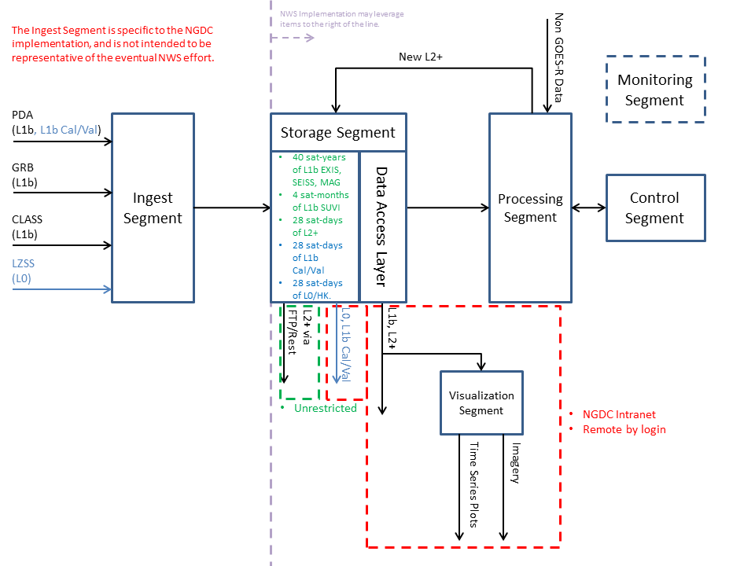
Space Weather Team
Cal-Val: SPADES Status (Post PDR)
In 2QFY15 the NGDC Agile Team will tackle the SPADES Ingest and Storage Segments. SPADES CDR now bumped to 30 April 15.
SPADES Function Elements
Ingest Segment
Storage Segment
Processing Segment
Visualization Segment
Control Segment
Monitor Segment
SPADES – Satellite Product Analysis and Distribution Enterprise System

Slide 20
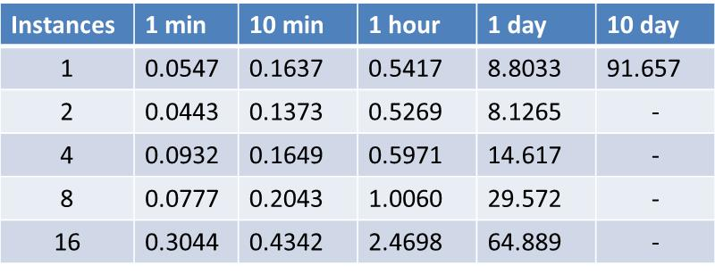
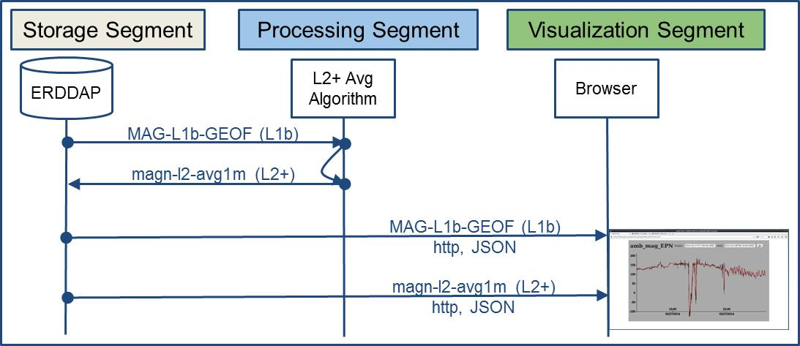
Space Weather Team
Cal-Val: SPADES Load Testing (PDR Demo)
Load test SPADES access using MAG proxy data by varying duration (length of proxy data) and instances (independent processes). All times in seconds. Data access layer uses ERDDAP.
ERDDAP – Environmental Research Division's Data Access Program

Slide 21
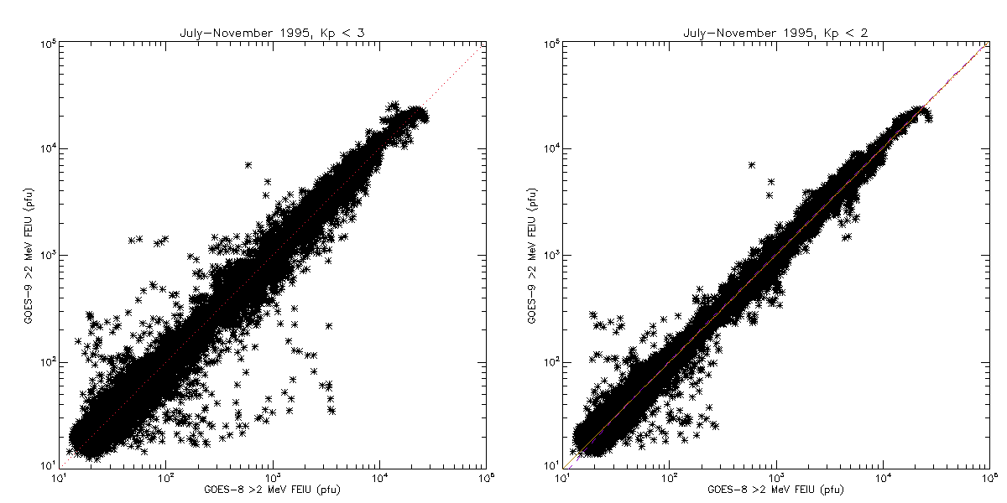

Space Weather Team
GOES-R Cal-Val: GOES 8-15 Cross Comparisons
Prep for GOES-R
Combines methods of Onsager et al. [2004] and Rodriguez et al. [2014]
Restricting cross-comparisons to quiet times (Kp < 2) reduces scatter
Results show good consistency among the GOES >2 MeV channels
Electrons
>2 MeV
Kp < 3
Electrons
>2 MeV
Kp < 2
GOES 9
vs
GOES 8
GOES 9
vs
GOES 8
GOES (y) | GOES (x) | Period | Slope
9 | 8 | Jul-Nov 1995 | 1.0477
10 | 9 | Jul 1998 | 0.6845
11 | 10 | Jun-Aug 2006 | 0.8067
10 | 12 | Jan-May 2007 | 0.8805
15w | 13w | Apr-Aug 2011 | 1.2301
References:
Onsager, T. G., A. A. Chan, Y. Fei, S. R. Elkington, J. C. Green, and H. J. Singer (2004), The radial gradient of relativistic electrons at geosynchronous orbit, J. Geophys. Res., 109, A05221, doi:10.1029/2003JA010368
Rodriguez, J. V., J. C. Krosschell, and J. C. Green (2014), Intercalibration of GOES 8-15 solar proton detectors, Space Weather, 12, 92-109, doi:10.1002/2013SW000996.

Slide 22
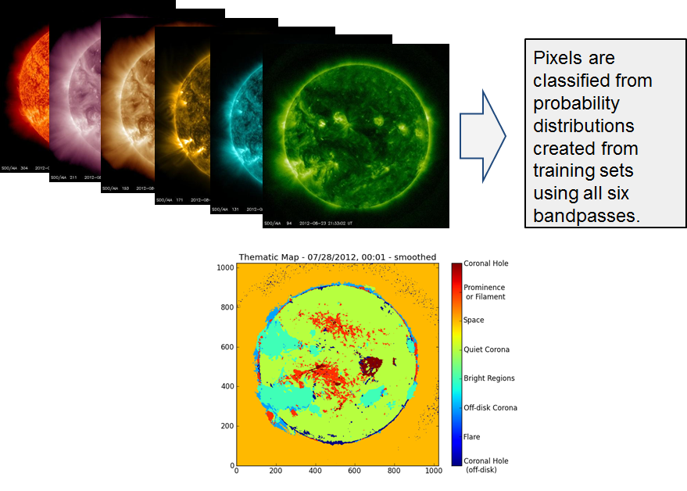

Space Weather Team
GOES-R Cal-Val: SUVI Solar Thematic Maps
Coronal Hole
Prominence / Filament
Space
Corona Quiet
Bright Regions
Corona off-disk
Flare
The SDO/AIA is the heritage sensor for SUVI
Coronal Hole off-disk
AIA – Atmospheric Imaging Assembly
Notes:
Current capabilities – 1 forecaster hand drawn image per day
No dynamics
Human factor
Thematic Maps
Forecaster creates training set ~ couple dozen images
Expert system based on training set
Cadence 1 / minute

Slide 23
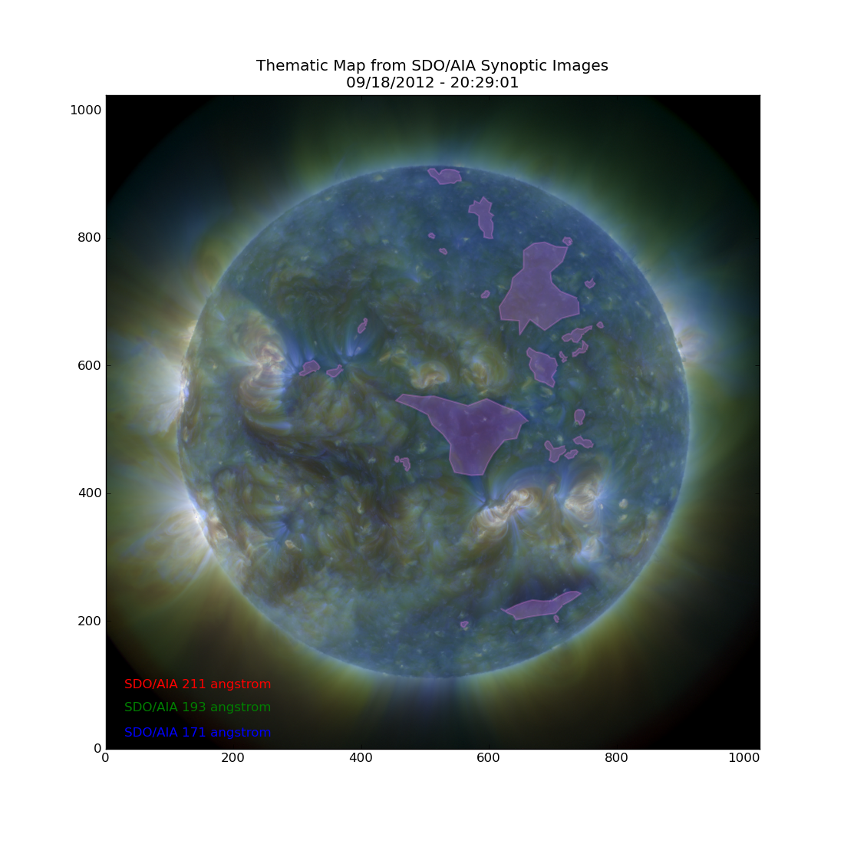
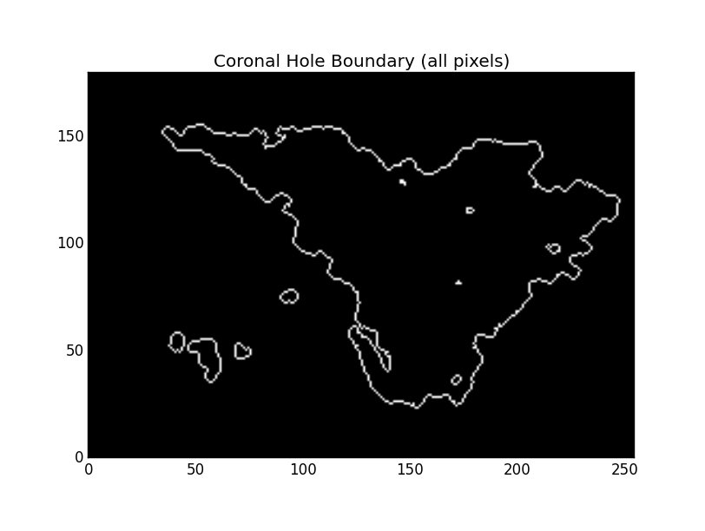
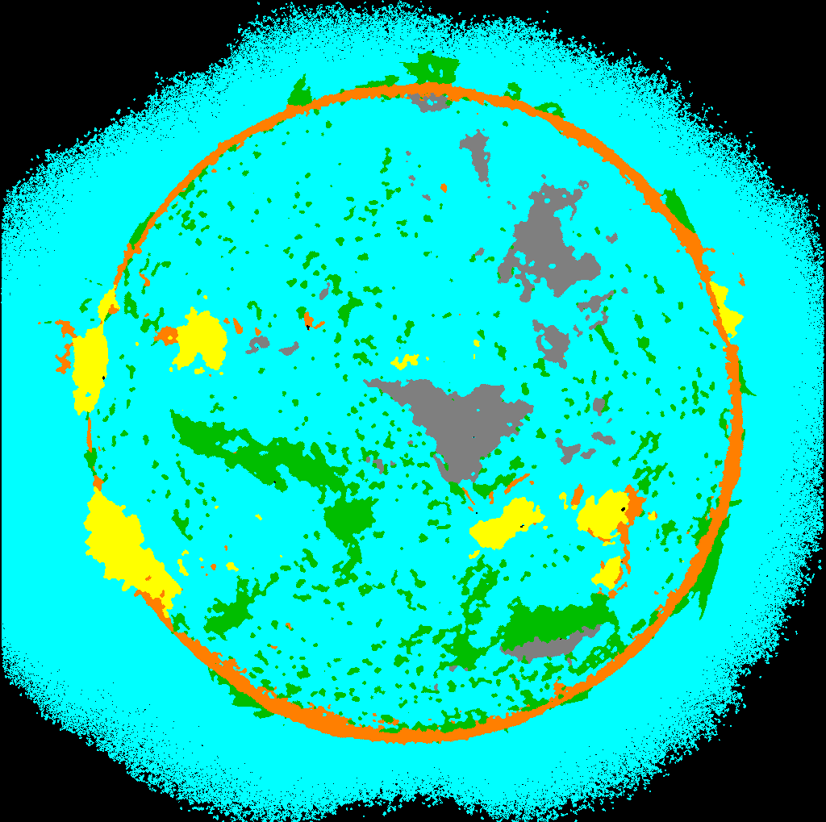
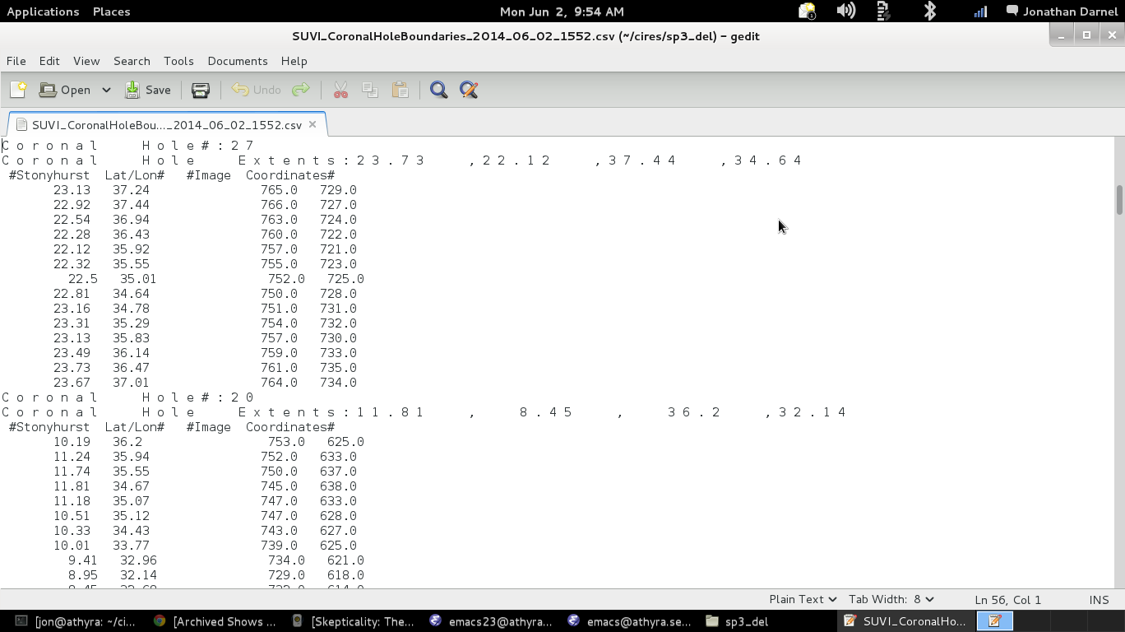
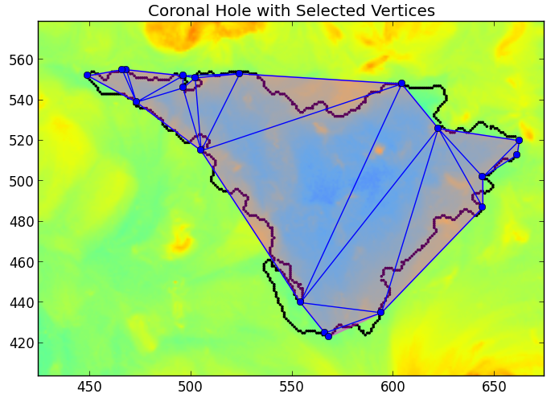
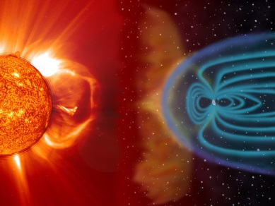
Space Weather Team
GOES-R Cal-Val: Coronal Hole (CH) Shape Files
SDO AIA solar images are used as proxy for SUVI. SUVI Thematic Maps (SUVI.19) and Coronal Hole Boundaries (SUVI.15) are L2+ SWx products.
NASA/SDO as Proxy
Thematic Map
Coronal Hole Boundary
9/18/2012 20:29:01
CH Shape File
Finite Vertices
Recurring larger solar speeds originate within coronal holes.

Slide 24
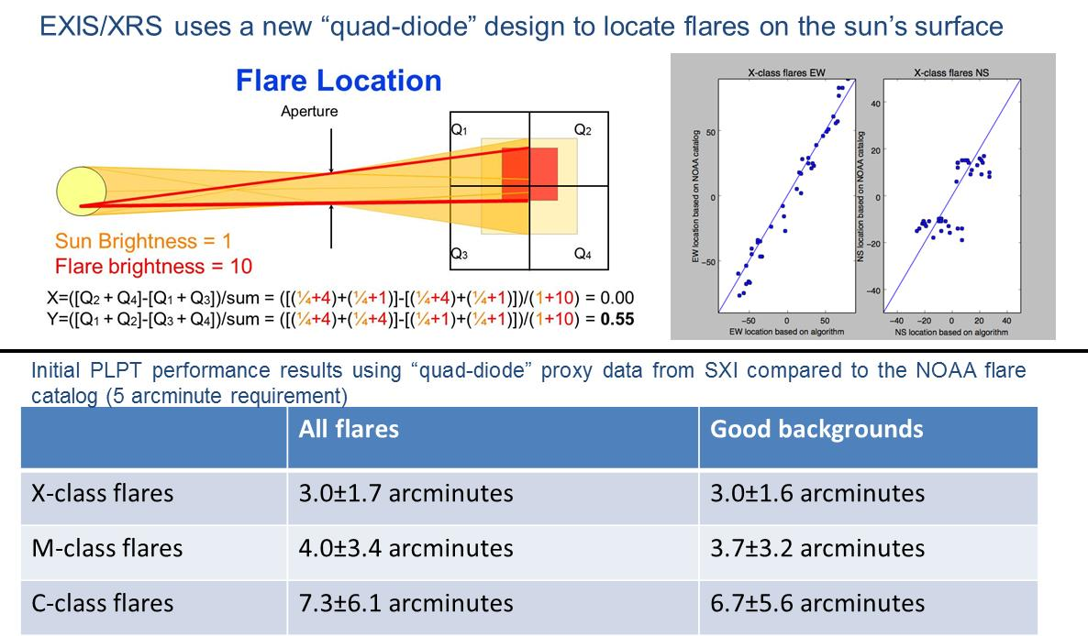
Space Weather Team
GOES-R Cal-Val: EXIS/XRS Flare Location (IAC Brief)

Slide 25
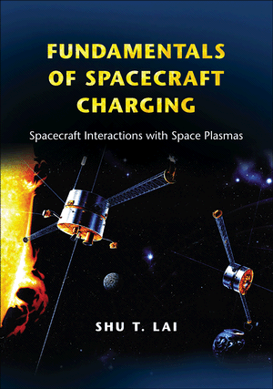
Space Weather Team
Spacecraft Anomalies: Status Update
Satellite Anomaly Support (Redmon):
Satellite anomaly - Draper Lab request – details are FOUO
NOAA-16 support of decommissioning report
  Launched in 2000, relegated to backup for NOAA-18 in 2005
  NOAA June press release
  NOAA OSPO - Decommissioned on June 9, 2014 at 14:23 UTC due to major spacecraft anomaly
  NGDC contributed space environmental assessment to final report
Conference Attendance (Denig):
Space Environment Applications, Systems and Operations for National Security (SEASONS)
    Presented overview of Galaxy-15 anomaly investigation
    Invitation to present report at National Defense University (NDU)
Papers in Progress (Loto’aniu):
Space Weather Conditions During the Galaxy 15 1Anomaly (submitted)
Space Weather Conditions During the February 2014 WAAS Outage (in draft)
Initiative: $366K (FY15) – NESDIS Approved; Funding Status Unknown
Notes:
Safeguarding Satellites from Space Weather

Slide 26
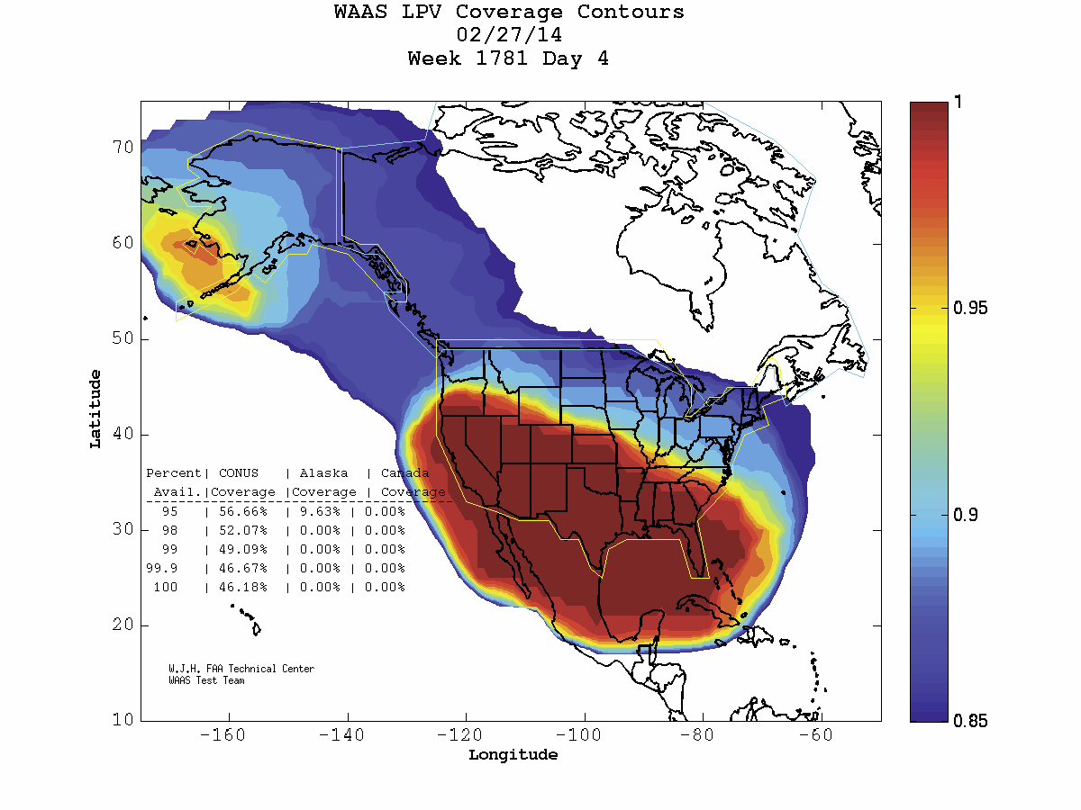
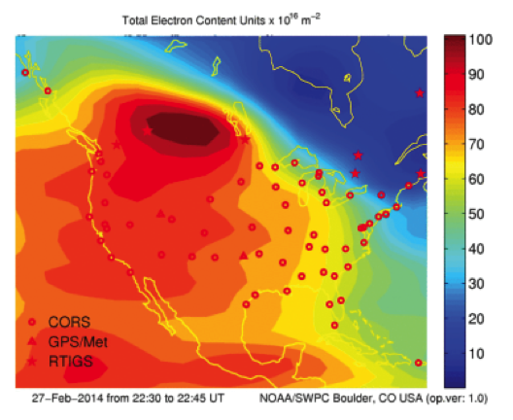
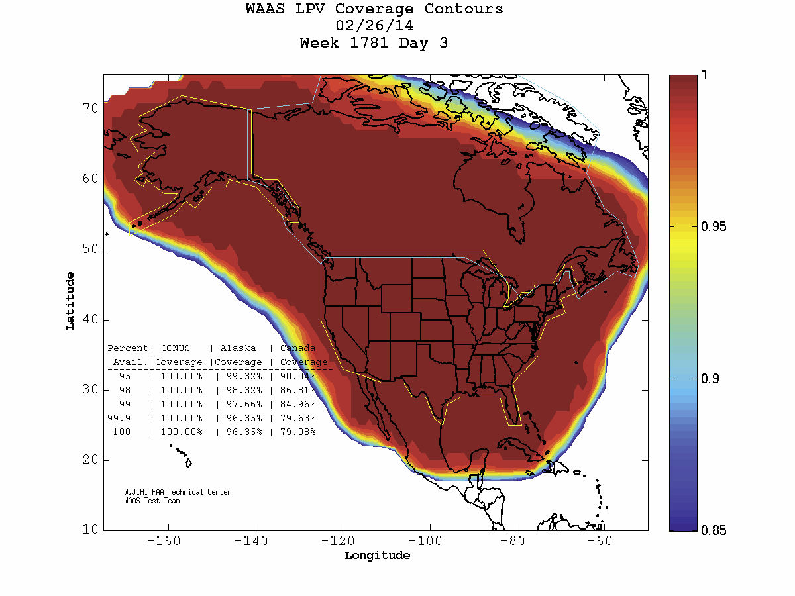
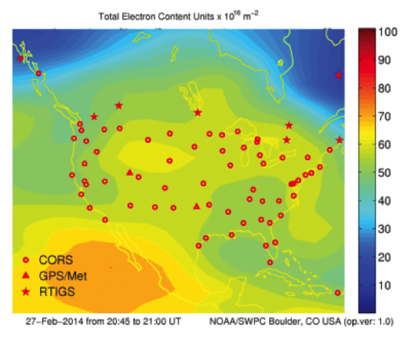
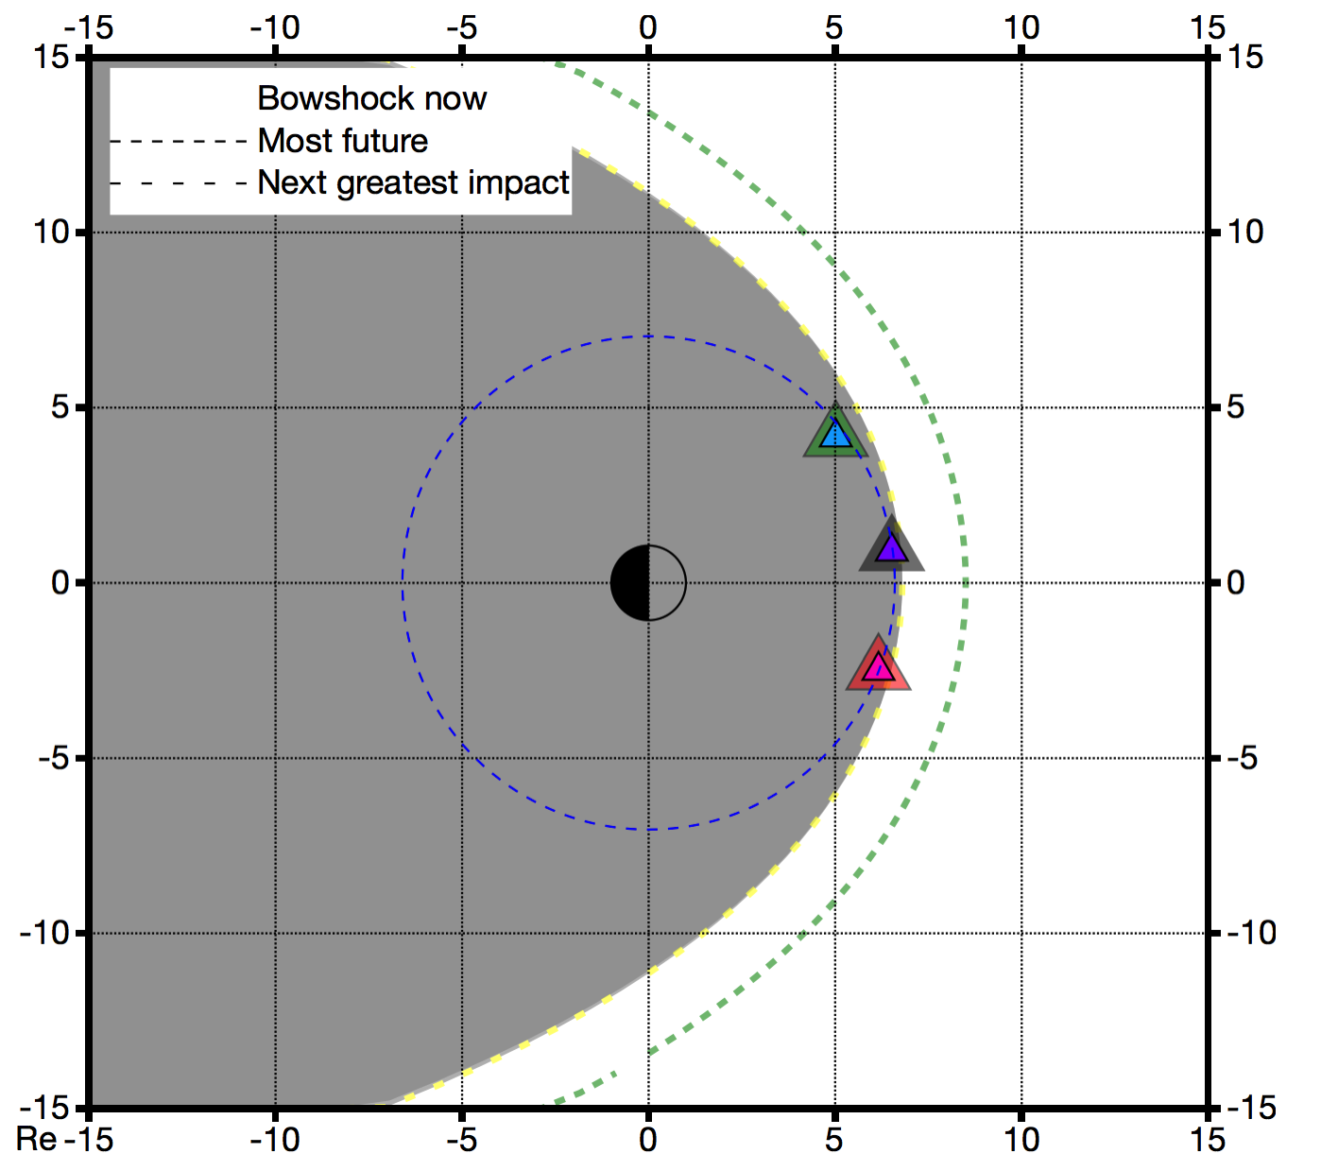
Space Weather Team
Spacecraft Anomalies: WAAS Outage – 27 Feb 14
Manuscript in
Preparation (Loto’aniu)
FAA Message to SWPC: “An Ionospheric Storm began on 2/27/14. The Satellite Operations Specialists were alerted at the WAAS O&M by a Significant Event 757 at 2120 Zulu. So far, LPV and LPV200 service has not been available in Eastern Alaska and Northeastern CONUS. At times, North Central CONUS and all of Alaska have lost LPV and LPV200 Service.”
NGDC Magnetopause Crossing
27 Feb 14 – 17-24 UT
WAAS Coverage 27 February
TEC 27 February 22:30 UT
Magnetopause Standoff Distance
27 Feb 14
Storm Day
GEO
GOES Magnetic Field
WAAS Coverage 26 February
TEC 26 February 20:45 UT
Magnetopause
Location
27 Feb 14
19:58 UT
GOES 13
Reference Day
GOES 14
GOES 15
LPV - Lateral Precision with Vertical guidance

Slide 27
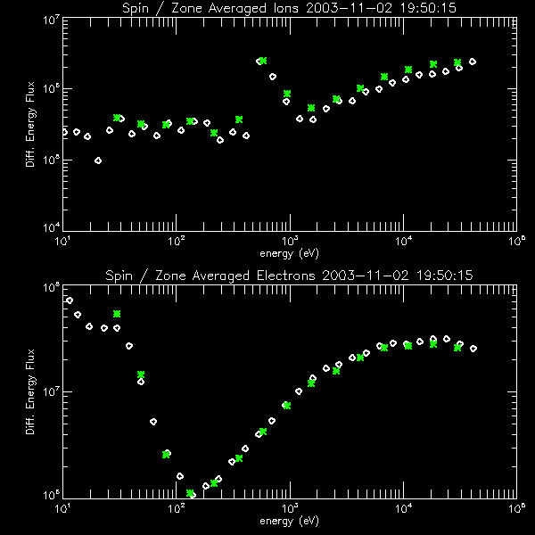
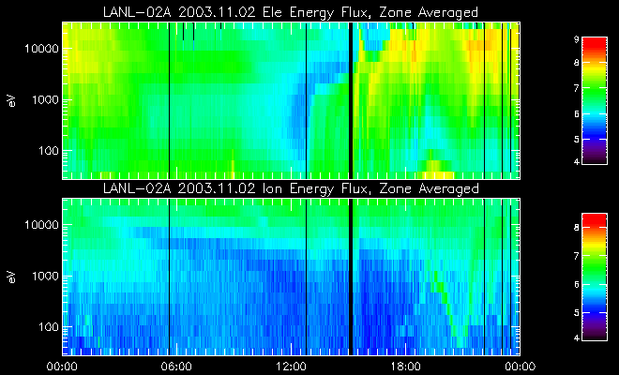
Space Weather Team
Spacecraft Anomalies: Spacecraft Frame Charging
Planning ahead for GOES-R
(capability does not currently exist)
Ion Line
Trapped Secondary/ Photo-electrons
Ion Line
Barrier Potential
LANL MPA data provided by Dr. M. Thomsen
Spacecraft electric potential derived from electron and ion fluxes (0.03 - 30 keV)
GEO s/c charge negatively to balance currents due to incident and emitted electrons and ions
Upsets caused by discharges from differential charging when s/c is sunlit or emerges from eclipse
Uniform (frame) charging is seen as an ‘ion line’ at the s/c potential [DeForest, 1972]
Differential charging traps secondaries and photoelectrons in a barrier potential [Whipple, 1976]
DeForest, S. E. (1972), Spacecraft charging at synchronous orbit, J. Geophys. Res., 77, pp. 651–659, doi:10.1029/JA077i004p00651.
Whipple Jr., E. C. (1976), Observation of photoelectrons and secondary electrons reflected from a potential barrier in the vicinity of ATS 6, J. Geophys. Res., 81, pp. 715–719, doi:10.1029/JA081i004p00715.

Slide 28
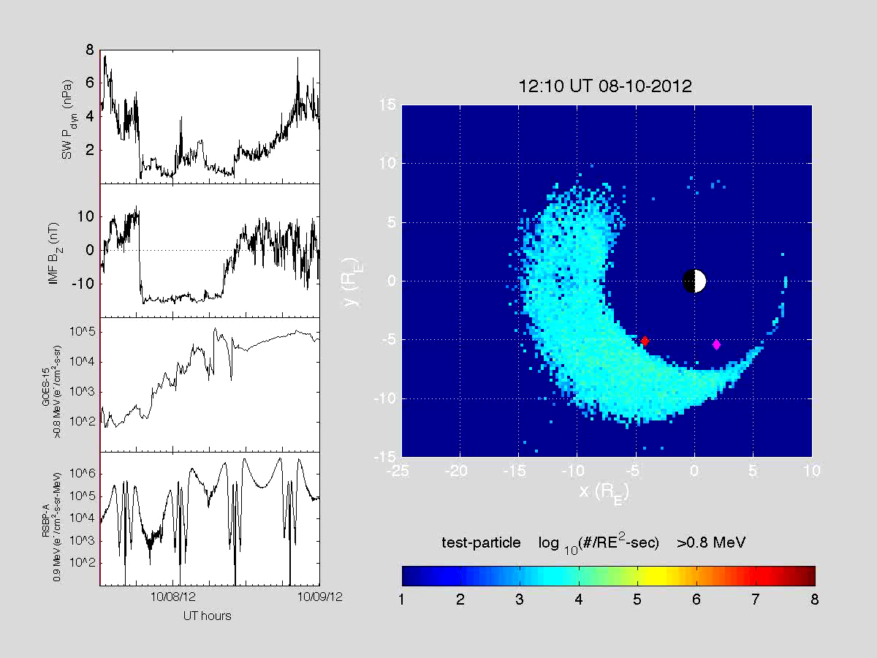
Space Weather Team
Research Item: Radiation Belt Dynamics
Rebuilding of Earth’s outer radiation belt during 8-9 October 2012 geomagnetic storm
>0.8 MeV electron flux in equatorial plane in SM coordinates.
GOES-15
and RBSP-A
spacecraft
positions
[After Kress et al., GRL, 2014]
Kress, B. T., M. K. Hudson, and J. Paral (2014), Rebuilding of the Earth's outer electron belt during 8–10 October 2012, Geophys. Res. Lett., 41, 749–754, doi:10.1002/2013GL058588.

Slide 29
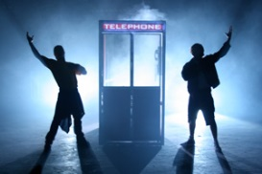
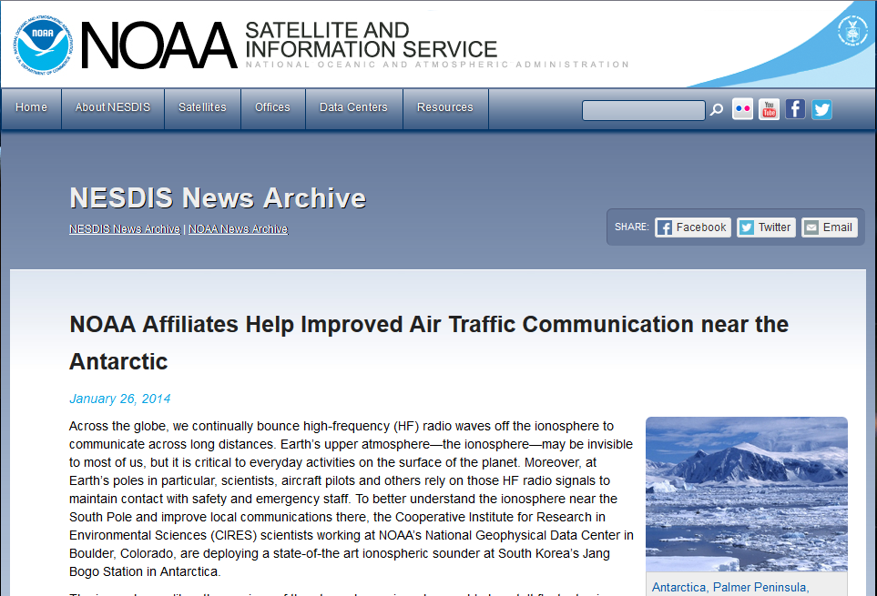
IONO Team
Terry & Justin’s Most Excellent Adventure
Terry Bullett & Justin Mabie

Slide 30
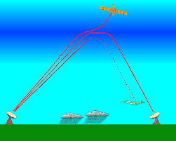

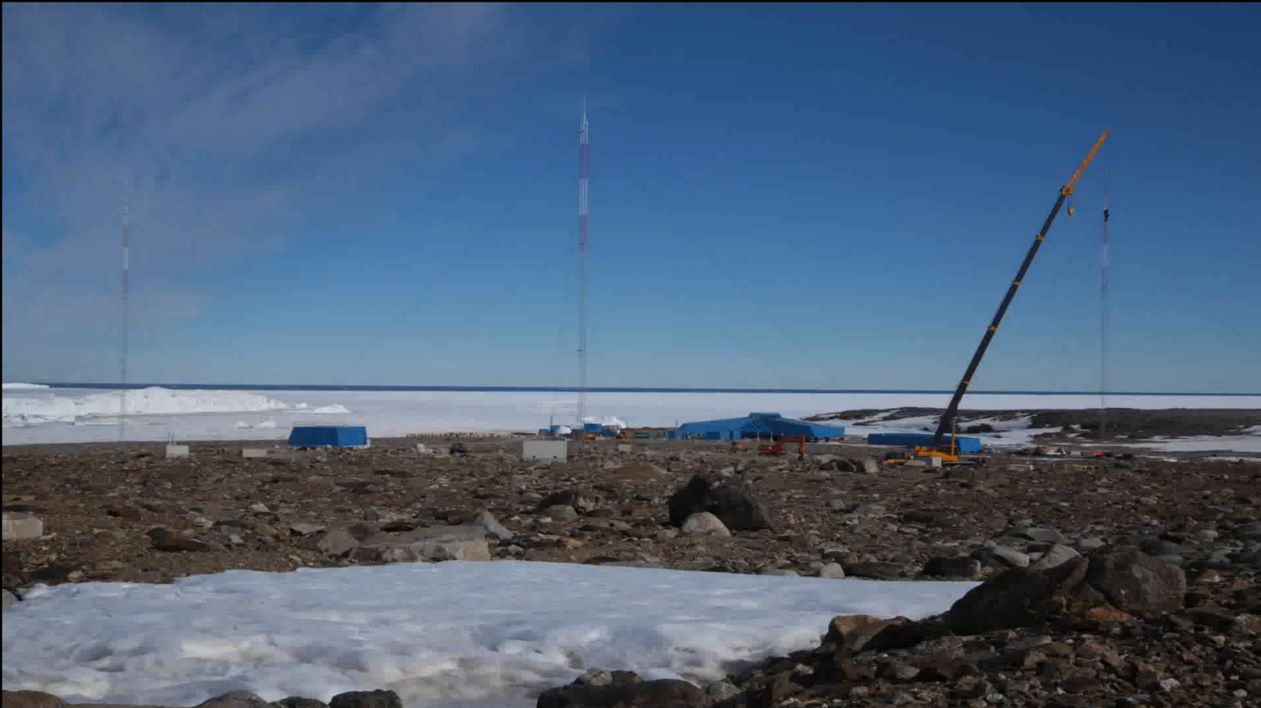

IONO Team
VIPIR: Antarctic Construction
Terry and Justin continue to assemble the Vertical Incidence Pulsed Ionosphere Radar (VIPIR) at South Korea’s Jang Bogo Station in the Antarctic. Once operational, these data will contribute to Korea’s increased interest in space weather. The team is currently trying to work through some equipment issues.
Movie
Antarctic Blog: http://ciresblogs.colorado.edu/spaceweather/

Slide 31
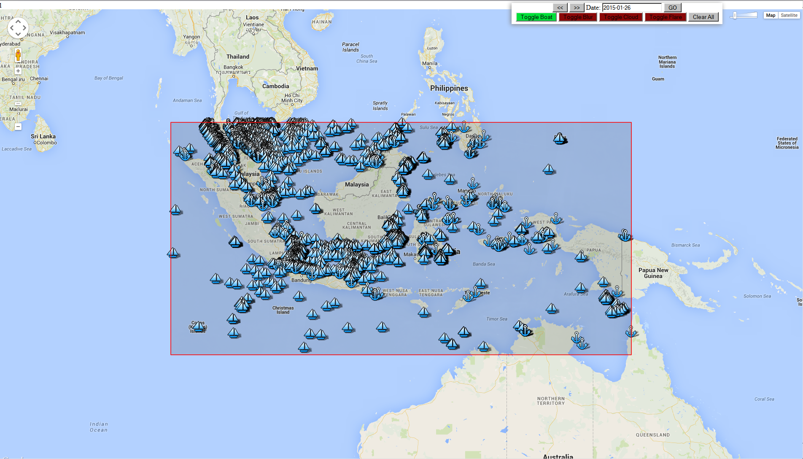
EOG Team
DNB Boat Detection: Indonesia
Demo (Under Development)

Slide 32
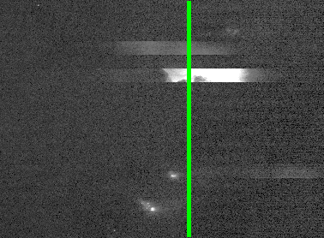
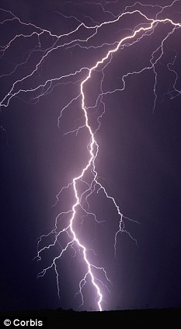
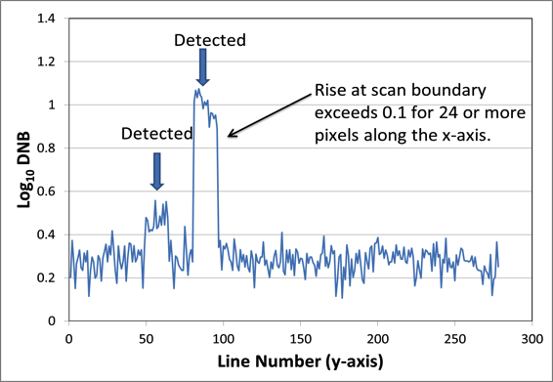
EOG Team
VIIRS Application: Lightning Detection (aka noise)
A
Identifying noise spikes in VIIRS DNB data
Lightning
B
A
B
DNB – Day/Night Band

Slide 33
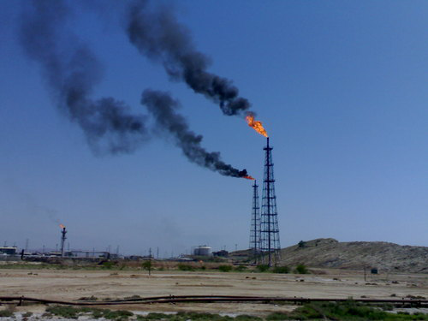
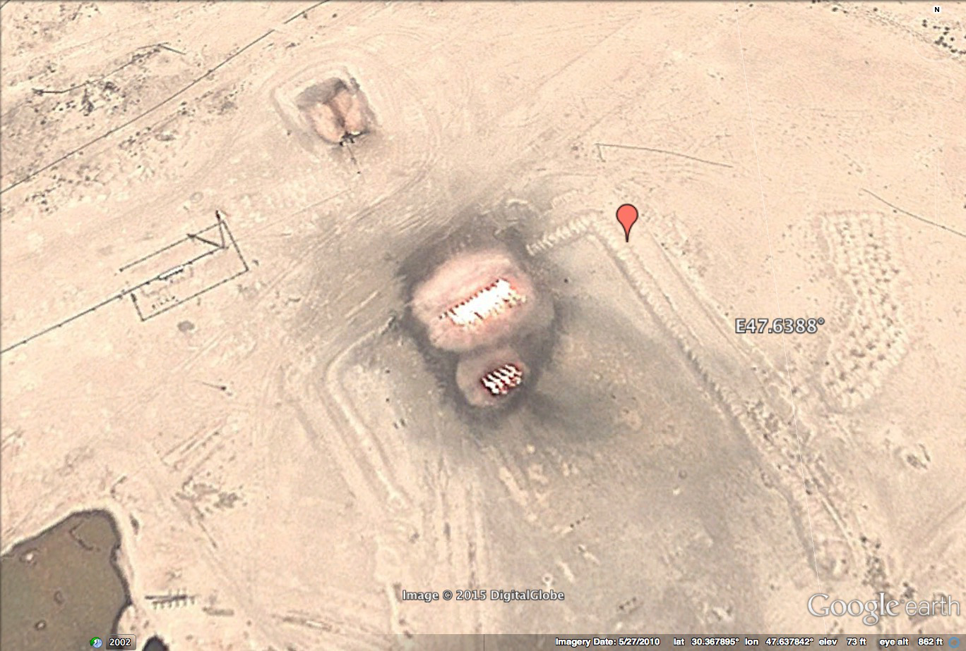

EOG Team
Flare Shapes: Source Area vs Zenith Angle
Door to Hell
inTadzhikistan
Flare in Northern Iraq
Flare Array in Basra
200
100
200
Source Area (m²)
Source Area (m²)
Source Area (m²)
100
50
100
0
0
0
-80
-60
-40
-20
0
20
40
60
80
-80
-60
-40
-20
0
20
40
60
80
-80
-60
-40
-20
0
20
40
60
80
Satellite Zenith Angle
Satellite Zenith Angle
Satellite Zenith Angle

Slide 34
OUTLINE
Solar & Terrestrial Physics Division
STP Division Overview
Milestones & Metrics
Program Updates
Special Interest Items
Publication and Presentations
Issues & Summary

Slide 35
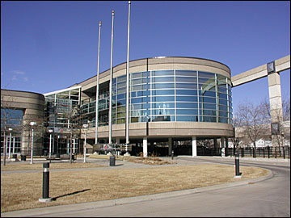
Special Interest Item
NOAA Satellite Science Week 2015
NOAA Satellite Science Week 2015 will be held 23-27 February at the UCAR Center Green facility, Boulder CO. NOAA Space Weather will be covered in 2 sessions in the afternoon of Tuesday, 24 Feb.
Science Week is a joint meeting to review and discuss the state of the science portfolio of the GOES-R and JPSS programs. This includes GOES-R and JPSS products, their availability and maturity, risk reduction science activities, and calibration/validation.
Objectives:
Communicate status of products available from NESDIS operations and direct readout.
Review the progress of GOES-R/JPSS Risk Reduction new and continuing projects over the past year.
Present results/issues/science from the GOES-R/JPSS Risk Reduction participants including: data fusion applications/techniques, proxy data and interactions with anticipated end-users.
Provide an overview of the GOES-R/JPSS cal/val activities (summary).
Examine value and impact of using the same/common algorithms for geostationary and polar orbiting data.
Identify methods for developing products integrated/fused with other data sources.
Promote understanding of scientific maturity, and readiness of path to operations between baseline, future capability and experimental products and/or decision aids.

Slide 36
Special Interest Item
NOAA Satellite Science Week 2015
STP Presentations:
GOES-R Space Weather - Operations to Research [Oral, Invited], W.F. Denig
Nighttime Light Compositing using VIIRS DNB [Poster], K. Baugh, F-S Hsu, M. Zhizhin, C. Elvidge
Multi-Spectral Subpixel Nighttime Fire Temperature and Size from VIIRS [Poster], F-S Hsu, M. Zhizhin, C. Elvdge and K. Baugh
Automatic Boat Identification System for VIIRS Low Light Imaging Data [Poster], M. Zhizhin, K. Baugh, M. Zhizhin and C. Elvidge
Automated Solar Feature Classification with the GOES-R SUVI [Poster], J. Darnel
Solar Extreme Ultraviolet and X Ray Irradiance: Impacts and Measurements [Poster], J. Machol, A. Reinard and R. Viereck
Real-Time Monitoring of the Dayside Geosynchronous Magnetopause Location [Poster], R. Redmon and Paul Loto’aniu, M. Berguson, S.M. Codrescu, J. Shue, H.J. Singer, W.F. Rowland, W.F. Denig
Other talks of interest:
Deep-space Satellites for Space Weather Forecasting: Science and Technology Challenges, T. Berger
Space Weather Prediction Testbed: Transitioning Satellite Data to Operations, R. Viereck
Title [TBD], S. Hill
The Science, Relevance, and Improvements of NOAA’s Upcoming TSIS, G. Kopp
International Coordination of Space Weather Observations and Products, T. Onsager
Realizing the Scientific and Operational Utilities of the VIIRS Day/Night Band—An Exercise in Dark Adaptation, S. Miller
The Tuesday Afternoon Session covers Space Weather

Slide 37
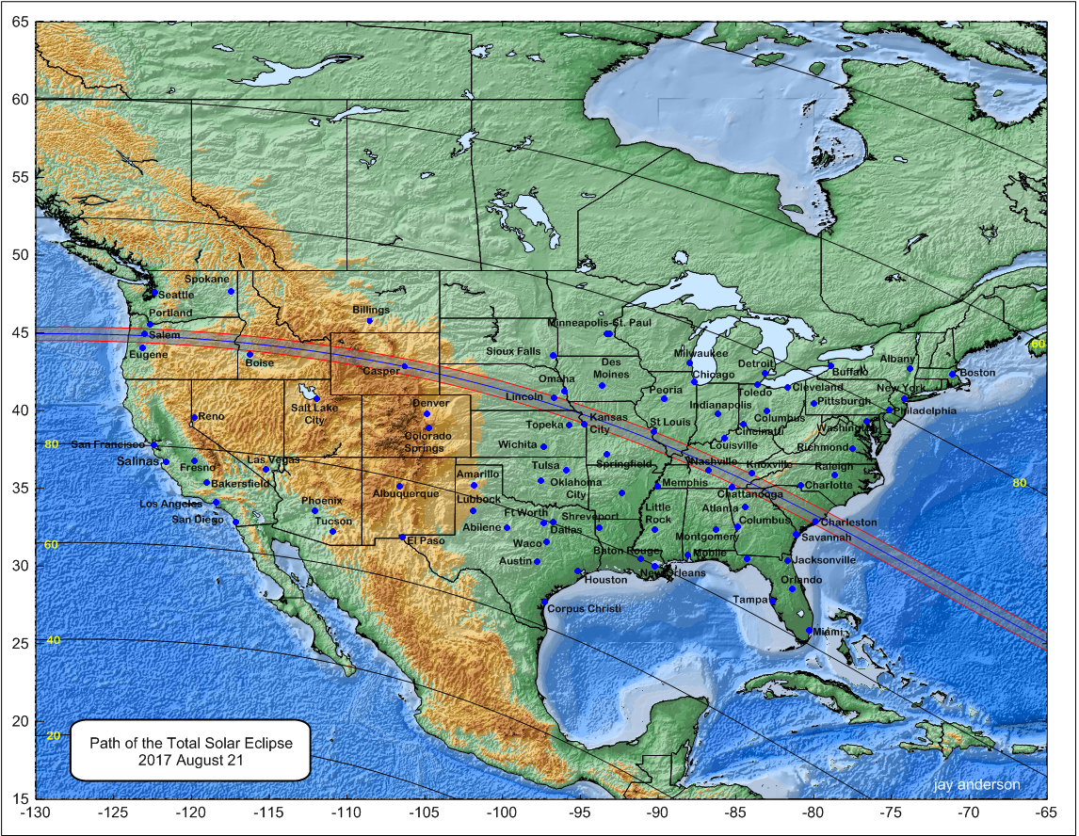
Special Interest Item
Total Solar Eclipse – 21 Aug 2017
Reserve your hotel in Casper, WY for the total solar eclipse that will occur on 21 Aug 2017;

Slide 38
OUTLINE
Solar & Terrestrial Physics Division
STP Division Overview
Milestones & Metrics
Program Updates
Special Interest Items
Publications and Presentations
Issues & Summary

Slide 39
Publications & Presentations
STP YTD FY15 Publications – 12 (1 of 2)
Publications (YTD):
Denig, W. F. (2015), The International Council for Science World Data System Stewardship Award 2014 Presented to Dr. Robert Redmon of the National Geophysical Data Center, Space Weather, 13, doi:10.1002/2014SW001136.
Feng-Chi, Hsu, Kimberly Baugh, Tilottama Ghosh, Mikhail Zhizhin, and Christopher Elvidge: DMSP-OLS Radiance Calibrated Nighttime Lights Time Series with Inter-Calibration, Remote Sensing, 2014 (Accepted)
Hudson, M.K., J. Paral, B.T. Kress, M. Wiltberger, D.N. Baker, J.C. Foster, D.L. Turner and J.R. Wygant (2015), Modeling CME-shock driven storms in 2012 – 2013: MHD-test particle simulations, J. Geophys. Res., Accepted manuscript online, DOI: 10.1002/2014JA020833. [Peer Reviewed]
Ieda, A., S. Oyama, H. Vanhamaki, R. Fujii, A. Nakamizo, O. Amm, T. Hori, M. Takeda, G. Ueno, A. Yoshikawa, R. J. Redmon, W. F. Denig, Y. Kamide and N. Nishitani (2014), Approximate forms of daytime ionospheric conductance, J. Geophys. Res., 119. DOI: 10.1002/2014JA020665 [Peer Reviewed]
Li, Z., R.M. Millan, M.K. Hudson, L.A. Woodger, D.M. Smith, Y. Chen, R. Friedel, J.V. Rodriguez, M.J. Engebretson, J. Goldstein, J.F. Fennell and H.E. Spence (2014), Investigation of EMIC Wave Scattering as the Cause for the BARREL 17 January 2013 Relativistic Electron Precipitation Event: A Quantitative Comparison of Simulation with Observations, Geophys. Res. Lett., 41, doi:10.1002/2014GL062273. [Peer Reviewed]
Rodriguez, J.V., T.G. Onsager, D. Heynderickx, and P. T. A. Jiggens (2014), Meeting Report: Solar Energetic Particle Measurements Intercalibration Workshop, 11 April 2014, Boulder, Colorado, Space Weather, 12, 613-615, doi: 10.1002/2014SW001134.
Sergeev, V.A., A.V. Nikolaev, M.V. Kubyshkina, N.A. Tsyganenko, H.J. Singer, J.V. Rodriguez, V Angelopoulos, R. Nakamura, S.E. Milan, J.S. Coxon, B.J. Anderson, and H. Korth (2014), Event Study Combining Magnetospheric and Ionospheric Perspectives of the Substorm Current Wedge Modeling, J. Geophys. Res, 119, doi:10.1002/2014JA020522. [Peer Reviewed]
Straka, W.C., III; C.J. Seaman, K. Baugh, K. Cole, E. Stevens, S.D. Miller (2015), Utilization of the Suomi National Polar-Orbiting Partnership (NPP) Visible Infrared Imaging Radiometer Suite (VIIRS) Day/Night Band for Arctic Ship Tracking and Fisheries Management. Remote Sens. 2015, 7, 971-989. [Peer reviewed]
Tuttle, B.T., S. Anderson, C. Elvidge, T. Ghosh, K. Baugh, P. Sutton (2014), Aladdin’s Magic Lamp: Active Target Calibration of the DMSP OLS. Remote Sens. 2014, 6, 12708-12722. [Peer reviewed]

Slide 40
Publications & Presentations
STP YTD FY15 Publications – 12 (2 of 2)
Publications (continued):
Verkhoglyadova, O. P., A. J. Mannucci, B. T. Tsurutani, M. G. Mlynczak, L. A. Hunt, R. J. Redmon, and J. C. Green (2015), Localized thermosphere ionization events during the high-speed stream interval of 29 April to 5 May 2011, J. Geophys. Res. Space Physics, 120, doi:10.1002/2014JA020535. [Peer reviewed]
Woods, T., R. Cahalan, W. Denig, G. Kopp, P. Pilewskie and T. Sparn (2014), New Space Measurements Extend Sun‐Climate Record, EOS, 95, pp. 429-430 [Peer Reviewed]
Yuyu Zhou, Y., S.J. Smith, C.D. Elvidge, K. Zhao, A. Thomson and M. Imhoff (2014), A Cluster-based Method to Map Urban Area from DMSP/OLS Nightlights, Remote Sensing of Environment, 147, pp. 173-185. [Peer reviewed]
Total accepted or published: 12
Peer Reviewed: 10

Slide 41
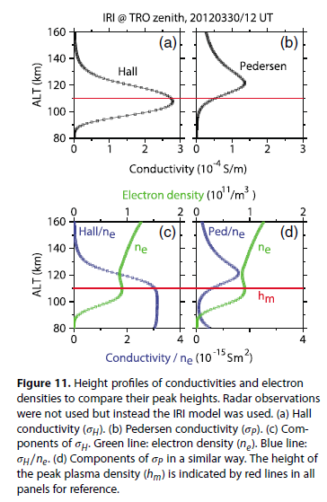
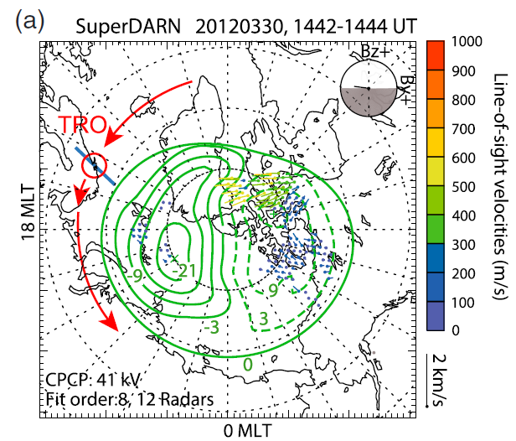
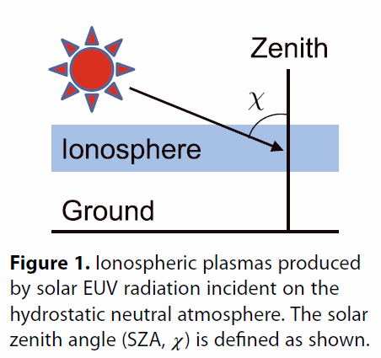
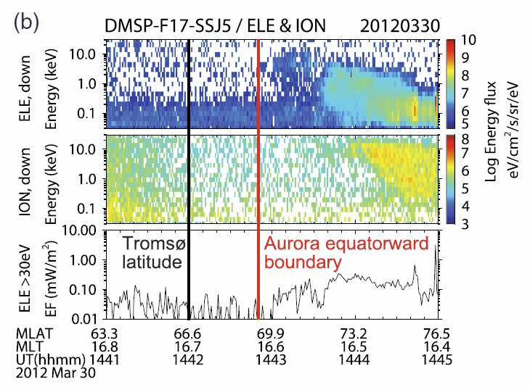
Publications & Presentations
Featured Publication
Ieda, A., S. Oyama, H. Vanhamaki, R. Fujii, A. Nakamizo, O. Amm, T. Hori, M. Takeda, G. Ueno, A. Yoshikawa, R.J. Redmon, W.F. Denig, Y. Kamide and N. Nishitani (2014), Approximate forms of daytime ionospheric conductance, J. Geophys. Res., 119. DOI: 10.1002/2014JA020665
Key Points:
Modeling the solar zenith angle dependence of Hall & Pedersen conductance.
Prior work relies on invalid assumptions.
Theoretic approach can be used for improved electro-dynamic calculations.

Slide 42
Publications & Presentations
STP FY15 Presentations – 22 (Pg 1 of 2)
YTD Presentations (FY15):
ICSU WDS and CODATA Joint Science Data Conference, 02-05 Nov 2014; New Delhi, India
Space Environmental Scientific Data Stewardship at the US National Geophysical Data Center (NGDC): Supporting Satellite Health and Research in Space Weather using Multi-Platform Observations [Invited Oral], Award Acceptance Talk, R.J. Redmon
World Data Service for Oceanography, [Poster], S. Rutz, D. Spring, I. Smolyar, S. Phillips, D. Johnson and M. Gregg (presented by R.J. Redmon)
World Data System for Geophysics, [Poster], R.J. Redmon and E.A. Kihn
American Geophysical Union, 15-19 December 2014, San Francisco, CA
Comparison of GOES Space Environment Monitor Data Collected During Solar Cycles 22, 23, and 24 [SH13B-4088, Poster], D.C. Wilkinson
Mapping Geosynchronous Solar Energetic Particle Observations to Lower Earth Orbits [SM31A-4157, Poster], S.L. Young and B.T. Kress
Improved in Situ Space Weather Data Services from the NOAA National Geophysical Data Center [SM31A-4181, Poster], J.V. Rodriguez, W.F. Denig, J.C. Green, T.M. Lotoaniu, R.E. McGuire, R.J. Redmon, W.F. Rowland, D.L. Turner, R.S. Weigel and D.C. Wilkinson
Forcasting Equatorial Spread-F on a Night to Night Basis in 5 Longitude Sectors [SA11D-01, Oral], D.N. Anderson, R.J. Redmon and T.W. Bullett
A Real-Time Technique for Sudden Commencement Detection [SM31A-4187, Poster], W.F. Rowland, R.J. Redmon and H.J. Singer
Evidence of Dayside Asymmetries in High-Latitude Magnetic Perturbations Measured By ST5 and DMSP [SA23D-05, Oral], D.J. Knipp, L.M. Kilcommons, J.A. Slavin, G. Le, J.W. Gjerloev and R.J. Redmon
Localized High-Latitude Ionosphere-Thermosphere Ionization Events during the High Speed Stream Interval of 29 April – 5 May 2011 [SA21B-05, Oral], O.P. Verkhoglyadova, A.J. Mannucci, B.T. Tsurutani, M.G. Mlynczak, L.A. Hunt, R.J. Redmon and J.C. Green
On the Cross-Energy Cross-Pitch-Angle Coherence of Electrons in the Outer Radiation Belt [SM31A-4163, Poster], Y. Chen, G.D. Reeves, W. Tu, G. Cunningham, M.G. Henderson, C. Kletzing and R.J. Redmon
Space Weather Conditions During the February 2014 Wide Area Augmentation System GPS Degradation [SM31A-4188, Poster], T.M. Lotoaniu, R.J. Redmon, M. Codrescu, H.J. Singer, R.A. Viereck and W.F. Denig
Real-Time Monitoring of the Dayside Geosynchronous Magnetopause Location [SM31A-4164, Poster], R.J. Redmon, T.M. Lotoaniu, M. Berguson, S.M. Codrescu, J-H. Shue, H.J. Singer, W.F. Rowland and W.F. Denig
GOES-R Rapid Refresh Imagery Advancements for the Earth and Space Weather Enterprise [IN42A-05, Oral], S.J. Goodman, T.J. Schmit, D.T. Lindsey and W.F. Denig

Slide 43
Publications & Presentations
STP FY15 Presentations – 22 (Pg 2 of 2)
YTD Presentations (Continued)
American Geophysical Union, 15-19 December 2014, San Francisco, CA (continued)
A Statistical View of the Effect of Density Asymmetry and Guide Field on the Structure of the Reconnection Layer Poleward of the Cusp [SM12B-08, Oral], F.M. Muzamil1, C.J. Farrugia1, R.B. Torbert1, P.L. Pritchett, F. Mozer, J.D. Scudder, C.T. Russell, P.E. Sandholt, W.F. Denig and L.B. Wilson III
Extreme Space Weather Events Observed Through the Decades [SH41D-06, Invited Oral], W.F. Denig
Rescuing NOAA's Earliest Airphoto Archive [IN43E-06, Oral], F.C. Hsu, K. Baugh, C.E. Elvidge and M. vonHendy
Global Urbanization Modeling Supported by Remote Sensing [B33J-03, Oral], Y. Zhou1, S. Smith, K. Zhao, M.L. Imhoff, A.M. Thomson, B.P. Bond-Lamberty and C.E. Elvidge
Improving Cloud-screening for Global Nighttime Lights Composites Using the VIIRS Day/Night Band [IN13C-3653, Poster], K.E. Baugh, M. Zhizhin, F-C. Hsu, and C.D. Elvidge
Nightfire: Sub-pixel Pyrometry of Nighttime Combustion Sources with Suomi NPP and Landsat 8 [A51B-3044, Poster] M. Zhizhin, C. Elvidge, F-C Hsu and K. Baugh
Analysis of fifty year Gas Flaring Emissions from oil/gas companies in Africa [A13E-3217, Poster] E. H. Doumbia, C. Liousse, L. Granier, R. Rosset, T. Oda, and F-C Hsu
American Meteorological Society, 04-08 January 2015, Phoenix, AZ
TSIS on the International Space Station: Continuity of the Solar Irradiance Data Record, P. Pilewskie, T. Sparn, G. Kopp, E. Richard, R.F. Cahalan and W.F. Denig

Slide 44
OUTLINE
Solar & Terrestrial Physics Division
STP Division Overview
Milestones & Metrics
Program Updates
Special Interest Items
Publications and Presentations
Issues & Summary

Slide 45
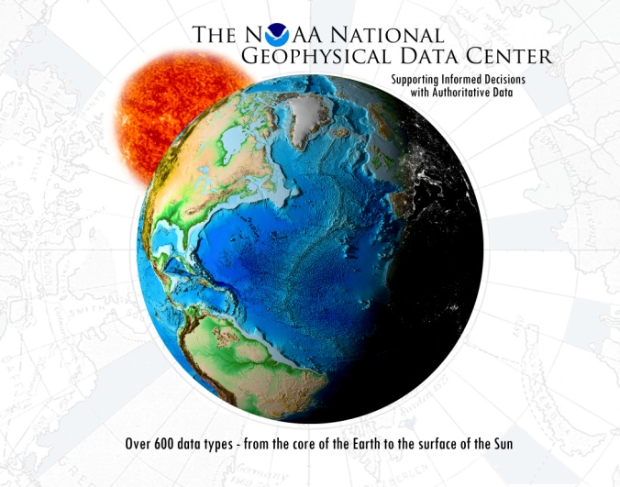
Issues & Summary
Solar & Terrestrial Physics Division
NGS Aerial Photography (4QFY13) – Unknown Status
GOES-R SWx Algorithm Risks (4QFY13) – Some new issues
Fed hiring restrictions having mission impact (3QFY12) – Better
GOES-R L2+ SWx algorithms (3QFY11) – Path to operations defined
  Frozen Baseline / Algorithm Readiness – Waivers – Watch Item
  GOES L0 Data Not in CLASS – On Track
  GOES-R Data Management Tasks – GOES-R Data Mngr – NLAI
Metrics (ytd)
    Papers (FY15): 12
      Peer Reviewed: 10
    Presentations (FY15): 22

Slide 46

QUESTIONS?

Slide 47
BACKUP
SLIDES

Slide 48
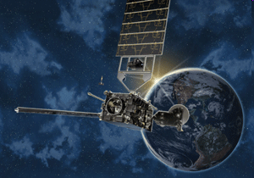
Division Overview
GOES Spacecraft/Instrument Status
SWPC operations use GOES-15 SEM & SXI, No GOES-14 data, GOES-13 SEM (no XRS) & SXI.
See “Acronym List” in the notes pages.
Notes:
Acronym List
GOES – Geostationary Operational Environmental Satellite
SEM – Space Environment Monitor
SXI – Solar x-ray Imager (GOES M, NOP)
XRS – (Solar) X-Ray Sensor (GOES M)
XRS-EUV – (Solar) X-Ray Sensor – Extreme UltraViolet sensor
EPS – Energetic Particle Sensor (GOES M, NOP)
HEPAD – High Energy Proton and Alpha particle Detector (GOES M, NOP)
XRP – X-Ray Platform/Positioner (GOES M)
EXIS – Extreme X-ray and Ultraviolet Irradiance Sensor (GOES-R series)
SUVI – Solar UltraViolet Imager (GOES-R series)
SEISS – Space Environment In-Situ Sensor (GOES-R series)
MAG – Magnetometer (GOES-R series)
SWPC – Space Weather Prediction Center (NWS)

Slide 49
Division Overview
Annual Data Ingest¹ – 1QFY15 (4QCY14)
CY12 CY13 CY14
GB GB GB
GOES SEM
GOES SXI
POES SEM
DMSP OLS
CORS GPS
Ionosonde
80
1,899
70
5,020
25,611
907²
69
1,887
72
5,050
26,005
750²
71
2,048
66
5,200³
40,017¹
610^{2,3}
¹Uncompressed data volumes
²Does not include VIPIR
³Estimate
Delta increased CORS GPS grow due to GLONASS
Notes:
49

