Slide 1
Space Weather Product Team
(SWPT)
July 10, 2013
Notes:
Add Training, CM,

Slide 2
Outline
SWPT Roster
SWPT Timeline (1)
GOES-R Pre-launch Timeline (1)
SPADES Overview (2)
Cal/INR/Product Science – Farida (8)
Pre-launch Test Datasets (1)
Product Monitoring – GOES NOP (1)
Product Monitoring – GOES-R (1)
Notes:
To-Do:

Slide 3
SWPT Roster

Slide 4
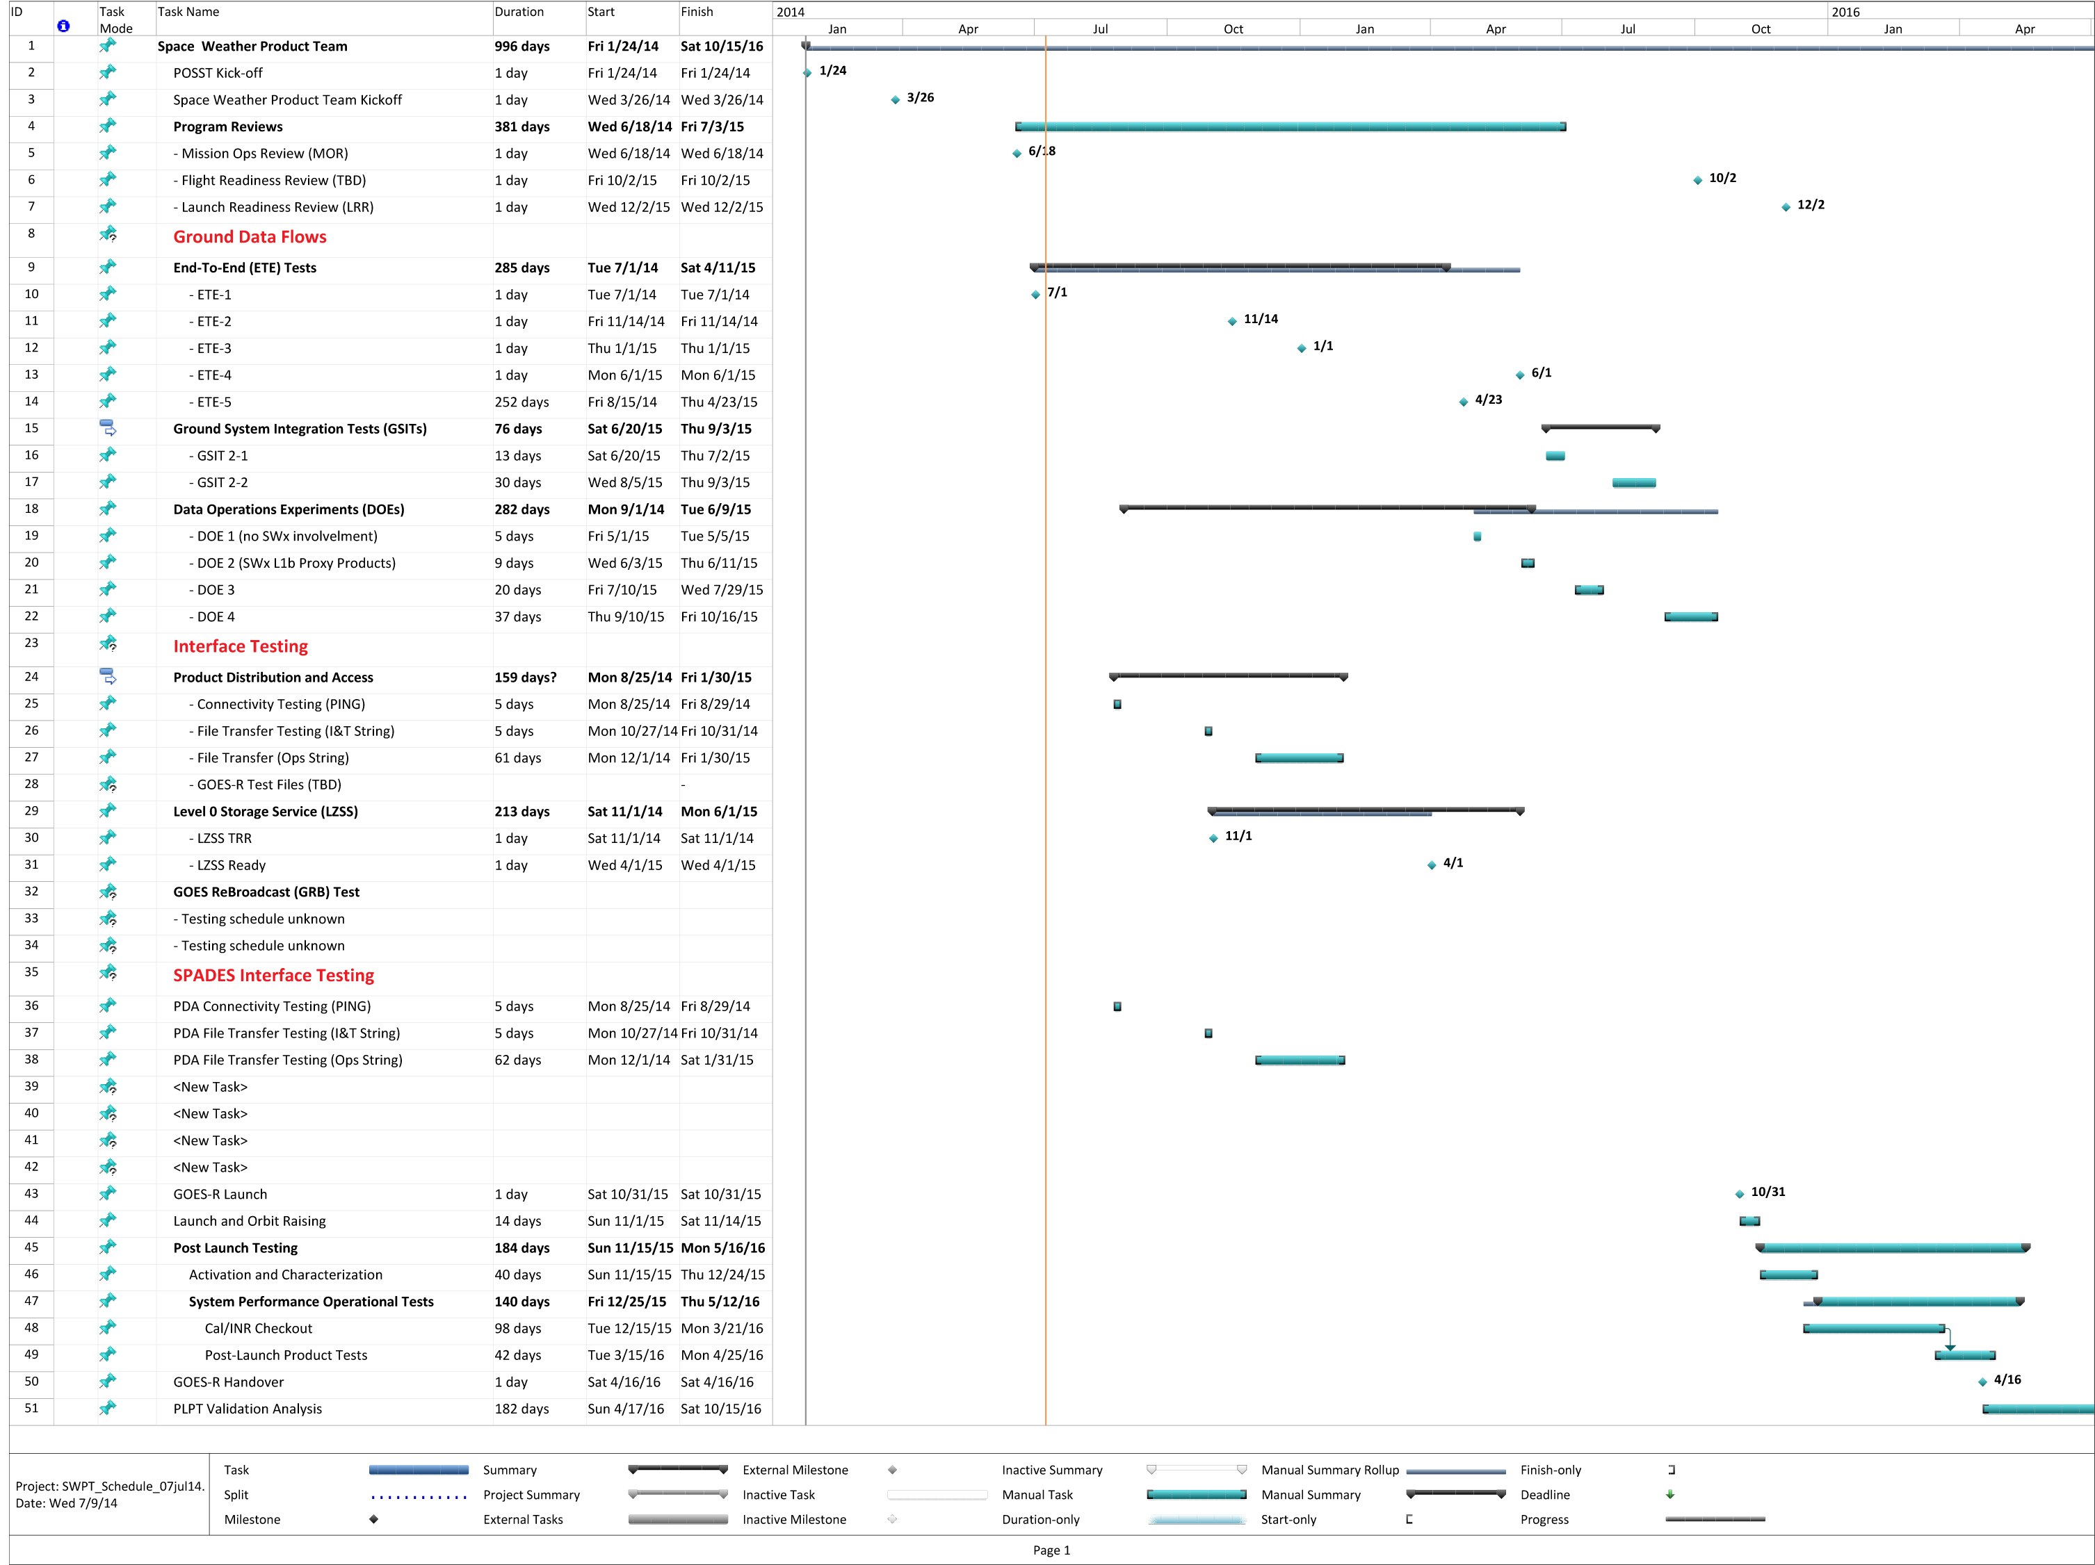
SWPT Timeline

Slide 5
GOES-R CVCT Timeline
Bob’s Pre-launch Schedule
GOES-R Series Pre-launch CVCT Activities
Post-Launch Test (PLT) Planning/ Preparation & System-Level Test Planning/Implementation
Cal&INR PLT Definition
Cal&INR PLT Procedure Development
ETE I-V Testing
Data Operations Tests (DOT) Planning & Ground Segment Training
DOE/GSIT
CIPS CONOPS/OPSCON Development
CIPS OPSCON Rehearsals
Cal/INR/Product Science (CIPS) Val Tool Development
CIPS Val Tool Testing
CIPS Val Maturity Stage Definitions
*Post-Launch Product Test (PLPT) Definition and Development
4 months
6 months
9 months
6 Months
Sep13
MOR - Jun 14/ SIR - Jul 14
Apr15
Oct15
CVCT Kick-Off
Mission Operations Review (MOR) and System Integration Review (SIR)
Flight Operations Review (FOR)
Launch
  Continue pre-launch instrument cal test assessment and reporting
  Develop and implement the GOES-R System-level Cal/Val CONOPS/OPSCON
  Cal/INR/Product Science (CIPS) PLT Planning
  Define CIPS-related data operations validation objectives to be carried out during Data Ops Exercises (DOEs) and GS Integration and Test (GSIT)
  Support SIR and MOR reviews
  Complete CIPS tool development planning and begin implementation
  Ground Segment Training for relevant personnel
  Clarify CIPS validation schedules and milestones
  Identify CIPS resource needs and risks
Cal/INR/Product Science Ops

Slide 6
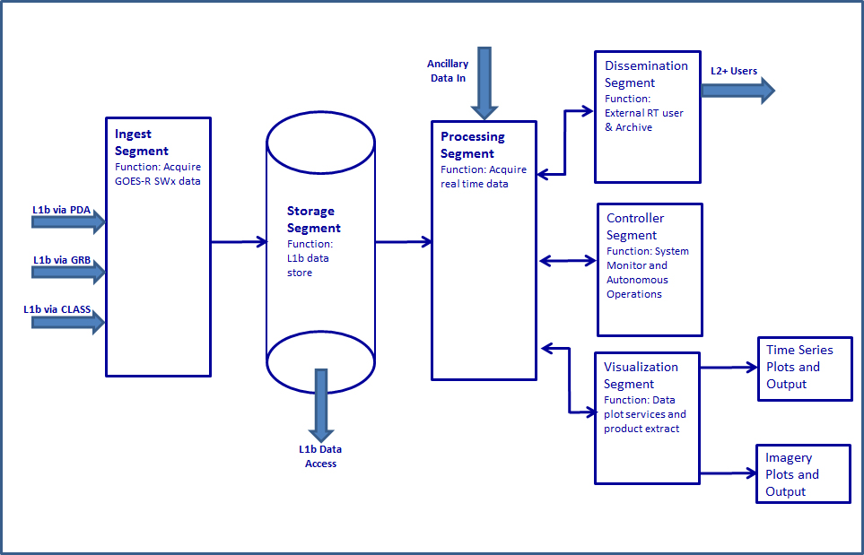

Satellite Product Analysis & Distribution Enterprise System (SPADES)

Slide 7
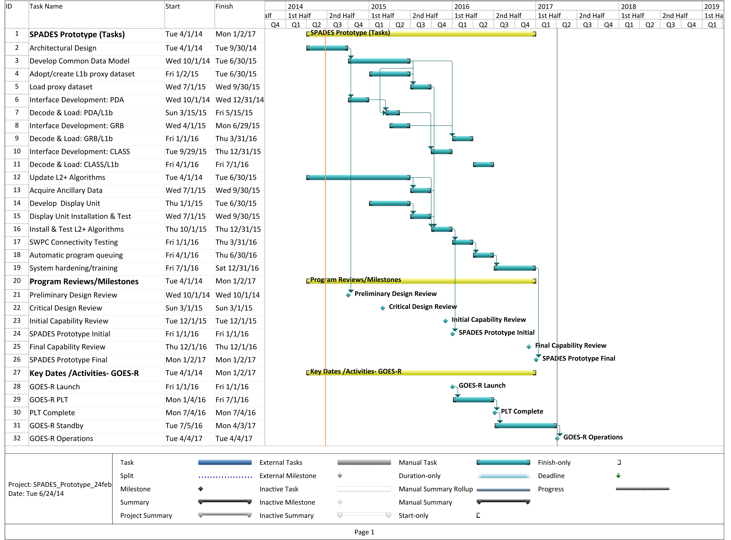
SPADES Timeline

Slide 8
Cal/INR/Product Science(CIPS)
Operations Validation and Transition/Handover - Draft
Farida’s Slides
Farida Adimi
7/8/2014
Note: This is presented within an ABI perspective. Significant differences are anticipated for SWx (WFD)

Slide 9
Product Science Operations
Farida’s Slides
Validate science products
Access to the GOES-R Ground System (GS)
Real time product monitoring and evaluation through the GS tools
Offline product monitoring and evaluation through CalVal tools within the Development Environment (DE)
Update processing parameters, including calibration parameters in DE.
Update algorithms in the DE
Integrate and test algorithms in the DE

Slide 10
Preparing for science validation
Pre-launch activities
Farida’s Slides
Support Ground test activities such as GS contractor Interim Releases when possible
Assess products associated with the GS Interim Releases
Assess GS tools associated with the GS Interim Releases
Assess access to the GS during the GS Interim Releases
Support the DOST testing (DOEs) such test data needs and assess products, tools, and GS access
Develop CalVal tools

Slide 11
GS Interim Releases
Farida’s Slides
Ground Contractor Verification Tests - GSP
Participate in Day In The Life (DITLs) during GS testing for IPS, FPS, and DE site testing
Attend training associated with of the above interim releases
Assess products from ground contractor testing events (IPS, FPS, and DE)
Assess access to GS during the DE testing events
Develop CalVal tools using test data generated from the above testing events
GS Release | Capabilities | Training & DITL
IPS | Initial Product Set, ABI L1 & CMI distribution to AWIPS | 9/8/14 – 10/16/14
FPS | Final Product Set, L2 + and non ABI L1 | 2/16/15 – 3/26/15
DE | NSOF and WCDAS Development Environment | 5/18/15 – 5/29/15

Slide 12
DOEs
Farida’s Slides
Data Operation Exercises (DOEs) - DOST
Support the planning of the DOEs (test data, products maturity, and product availability,…)
Participate in DOEs testing.
Assess products from the DOEs
Assess GS access during the DOEs
Develop and assess Cal-Val tools
 | Capabilities | Date
DOE-0 | Initial generation of GRB ABI products and initial testing with AWIPS | 9/2014
DOE-1 | Data flow with PDA/AWIPS/LZSS in nominal configuration, with some anomalies inserted | 05/2015
DEO-2 | Data flow with PDA/AWIPS/LZSS in nominal and non-nominal configurations, with anomalies inserted | 6/2015
DE-03 | Data flow injected from the antenna to PDA/AWIPS/LZSS in nominal and non-nominal configurations, with anomalies inserted | 7/2015
DE-04 | Data flow with PDA/AWIPS/LZSS in nominal and non-nominal configurations, with anomalies inserted, to demonstrate system stability | 10/2015

Slide 13
Test data for the DOEs
Farida’s Slides
Test data for the DOEs is under development
Provide input for test data needs
Test data under consideration: instrument vendor (CDRL82), Triplet data set from Wisconsin, SC level thermal Vac test data,…

Slide 14
Algorithm and Calibration Data Update
Farida’s Slides
Next…
Roles and responsibilities during algorithm and table update, need input from the CalVal team
Process for algorithm and Table update (TBD)
Tools development for algorithm and Cal Data update

Slide 15
CalVal Team
Farida’s Slides
POC | Role | Organization | Products | Location | GS access need
Mike Weinreb Ken Mitchell Paul Douglas | Radiometric engineer | OSPO | ABI L0, L1, PP, PM | NSOF, Suitland MD | OE PPZ DE PPZ DE SOZ
Dave Pogorzala | CWG | STAR | ABI L0 & L1, PP, PM | Center for STAR, College Park MD. | DE PPZ - remote
Bill Denig William Rowland | Space Weather Lead | NGDC | EXIS, MAG, SEISS, and SUVI L0, L1, PP, PM | NGDC Boulder, CO
Jamie Daniels | L2+ lead | STAR/AWG | ABI & GLM L2+ | Center for STAR, College Park MD. | DE PPZ - remote
Ricky Irving | Product Area Lead | STAR? OSPO? | L0, L1, and L2+ | Center for STAR, College Park MD. | OE PPZ - remote DE PPZ – remote

Slide 16
Pre-launch Test Datasets
Assumptions:
Form-Fit-Function datasets are currently available (Yes/No?)
Valid proxy datasets will be available to support DOE 2 (Jun ‘15)
L2b proxy data available via PDA during DOE 2-4 and GSIT 1-2
No SWPT participation expected during ETE 1-5
SPADES will be available for L1b data receipt
NGDC interface to LZSS (Ingest to archive) will be available
Questions:
Will L0 proxy data be available via the LZSS?
Will independent L1b algorithms will be available for GS validation
Discussion Topic

Slide 17
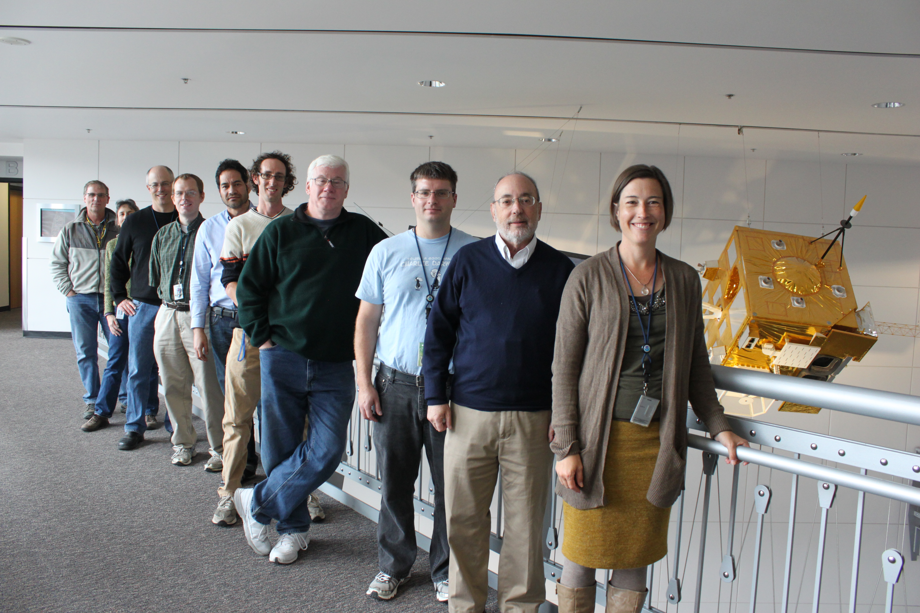
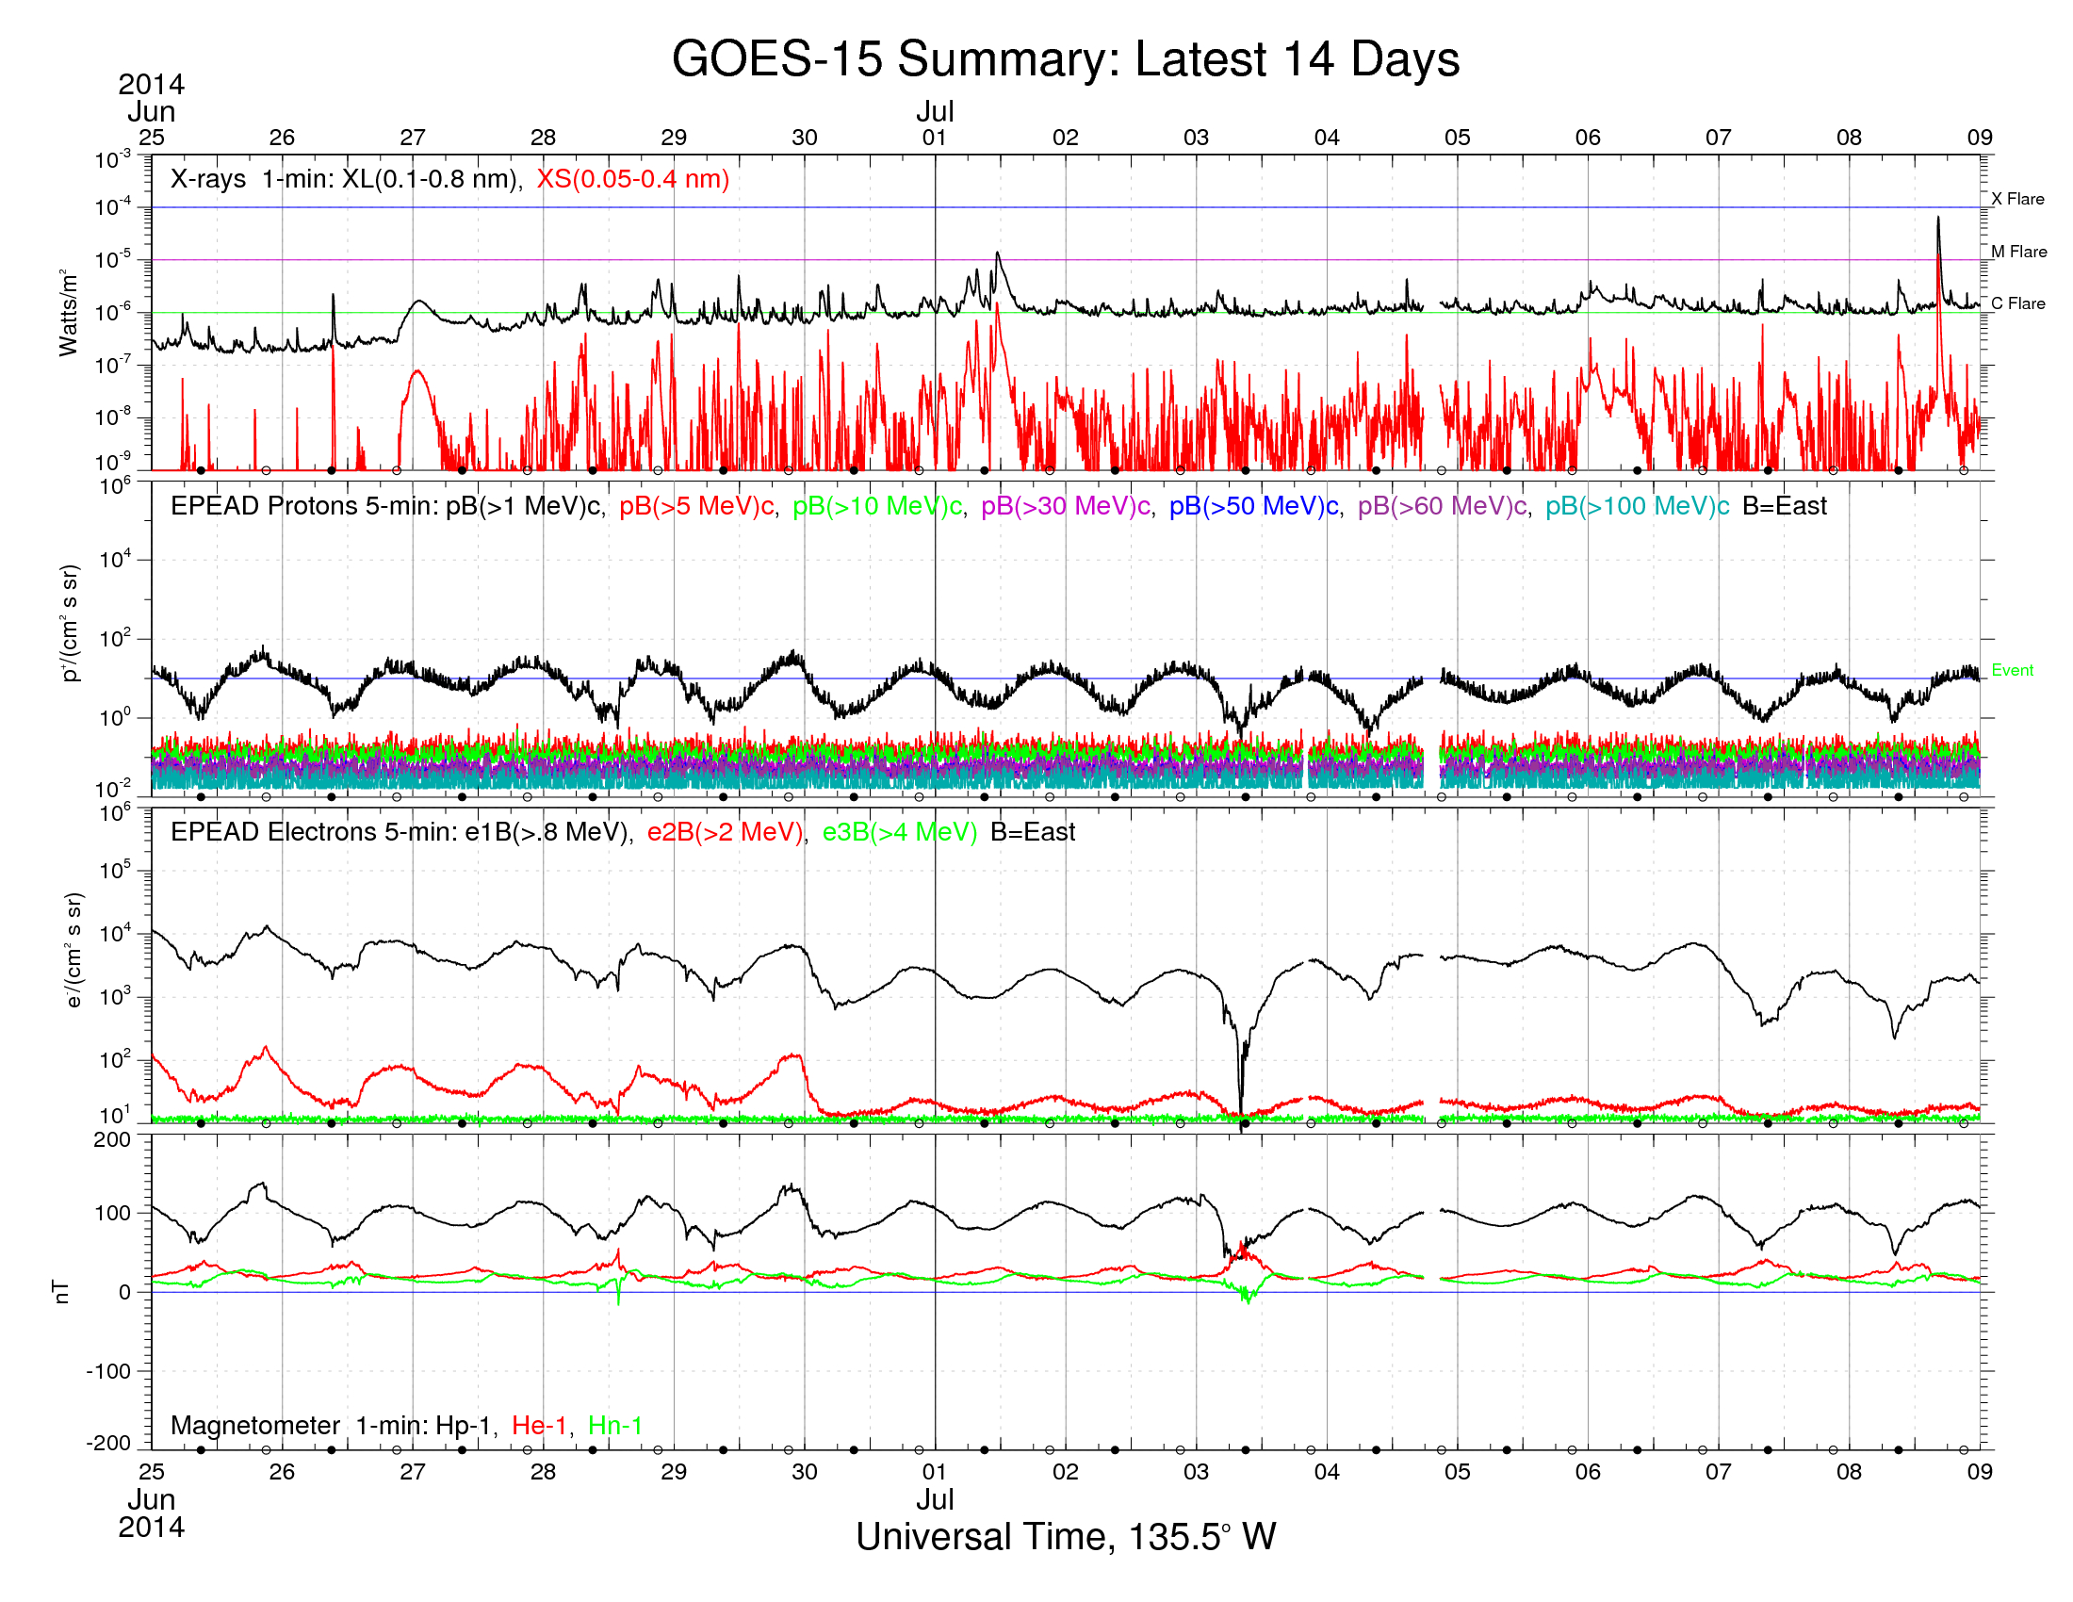
Product Monitoring – GOES NOP
OSPO roles and responsibilities
  SWx sensor health and safety monitoring
  Basic instrument functionality – data within range
  Sensor commanding
NGDC/SWPC roles and responsibilities
  Raw data receipt via local antennas
  Data product generation
  Product performance and oversight
  Instrument calibration and algorithm updates
Discussion Topic

Slide 18
Product Monitoring – GOES R
Understanding new roles and responsibilities
OSPO roles and responsibilities
  SWx sensor health and safety monitoring
  L1b data product generation
  L1b calibration table updates
  Sensor commanding
NWS IDP roles and responsibilities
  L2+ data product generation
  GRB/Boulder receipt and de-coding
NGDC/SWPC roles and responsibilities
  L1b/2+ data product performance and oversight
  Sensor calibration monitoring and updates
  L2+ algorithm updates and configuration control
Discussion Topic

Slide 19
Backups

Slide 20
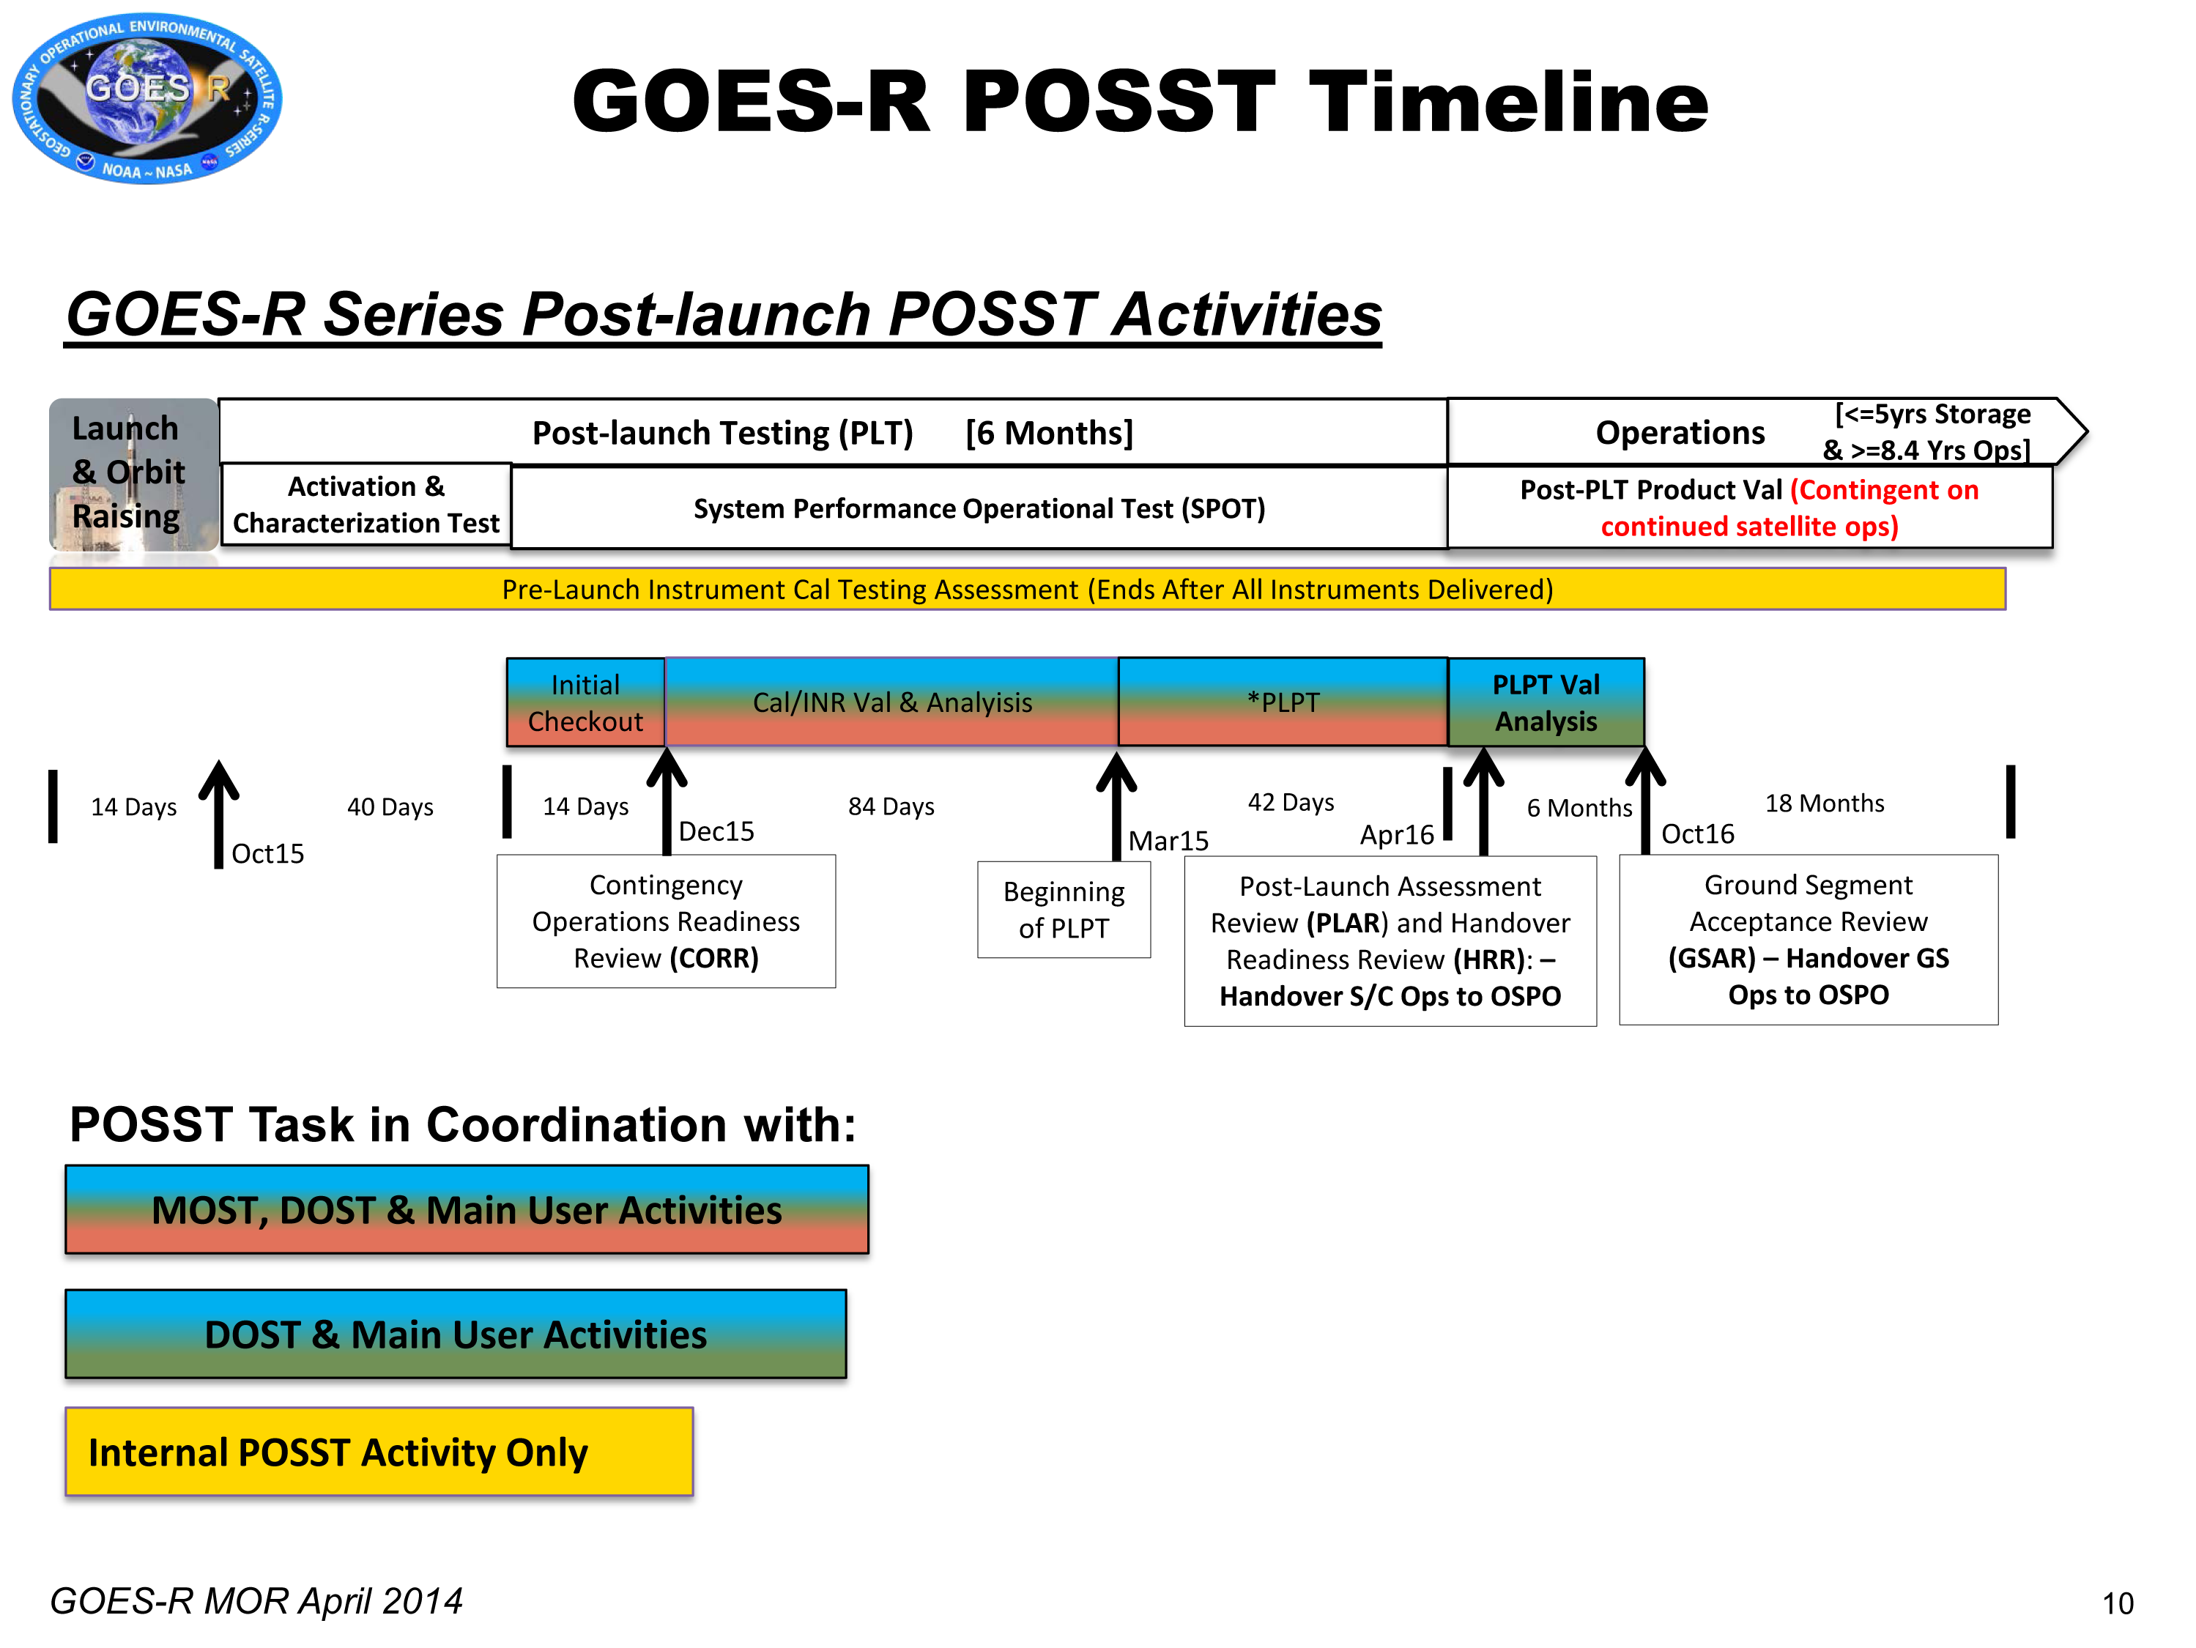
Bob’s Chart

